Slide 1
Oak Specialist
Independent Living Unit 2- Personal Care
Applying Learning

Slide 2
Unit 2- Personal Care
Lesson 1- Self-care and Hygiene
Lesson 2- Balanced Plate of Food
Developing healthy hygiene habits and routine.
Understanding the 5 main food groups and what to eat to stay healthy.
Lesson 3- Daily Recommendations
Lesson 4- Balanced Leisure Activities
Option 3
Option 4
Learning about calories and what the daily recommendations are for boys and girls..
Thinking about activities to do in our free time and what is available in our local area.
Option 3
Lesson 5- Celebrating Ourselves
Lesson 6- Managing our Emotions
Option 4
Recognising and celebrating our accomplishments and those of others.
Identifying and understanding negative emotions and learning strategies to help.

Slide 3
Lesson 2- Balanced plate of food

Slide 4
Teacher notes- Lesson 2
Learning intention: to understand the difference between healthy and unhealthy food and what makes a balanced, healthy meal.
Learn about healthy and unhealthy food.
Introduction to the five main food groups and how much to eat to help us stay healthy and well.
Drawing or computer activity; creating a balanced meal.
Additional resources: pen, paper, colouring pencils

Slide 5
Personal Care
Balanced plate of food
Applying Learning

Slide 6
Lesson Activity Stages
This lesson will be taught in 4 stages:
Identifying and sorting healthy and unhealthy foods.
Sorting foods into the 5 main food groups.
Understanding the role of each food group in keeping us healthy and how much we need to eat of each.
Create your healthy plate of food.

Slide 7
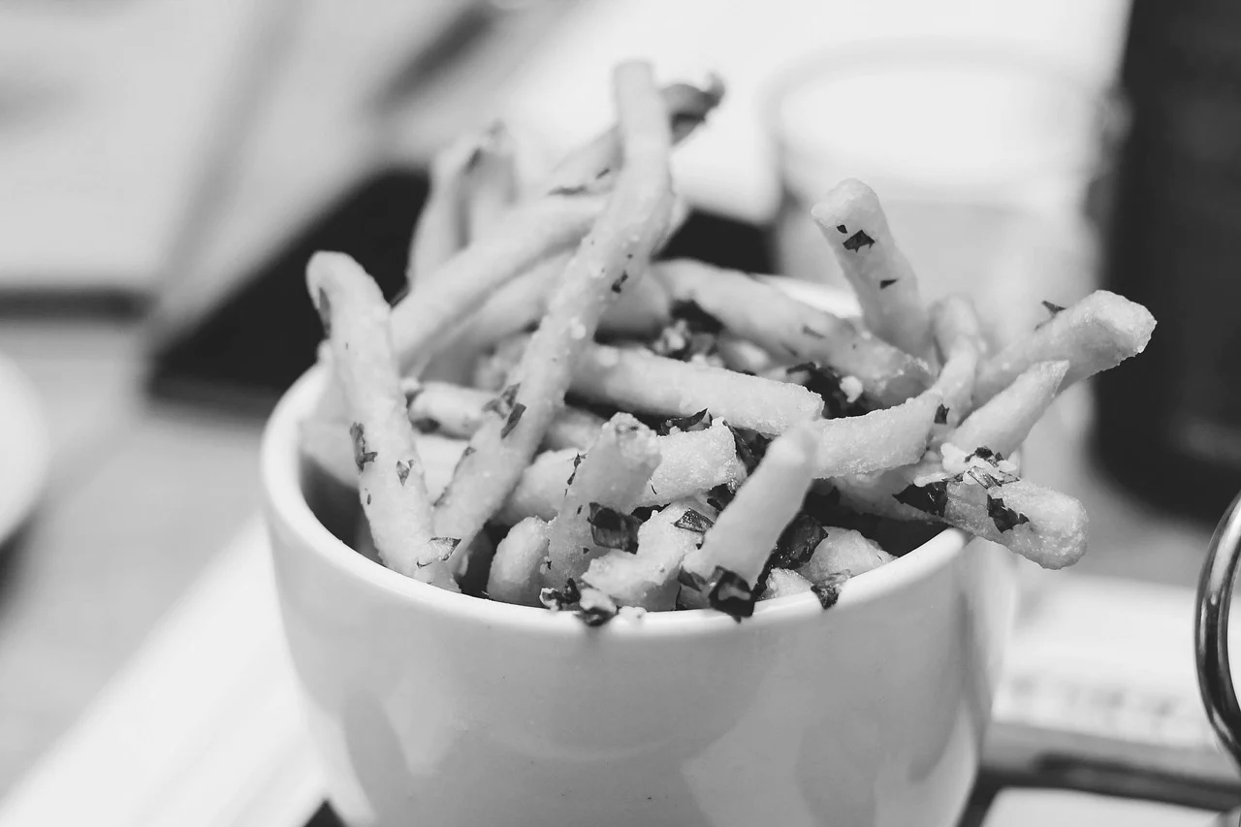
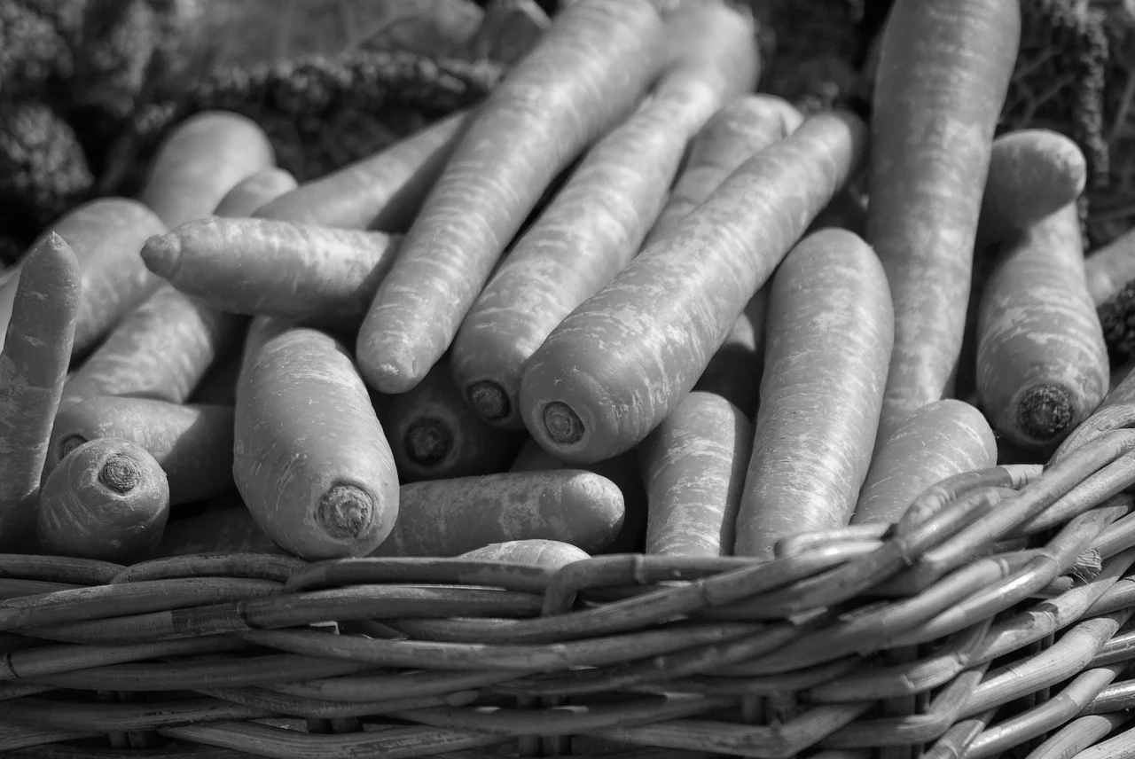
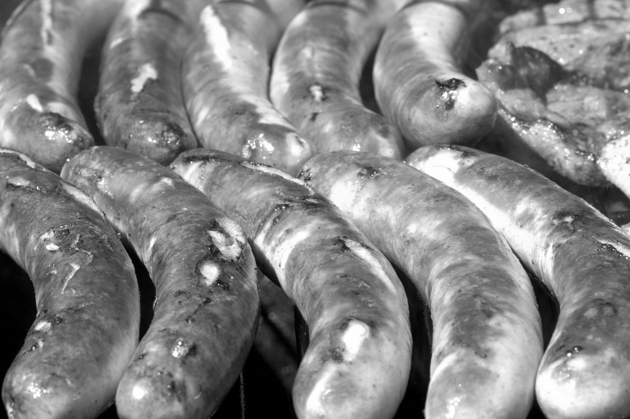
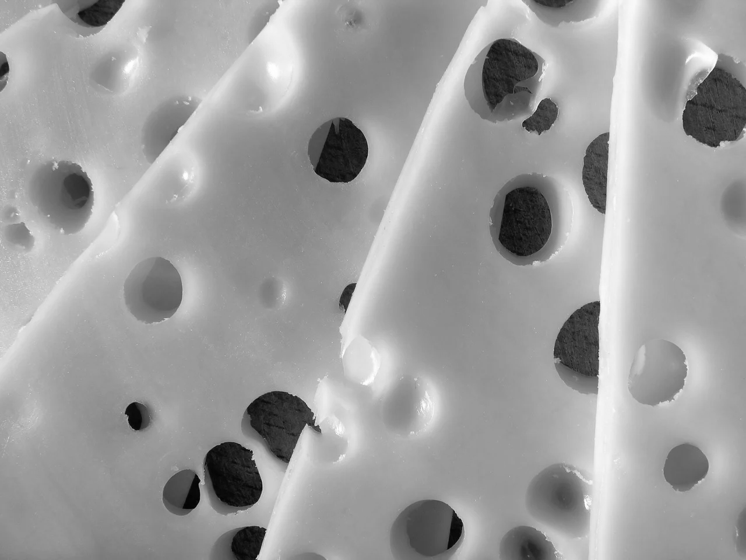
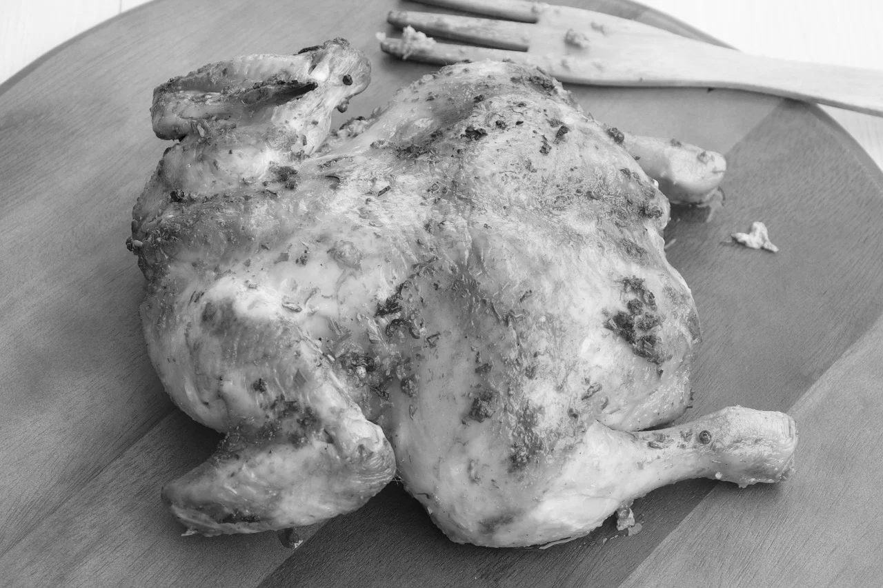
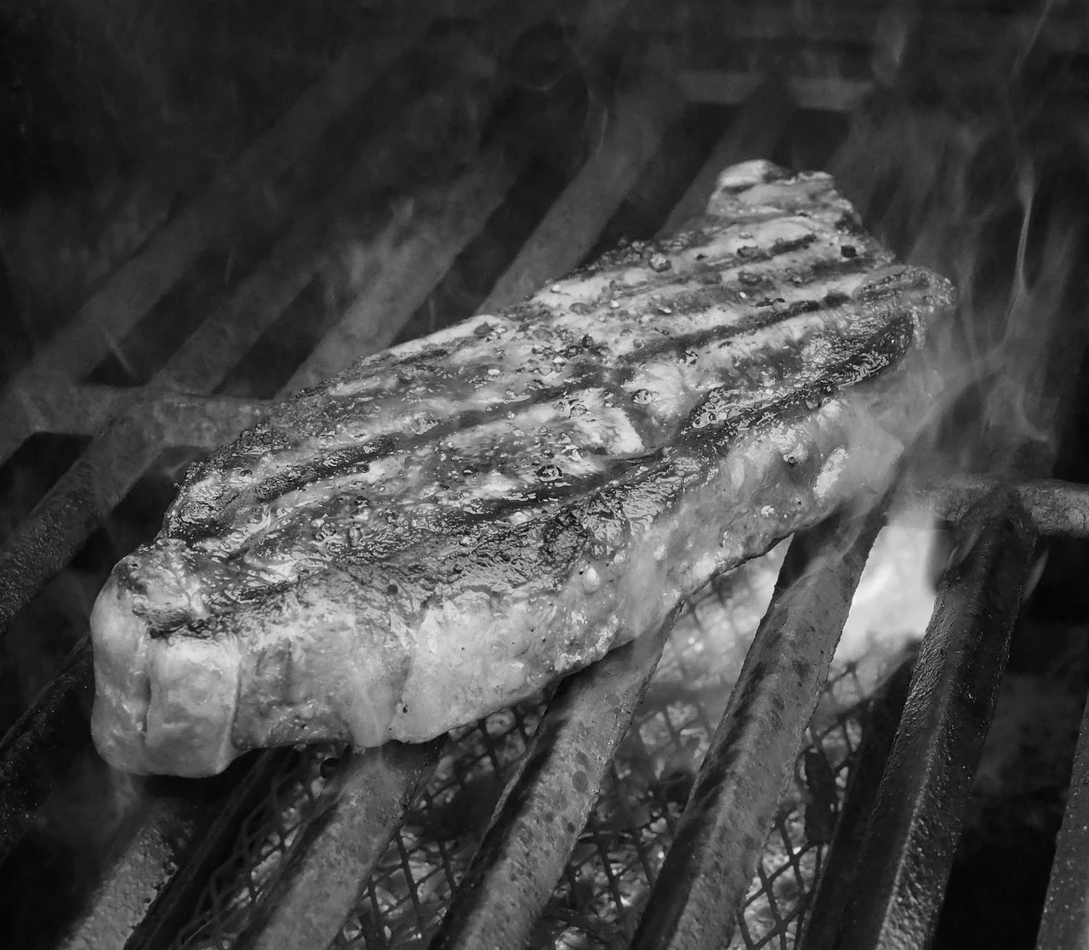
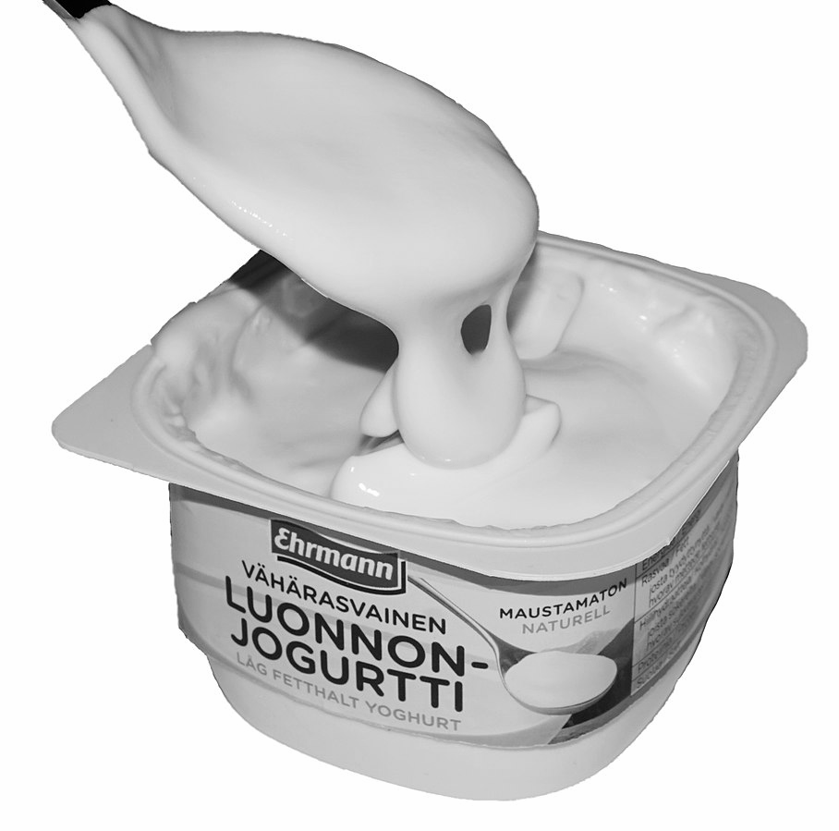
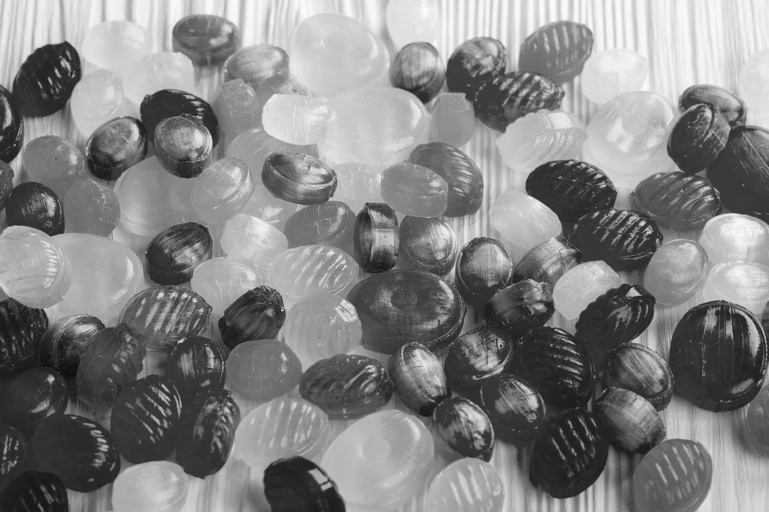
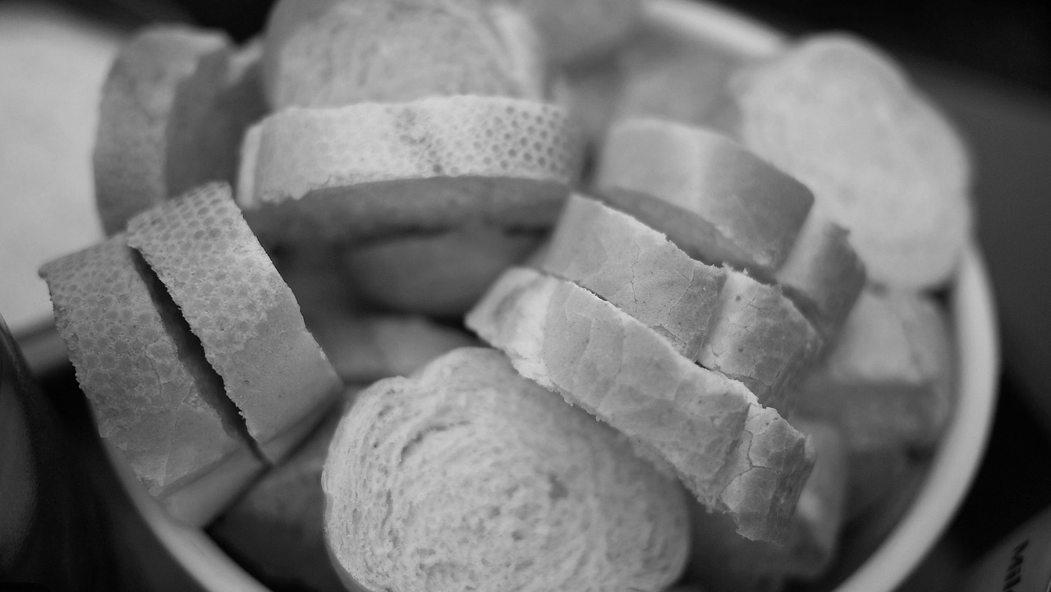
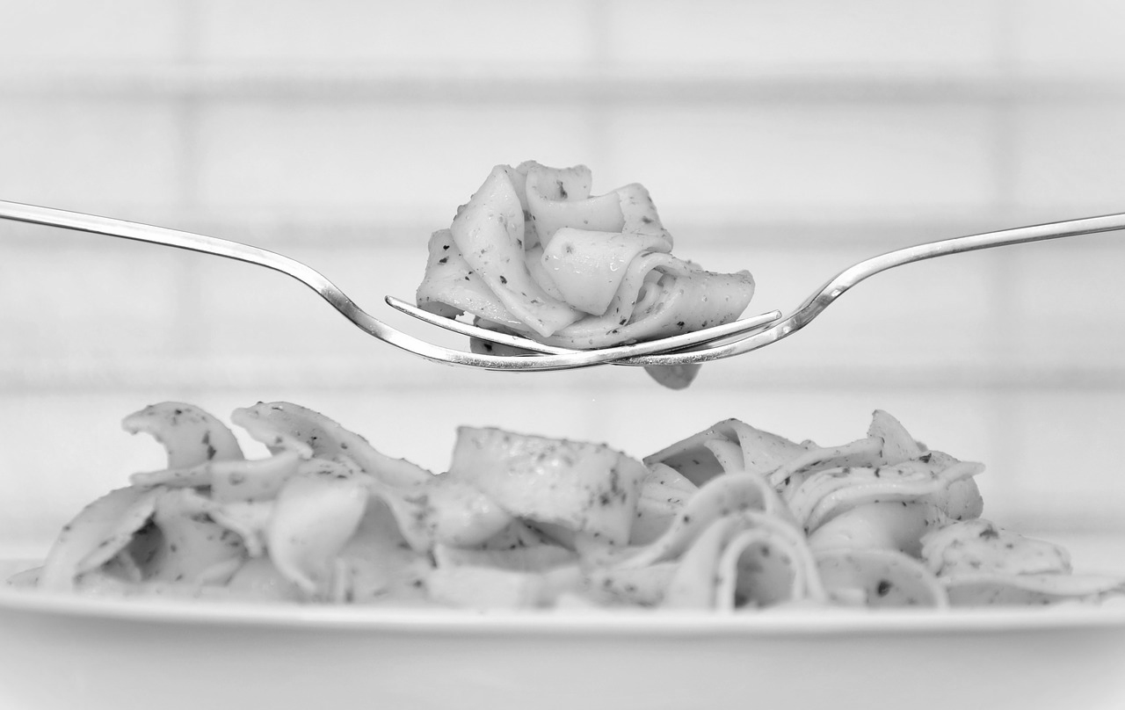
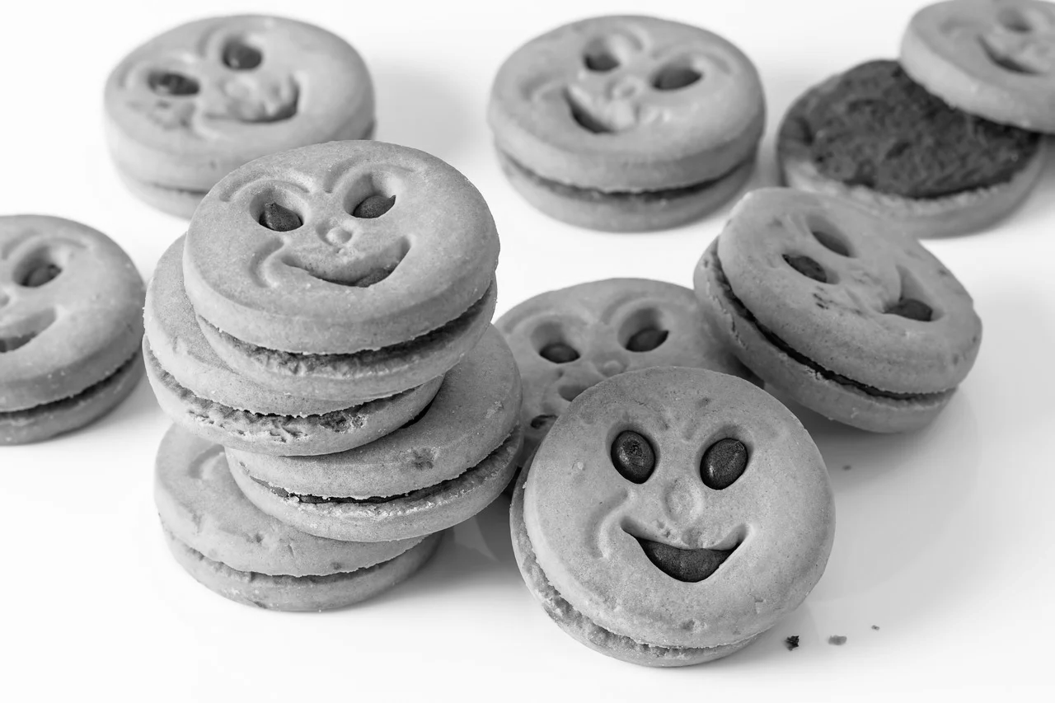
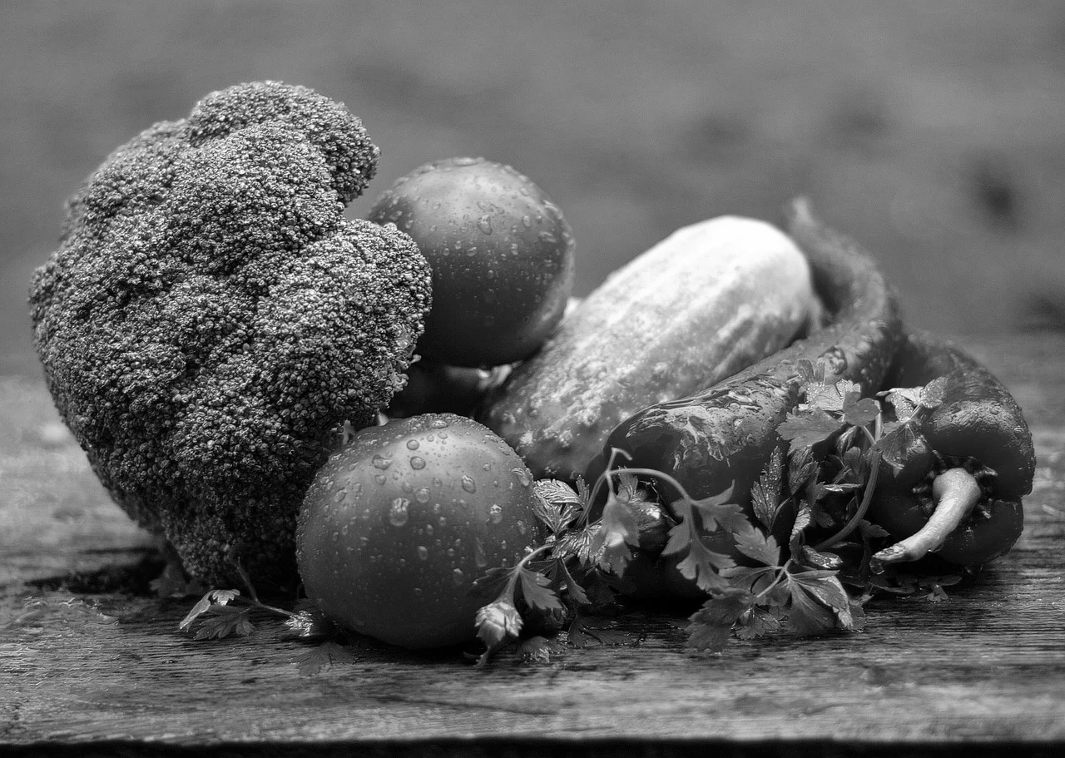
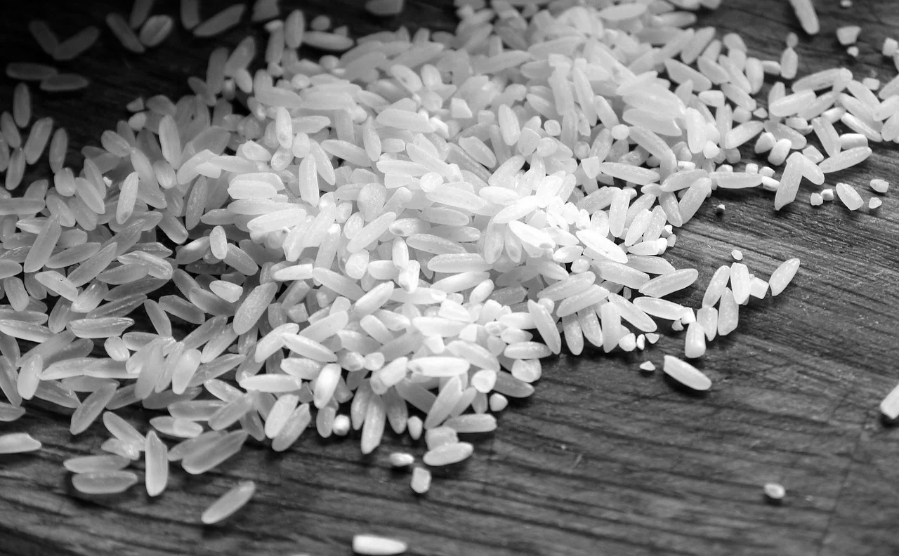
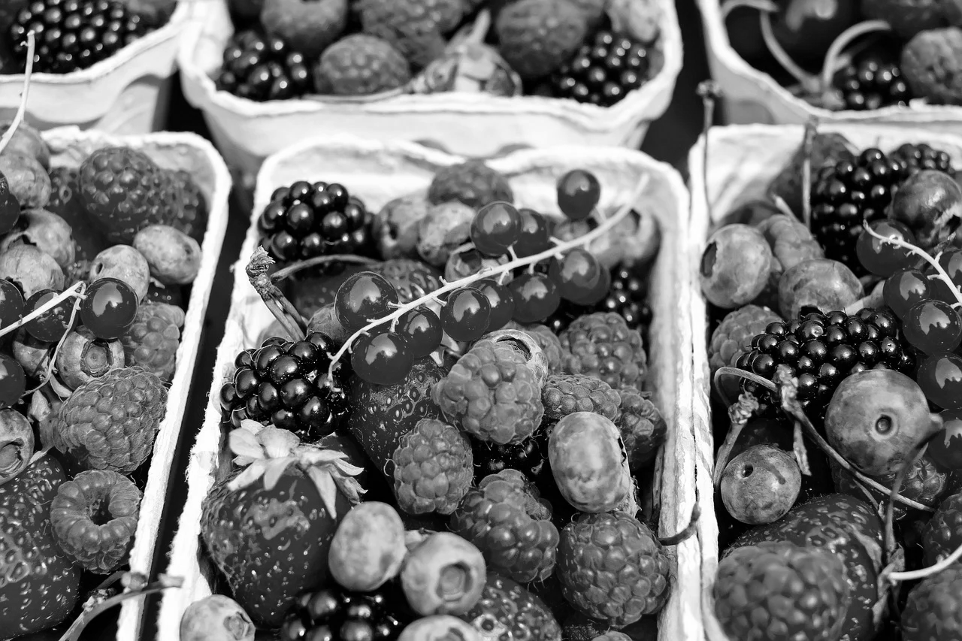
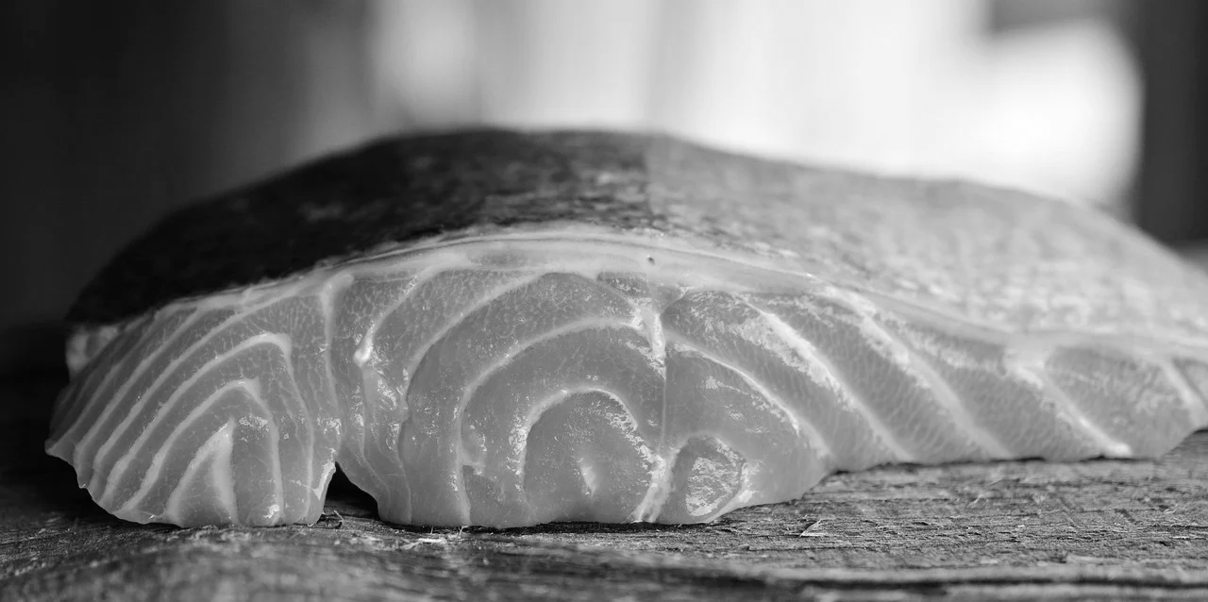
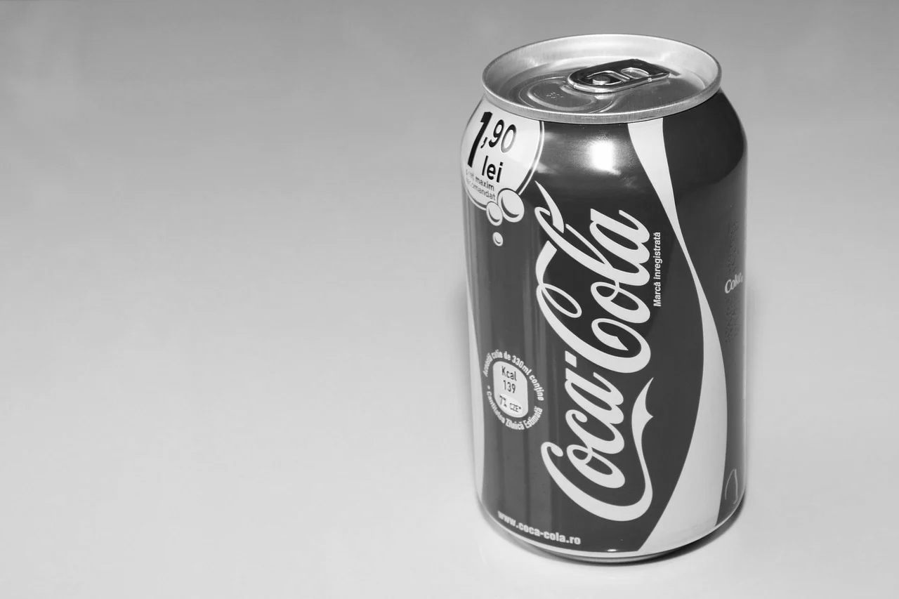
Notes:
Discuss,
Look at the images, which foods do you think are healthy and which are unhealthy?
*Most things are ok in moderation, but if you eat too much unhealthy food you can begin to develop health issues, like diabetes, high blood pressure and heart disease.

Slide 8
Using the images separate the foods into healthy and unhealthy.
Divide your page into two, put the unhealthy food on one side and the healthy food on the other.
Activity

Slide 9
Healthy Food
Broccoli
Chicken
Carrots
Meat
Milk
Yoghurt
Cheese
Bread
Pasta
Vegetables
Rice
Fruits - Berries
Fish
Notes:
Discuss,
Eating a small amount of pasta and rice can give us energy to perform our day to day tasks.
Fruit and vegetables provide us with the vitamins and minerals our organs need to function properly.
Dairy products, such as, cheese, milk and yoghurt contain calcium that is good for our teeth and bones.
Fish and meat are high in protein that help maintain healthy muscle function and repair.

Slide 10
Unhealthy Food
Chips/Fries
Processed Meat
Ice-cream
Fizzy Drinks
Sweets
Chocolate
Biscuits
Notes:
Discuss;
Why do you think chips are unhealthy? What are chips cooked in?
Sausages contain some protein as they are usually made from pork, however, they are very high in fat.
Fizzy drinks, chocolate, ice cream, biscuits and sweets are very high in sugar, which is bad for your teeth and body if you eat too much.

Slide 11
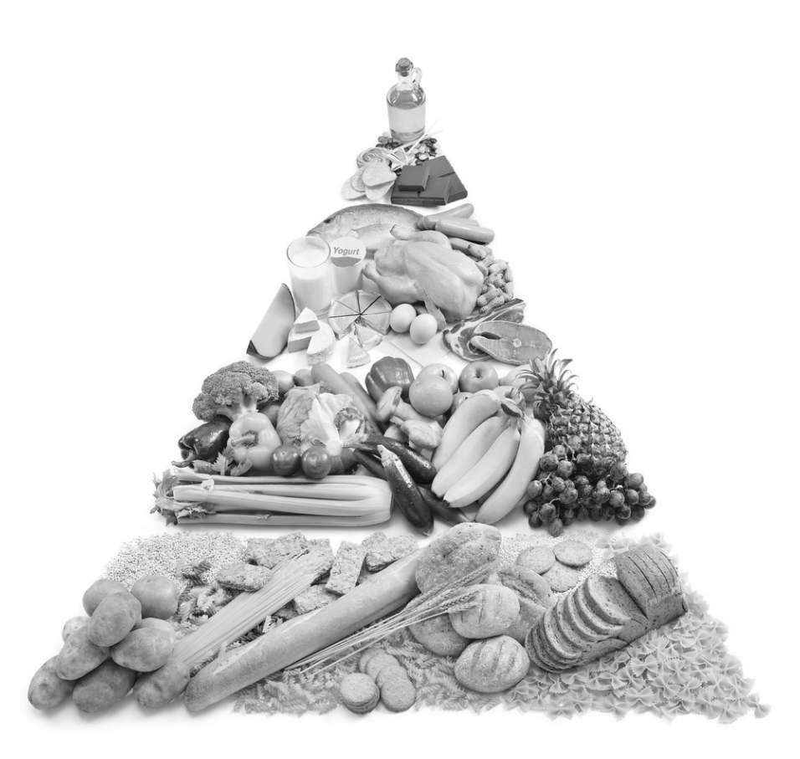
The 5 Food Groups
Fats and Sugars
Dairy
Proteins
Fruits and Vegetables
Carbohydrates
Notes:
Discuss;
For a healthy, balanced diet we should be eating a variety of different food.
Carbohydrates like bread, rice, pasta and potatoes give us energy and make up a large portion of our diet
Fruit and vegetable should also make up a large portion of our diet. We get a lot of the vitamins and minerals our body needs to keep our organs healthy and functioning properly.
Proteins like fish, meat and eggs help us to build and maintain healthy muscles. These make up the second largest part of our diet.
Dairy products are usually high in fat, but if you eat them in moderation they contain calcium that keeps our teeth and bones strong.
Sweets and treats are ok on occasion and can provide the body with a quick energy boost when eaten before exercise!

Slide 12
Notes:
Discuss,
Look at the images, which foods do you think are healthy and which are unhealthy?
*Most things are ok in moderation, but if you eat too much unhealthy food you can begin to develop health issues, like diabetes, high blood pressure and heart disease.

Slide 13
Carbohydrates
Potatoes
Bread
Rice
Pasta
Notes:
Discuss;
Can you think of any other carbohydrates?

Slide 14
Protein
White Meat
Red Meat
Milk
Yoghurt
Fish
Notes:
Discuss;
Yoghurt and milk also contain protein, but are part of the dairy group too.

Slide 15
Fruits and Vegetables
Broccoli
Carrots
Berries
Notes:
Discuss;
Can you think of any more fruit and vegetables?

Slide 16
Dairy
Ice cream
Cheese
Yogurt
Milk
Notes:
Discuss,
Can you think of any other dairy food items?
What makes them dairy?
*Being made from animal milk

Slide 17
Fats and Sugars
Fries
Fatty Meats
Ice Cream
Cheese
Sweets
Chocolate
Biscuits
Fizzy Drinks
Notes:
Discuss;
Why do you think sausages and cheese are also in the fats and sugars category?
How much of these these types of food should we eat as part of a healthy diet?
Can you think of any more fats and sugars?

Slide 18
The 5 Food Groups
Fats and Sugars
Dairy
Proteins
Fruits and Vegetables
Carbohydrates
Notes:
Discuss;
Reminder of portion sizes for each food group.

Slide 19
Design your own healthy plate of food.
Things to think about:
How will you balance your plate?
Will you have more of one type of food than another?
Remember to choose something from each food group.
Activity

Slide 20
Independent Living Personal Care
Balanced plate of food
Make it easier
Make it harder
More ideas
Create a plate of food including three of the five food groups.
Design a daily meal plan including breakfast, lunch and dinner.
Get a Parent/Carer to help you practice shopping for these foods online using a supermarket website.

Slide 21
Further Learning with Oak National
Independent Living:
Building Understanding- Daily meals for different times (Unit 3)
Building Understanding- Following a simple recipe (Unit 3)
Applying Learning- Daily recommendations (Unit 2)
Applying Learning- Daily meals for different times of the day (Unit 3)
Applying Learning- Preparing a simple meal (Unit 3)
Notes:
Insert info for subject/lesson name/stage (if appropriate)

Slide 22
References
Slide 7- Chips, Pixabay / Carrots, Pixabay / Ice cream cone melting, Pixabay / Grill party, Pixabay / Chocolate, Pixabay / Coca cola, Pixabay / Cookie biscuit, Pixabay / Cheese, Pixabay / Caramel candy / Milk glass, Pixabay / Natural Yoghurt, Tiia Monto, Wikimedia Commons / Rice, Pixabay / Pasta, Pixabay / Bread, Pixabay / Broccoli, Pixabay / Berries, Pixabay / Salmon, Pixabay / Chicken roasted, Pixabay / Vegetables, Pixabay / Steak beef, Pixabay
Slide 11- Food3, bigbrand, Flickr Attribution 2.0 Generic (CC BY 2.0)
Notes:
Insert info for subject/lesson name/stage (if appropriate)

