Slide 1
Sequences Generalising arithmetic sequences through tracking calculations
Downloadable Resource
Mathematics
Ms Jones

Slide 2
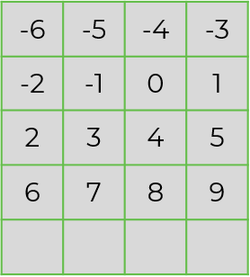
Try This
Imagine the number grid continues for many rows.
Write down a number to match each description:
A number greater than 20 in column A
A number greater than 20 in column C
A number between 100 and 110 in column B
How many ways can you complete this sentence:
“Numbers in column A / B / C / D will always / sometimes / never …… ”
A
B
C
D
44

Slide 3
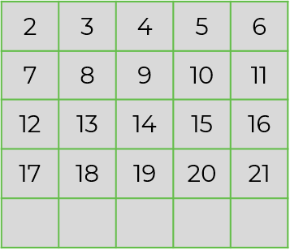
Independent task
A
B
C
D
E
Row 1
Row 2
Row 3
Row 4
44
3. Look at the same number grid as Q1. Which columns and rows would these numbers fall into?
123
497
1 000 006

Slide 4
Explore
Zaki is describing a number grid.
The first row contains the number -3.
Every column contains odd and even numbers.
The 10th row contains the number 64.
What could his grid look like? Draw the first two rows.
How many different grids could he be describing?

