Slide 1
Horizontal and vertical lines recap
Downloadable Resource
Mathematics
Mr Maseko

Slide 2
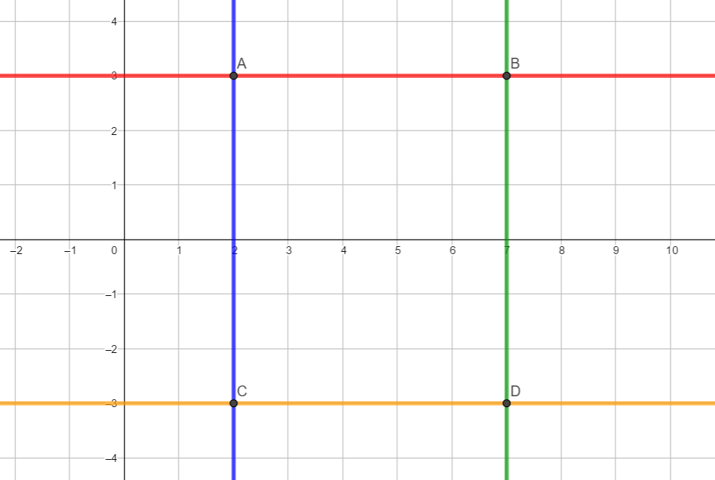
Try this
What statements can you make about this graph?
I can name some coordinates on the green line
I can find the coordinates of A, B, C and D
I can find some midpoints

Slide 3
Connect
State 4 coordinates on each of the lines.
What do you notice?
What is the same and what is different about horizontal and vertical lines?

Slide 4
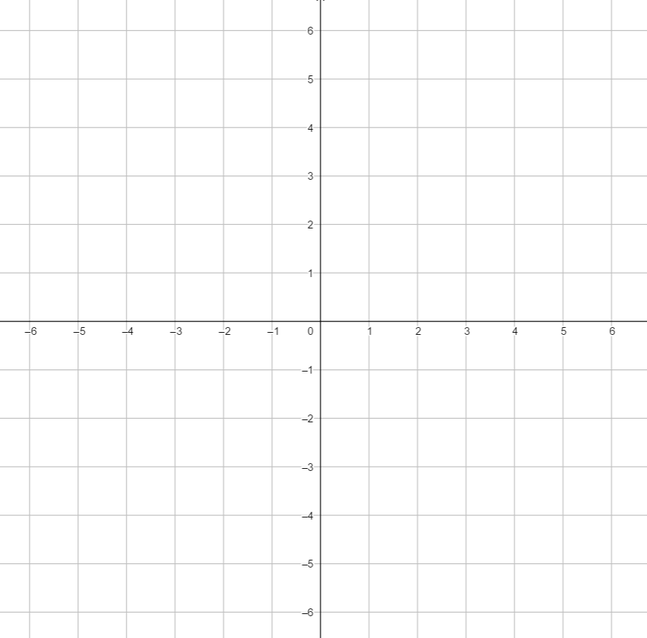
Independent task
1) On the coordinate grid draw the following lines:
y = 3
x = -2
y = -5
x = 5
2) Draw the line y = x
Why is the line y = x not a horizontal or vertical line?

Slide 5
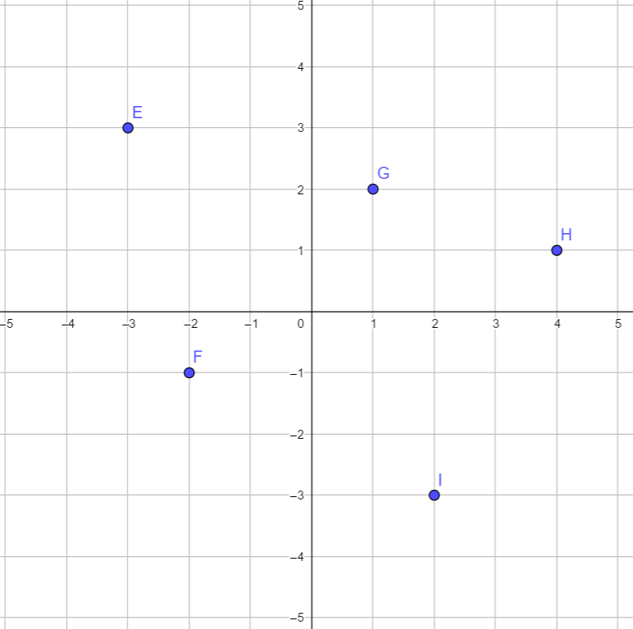
Explore
Find a vertical and horizontal line that passes through each of these coordinates. Where will these lines intersect?

