Slide 1
Should we believe everything we read?
Lesson 5 of 6
Downloadable Resource
Citizenship
Mr Joy

Slide 2
Task 1 - Trust Tower information sources
Put these nine information sources into your Trust Tower.
Newspapers | Family members | News on social media
Wikipedia | Google or Google News | Government
BBC | Friends | Teachers

Slide 3
Image from Association of Citizenship Teaching

Slide 4
Source 1: Girl suffered collapsed lung after screaming at One Direction concert article excerpt
In a paper published last week in the Journal of Emergency Medicine, a Dr J. Mack Slaughter from Dallas, Texas, related an interesting incident, thought to be the first of its kind. Three years ago, he dealt with a patient who appeared to have ripped a hole in her lung by screaming at a One Direction concert.
The girl…was finding it hard to breathe. Afterwards, she went to the hospital. It was eventually determined that a tear in the lung had meant air had escaped to three separate places in her chest.
Source: Refinery29, published October 16, 2017

Slide 5
Source 2: Excerpt of the Media Bias Fact Check profile of Refinery29
Refinery29 is owned by the Vice Media Group, which publishes Vice News and several other websites.
Refinery29 publishes articles with emotionally loaded language [and] typically utilizes credible sources such as USAToday, Wall Street Journal, and AP News.
Overall, we rate Refinery29 ’Mostly Factual’, rather than ‘High’ due to a failed check and a lack of transparency regarding editor.
Source: Media Bias Fact Check, publication date unclear

Slide 6
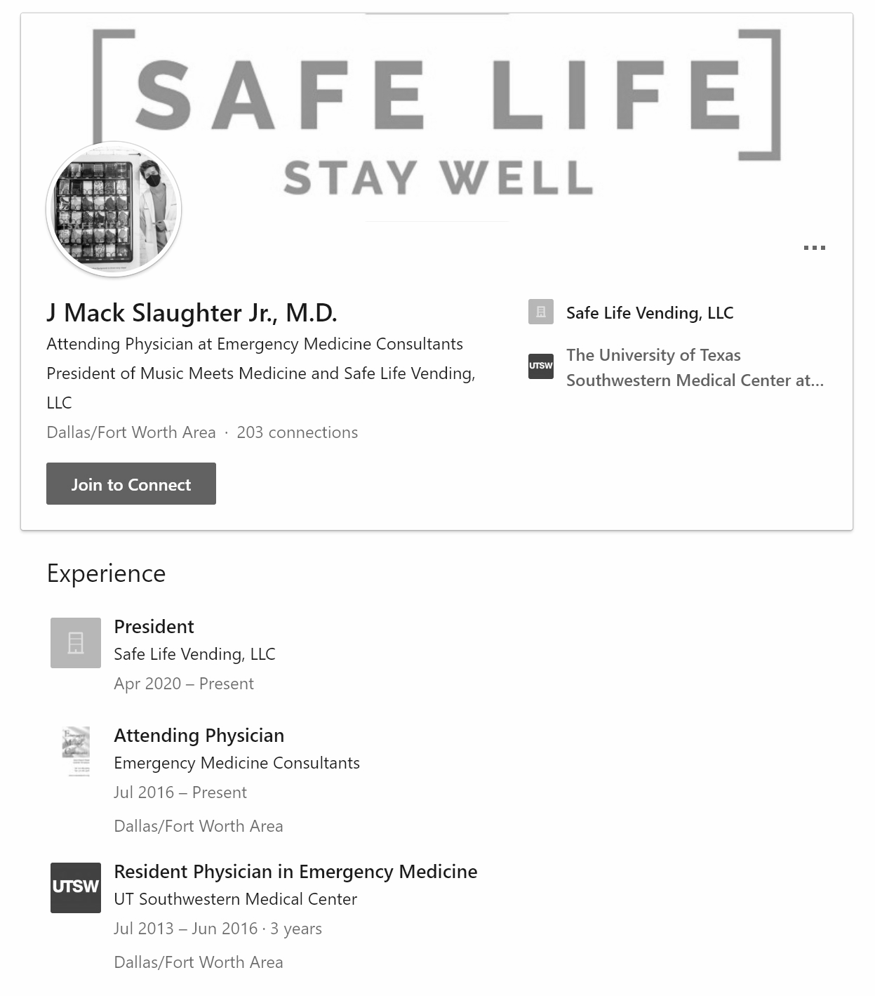
Source 3: Dr J. Mack Slaughter’s LinkedIn profile

Slide 7
Source 4: One Direction mega fan screams so hard at concert both her lungs collapse article excerpt
An excited teenage girl overwhelmed at being so close to her heroes screamed so hard at a One Direction gig her lungs collapsed.
Baffled medics were told she began to suffer her symptoms after screaming her head off at a One Direction concert, the night before.
The doctors, at UT Southwestern Medical Center in Dallas, Texas, diagnosed the girl with a… slight collapse of both lungs.
A case report was published in the Journal of Emergency Medicine.
Source: The Sun, published October 12, 2017

Slide 8
Source 5: Search record from The Journal of Emergency Medicine website
Screenshot taken from The Journal of Emergency Medicine website

