Slide 1
Finding the length of a line from tilted squares.
Downloadable resource.
Lesson 3 of 8.
Mathematics
Dr Rim Saada

Slide 2
1) List these line segments from shortest to longest.
2) How did you decide? What was your reasoning?

Slide 3
1) Find the length of the lines shown on the grid.

Slide 4
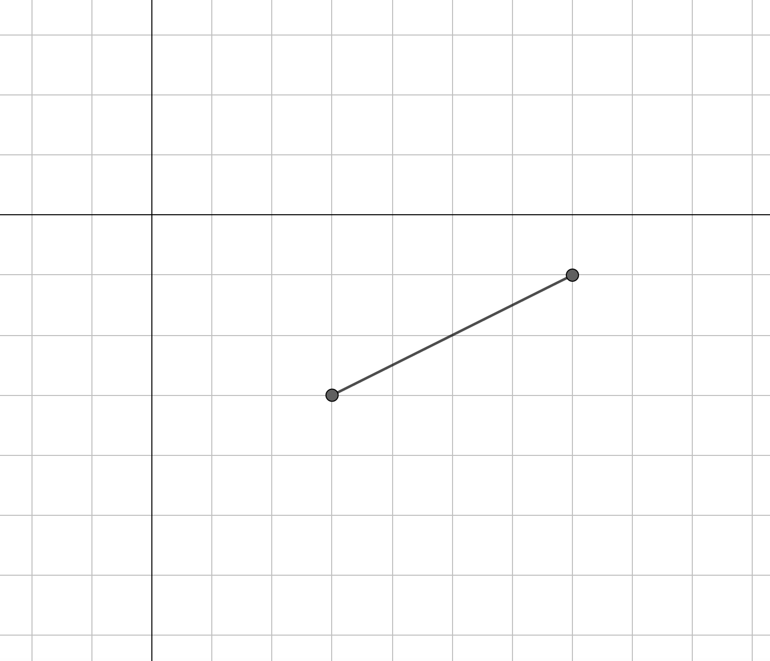
2) Use the line on the grid to draw a square.
What are the coordinates of its vertices?
What is the length of the line?

Slide 5
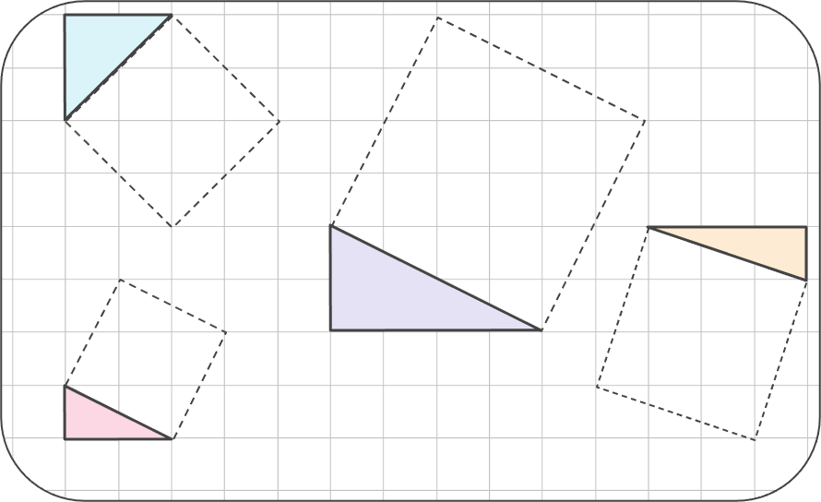
List the side lengths of each of these triangles.
What do you notice?

