Slide 1
Calculations with variables
Downloadable Resource
Mathematics
Mr Maseko

Slide 2
What number could Yasmin be thinking of if her final answer is between:
50 – 100
100 – 150
240 – 260
Hint: try different starting numbers and see what you get.
I think of a number. I divide my number by 2, then add 6 and finally multiply by 4.
How else could you express Yasmin’s statement?

Slide 3
I think of a number. I divide my number by 2, then add 6 and finally multiply by 4.
Expressing Yasmin’s statement

Slide 4
Show Cala’s statement on a function machine then write a matching calculation.
I think of a number. I add 2 then square the answer. I then subtract 1, and finally divide my number by 2.

Slide 5
Which of the calculations match Antoni’s statement? For those that don’t, write a correct matching statement.
I think of a number. I then subtract 5 and multiply the answer by 6. Next I add 5 and finally divide by 6.

Slide 6
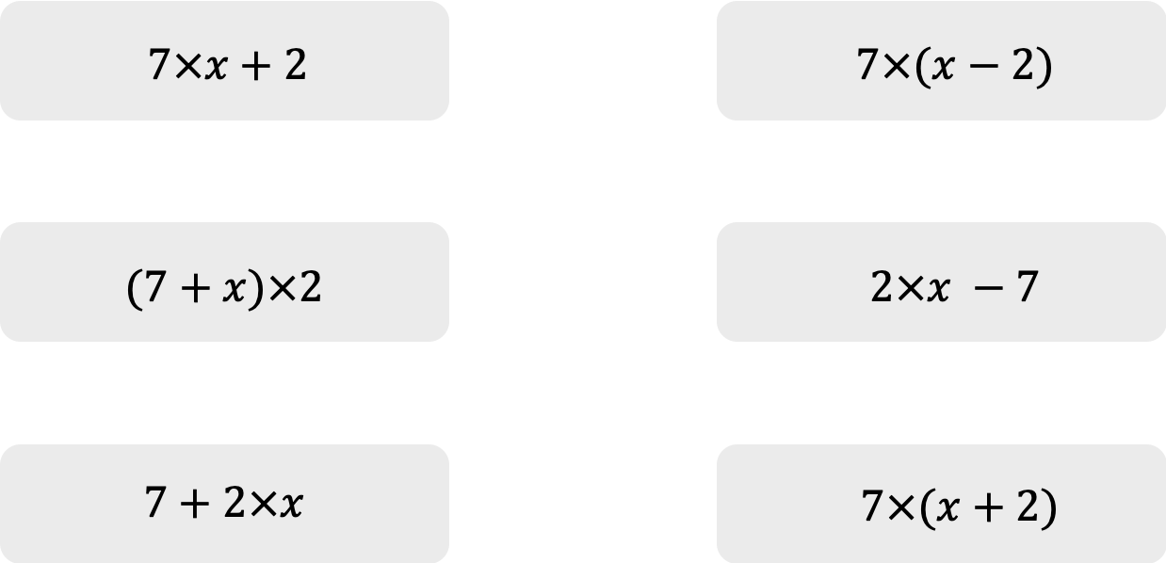
For each of the following calculations write a matching ”think of a number” statement.

