Slide 1
Subtract two surds
Maths
Mr Chan

Slide 2
Subtract two surds

Slide 3
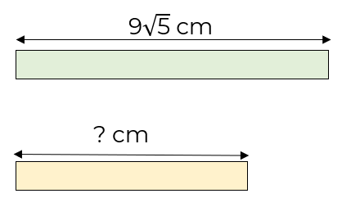
Subtract two surds
4. Here are some number cards.
Work out
the mode of the cards.
the median of the cards.
the range of the cards.

Slide 4
Answers
‹#›

Slide 5
Subtract two surds

Slide 6
Subtract two surds

