Slide 1
Combined science - Physics - Key stage 4 - Particle Model of Matter
Multi-step energy calculations
Worksheet
Mr Charman
Mr Charman

Slide 2
Exam question

Slide 3
Exam questions
Calculate the total energy transferred when 250 g of ice cubes at 0 °C are changed to steam at 100 °C. Specific latent heat of fusion of ice = 334 000 J/kg °C Specific heat capacity of water = 4200 J/kg °C Specific latent heat of vapourisation of water = 2260 000 J/kg
A block of ice at -3 °C was heated. After 7500 J of energy was transferred to the ice, the ice had melted and reached a temperature of 5 °C . Calculate the mass of the ice. Specific latent heat of ice = 2100 J/kg °C Specific latent heat of fusion of ice = 334 000 J/kg °C Specific heat capacity of water = 4200 J/kg °C

Slide 4
Answers

Slide 5
Exam question - review
Mass = 0.25 kg (1) Ice melting = 0.25 X 334000 = 83500 J (1) Temperature change = 100 - 20 = 80 °C (1) Water heating = 0.25 X 4200 X 80 = 84000 J (1) Water boiling = 0.25 X 2260000 = 565000 J (1) Total thermal energy = 83500 + 84000 + 565000 = 732500 J (1)

Slide 6
Exam question - review
2)
Ice heating: E = m X 2100 X 3 = m X 6300 (1) Ice melting: E = m X 340000 (1) Water heating: E = m X 4200 X 5 = m X 21000 (1) Total thermal energy transfer: 7500 = m X 6300 + m X 340000 + m X 21000 = m X 361300 (1) m = 7500 / 361300 (1) m = 0.02 kg (1)

Slide 7
In lesson questions

Slide 8
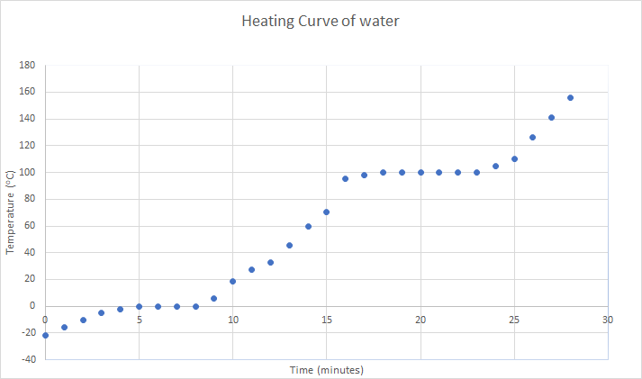
Warm up
For each stage (A-E) write down if the kinetic store or potential store is increasing
Identify for each stage (A-E) if it relates to specific heat capacity or latent heat.
Heating curve of Ice
E
D
C
A
B
Image, Mr Charman

Slide 9
Independent practice
What mass of liquid hydrogen needs 910 000 J of heat energy to turn into a gas? The specific latent heat of vapourisation of hydrogen is 455 000 J/kg
What is the mass of an unknown material with a specific latent heat of 14 000 J/kg if it takes 42 kJ to turn it into a liquid from a solid?
Challenge: What mass of nitrogen gas is produced when 1.6 x 10⁴ J is needed to turn it from a liquid to a gas? The specific latent heat of vapourisation of nitrogen is 2 x 10⁵ J/kg.

Slide 10
Independent practice
What is the specific latent heat of copper if it requires 414 000 J of heat energy to melt 2 kg of copper?
What is the specific latent heat of lead if it requires 92 000 J of heat energy to melt 4 kg of lead?
Challenge - what is the specific latent heat of aluminium if it requires 203 400 J of heat energy to melt 600g of aluminium?

Slide 11
Worked example 1
An ice cube has a mass of 50 g and a temperature of -10 °C. Calculate the total thermal energy required to melt the ice cube.
Specific heat capacity of ice = 2100 J/kg °C
Specific latent heat of fusion of ice = 334 000 J/kg (5)
Energy = …………………………… J

Slide 12
Worked example 2
An ice cube has a temperature of –20.0 °C The total thermal energy needed to raise the temperature of this ice cube to 0.0 °C and completely melt the ice cube is 75200 J
Specific heat capacity of ice = 2100 J/kg °C
Specific latent heat of fusion of ice = 334 000 J/kg
Calculate the mass of the ice cube. (5)
Energy = …………………………… J

Slide 13
Answers

Slide 14
Review
Warm up
For each stage (A-E) write down if the kinetic store or potential store is increasing. A, C and E - kinetic energy store increasing. B and D - potential energy store increasing.
Identify for each stage (A-E) if it relates to specific heat capacity or latent heat. A, C and E relate to specific heat capacity. B and D relate to latent heat.

Slide 15
Independent practice -review
What is mass of liquid hydrogen needs 910 000 J of heat energy to turn into a gas? The specific latent heat of vaporization of hydrogen is 455 000 J/kg. 2 kg
What mass of an unknown material with a specific latent heat of 14 000 J/kg is produced when it takes 42 kJ to turn it into a liquid from a solid? 3 kg
Challenge: What mass of nitrogen gas is produced when 1.6 x 10⁴ J is needed to turn it from a liquid to a gas? The specific latent heat of vaporisation of nitrogen is 2 x 10⁵ J/kg.

Slide 16
Independent practice -review
What is the specific latent heat of copper if it requires 414 000 J of heat energy to melt 2 kg of copper? 207 000 J/kg
What is the specific latent heat of lead if it requires 92 000 J of heat energy to melt 4 kg of lead? 23 000 J/kg
Challenge - what is the specific latent heat of aluminium if it requires 203 400 J of heat energy to melt 600g of aluminium? 339 000 J/kg

