Slide 1
Lesson 2: A Splash of Colour
Data Representation
Computing
Dharini Krishnamoorthy
Materials from the Teach Computing Curriculum created by the National Centre for Computing Education

Slide 2
Task 1 - Pick and mix colours
Steps | Instructions
Visit the RGB Colour Mixer (oaknat.uk/comp-csfg-rgb-mixer) on the Computer Science Field Guide website. website. | You do not need to give specific values; any shade of the colours will do. The point is for you to experiment with how mixing elementary colours produces the desired ones.

Slide 3
Task 1.1: Pick and mix colours
Fill in the table below:
The table on the right contains specific values of red, green, and blue.
Write down the colour that you get when you mix red, green, and blue in these quantities.
Red | Green | Blue | Composite colour
255 | 255 | 0
160 | 0 | 160
128 | 128 | 128

Slide 4
Task 1.2: Pick and mix colours
Fill in the table below:
The table on the right contains specific colours.
Write down the values of red, green, and blue that you need to mix in order to produce these colours.
Red | Green | Blue | Composite colour
 |  |  | Orange
 |  |  | Brown
 |  |  | White

Slide 5
Task 2 - Representation Size
The two factors that determine the representation size of an image are its resolution (how many pixels it comprises) and its colour depth (how many bits or bytes are used to represent the colour of a pixel).
Representation size of a bitmap image | = | Resolution number of pixels | ⨉ | Colour depth number of bits or bytes for each pixel’s colour
If the colour depth of an image is not specified, you can assume that it is 24 bits. This is the most common value in contemporary bitmap images.

Slide 6
Task 2 - Worked example to compute image size:
What is the representation size, in bits and bytes, of a bitmap image with a resolution of 800⨉600 and a colour depth of 24 bits.
Representation size | = | resolution | ⨉ | colour depth
 | = | 800 ⨉ 600 pixels | ⨉ | 24 bits per pixel
 | = | 480,000 pixels | ⨉ | 24 bits per pixel
 |  | 11,520,000 bits (or 11.5 megabits)

Slide 7
Task 2 - Worked example to compute image size:
You could convert bits to bytes by dividing by 8. You could also calculate the size in bytes directly, since 24 bits is 3 bytes:
Representation size | = | resolution | ⨉ | colour depth
 | = | 480,000 pixels | ⨉ | 3 bytes per pixel
 |  | 1,440,000 bytes (or 1.44 megabytes)

Slide 8
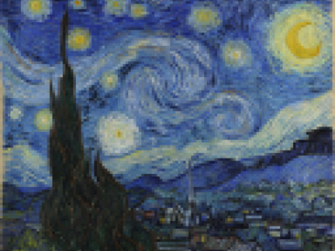
Task 2 : Representation Size
On the right you can see the image of Van Gogh’s famous The Starry Night painting.
This image has been reduced to a resolution of 640⨉500, with a colour depth of 3 bytes.
Tasks:
Use this information to calculate the number of bytes required to represent this image.
Convert this size to megabytes.
Credit: Van Gogh, The Starry Night image:Pixabay

