Slide 1
Magnetism Review 2 (Physics only)
Physics - Key stage 4 - Magnetism
Mr van Hoek

Slide 2
Independent practice
1. Describe the key principles of the generator effect using the terms below.
induced potential difference magnetic flux cut moves conductor
2. Describe how changes to the speed of movement, magnetic flux density and number of turns on a coil will affect the size of the induced potential difference in the motor effect?
3. In the generator effect, describe how the direction of the induced potential difference can be reversed.

Slide 3
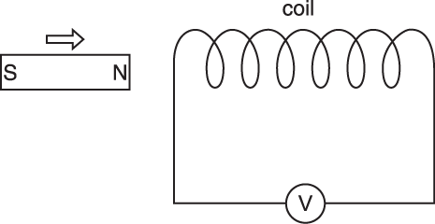
Exam question
Maria is investigating the generation of electricity.
She pushes the north pole of a magnet into a coil of wire. The coil is connected to a sensitive voltmeter.
The voltmeter gives a reading when the magnet is moving.
What is the name of the process that produces the voltage? [1]
State one change that Maria can make to produce a voltage in the opposite direction. [1]
OCR, June 2016, A182/02
Additional answers and guidance not checked by OCR

Slide 4
Exam question
Ali investigates electromagnetic induction.
He pushes a magnet quickly into a coil of wire. He uses an ammeter to record the biggest current produced in the coil.
He repeats the experiment for coils with different numbers of turns.
As Ali pushes the magnet towards the coil, he feels a small repulsive force.
Explain why. [2]
OCR, June 2018, J259/03
Additional answers and guidance not checked by OCR

Slide 5
Independent practice
Compare the structure of an alternator and a dynamo
Compare the electrical output of an alternator and a dynamo running at the same speed, with the same number of coils and magnetic flux density.
State and describe the effect used to produce electricity in alternators and dynamos.

Slide 6
Exam question
Motors and generators both contain magnets and coils of wire.
Explain the similarities and differences between a motor and a generator. [6]
OCR, June 2013, A182/02
Additional answers and guidance not checked by OCR

Slide 7
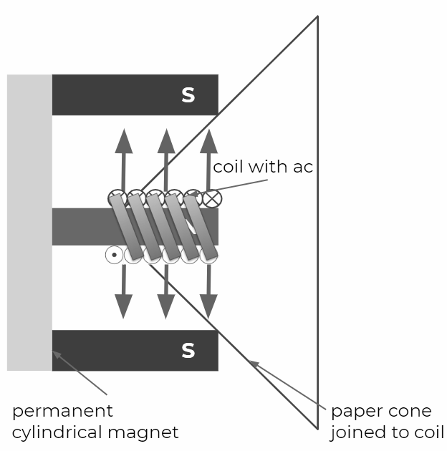
Exam style question
The diagram to the right shows the parts of a moving-coil loudspeaker.
There is a coil of wire between the north and south poles of the cylindrical magnet.
Explain how the loudspeaker converts alternating current into a sound wave. [6]

Slide 8
Independent practice
Draw a diagram of a transformer, labelling the key parts.
Compare the structure of a step-up and step-down transformer.
Explain, with reference to electromagnetism and electromagnetic induction, how a transformer increases the potential difference of an alternating current.
Explain why the potential difference of direct current electricity cannot be increased or decreased using a transformer.
A transformer with 100 turns on the primary coil and 500 turns on the secondary coil has an input of 46V a.c. What is output potential difference?

Slide 9
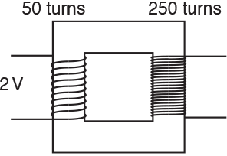
Exam question
What output voltage does the transformer produce?
A 0.2 V
B 0.4 V
C 5 V
D 10 V
OCR, June 2018, J249/03
Additional answers and guidance not checked by OCR

Slide 10
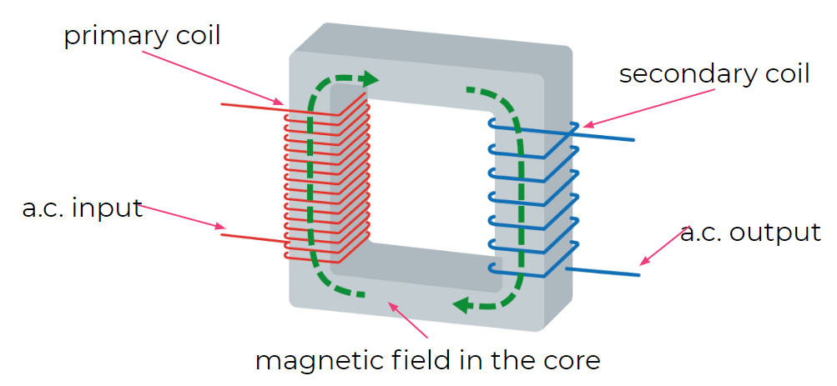
Exam style question
The diagram shows the basic structure of a transformer.
What is the core made of? [1]
Which type of transformer is it [1]
Explain how an alternating current input produces a different alternating current output. [3]

