Slide 1
Combined Science - Chemistry - Key Stage 4
Displacement Reactions of Metals
Mr Campbell

Slide 2
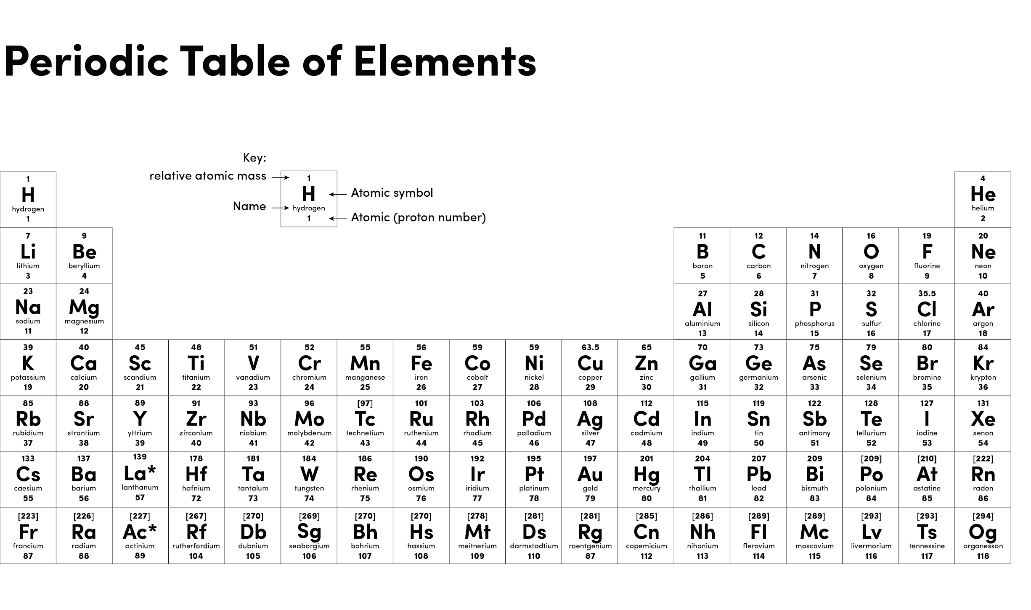
Source: Oak

Slide 3
Potassium
Sodium
Calcium
Magnesium
Aluminium
Zinc
Iron
Tin
Lead
Copper
Silver
Gold
Platinum
Increasing Reactivity

Slide 4
Independent Task
Place the metals W, X, Y and Z in order of reactivity, from most to least.
Complete this sentence.
I know ____________ is the most reactive because …………….
How do the results show that none of the metals were more reactive than magnesium

Slide 5
Independent Task Answers
Most W, Y, X, Z least
I know W is the most reactive because it produced the highest temperature increase with copper nitrate or W reacted with both copper nitrate and zinc chloride
None of the metals were able to react with magnesium sulfate or none of the metals could displace magnesium (from magnesium sulfate)

