Slide 1
Oak Specialist
Independent Living Unit 4- Community Living
Applying Learning

Slide 2
Unit 4- Community Living
Lesson 1- Knowing which shop to buy from
Lesson 2- Putting shopping away
Identifying a range of high street shops and knowing what they sell.
Knowing where to store food in the kitchen and other items.
Lesson 4- Health support in the community
Option 3
Lesson 3- Best Value
Option 4
Comparing same items from different shop including price, quality and quantity.
Who can support us with health and where to find help in the community.
Lesson 5- People who help us
Lesson 5- Travel in the community/planning a journey
Option 3
Option 4
Identifying emergency services and their roles.
Following steps to plan a journey and choose the correct mode of transport.
Notes:
Choose a lesson from the list

Slide 3
Lesson 5- People who help us

Slide 4
Teacher notes- Lesson 5
Learning intention: Understanding the different people in our community that can help us.
Learning about emergency service workers and their roles. How they can help us in an emergency.
Looking at different healthcare professionals in our community and how they help us to stay healthy and well.
Discussing other professionals in our community and what role they play in helpings us and offering us us when we need it. E.g. Teachers, shop assistants and our families.
-Additional resources: pen and paper
Notes:
This is the equivalent to a loose lesson plan/overview for teachers before starting the lesson.

Slide 5
Community Living
People who help us
Applying Learning

Slide 6
Lesson activity stages
This lesson will be taught in 4 stages:
Emergency services who help us.
Health care professionals who help us.
Other people who help us in the community.
Can you think of people who help you?

Slide 7
Activity 1
Look closely at the different emergency service workers on the next slide and think about their job roles.

Slide 8
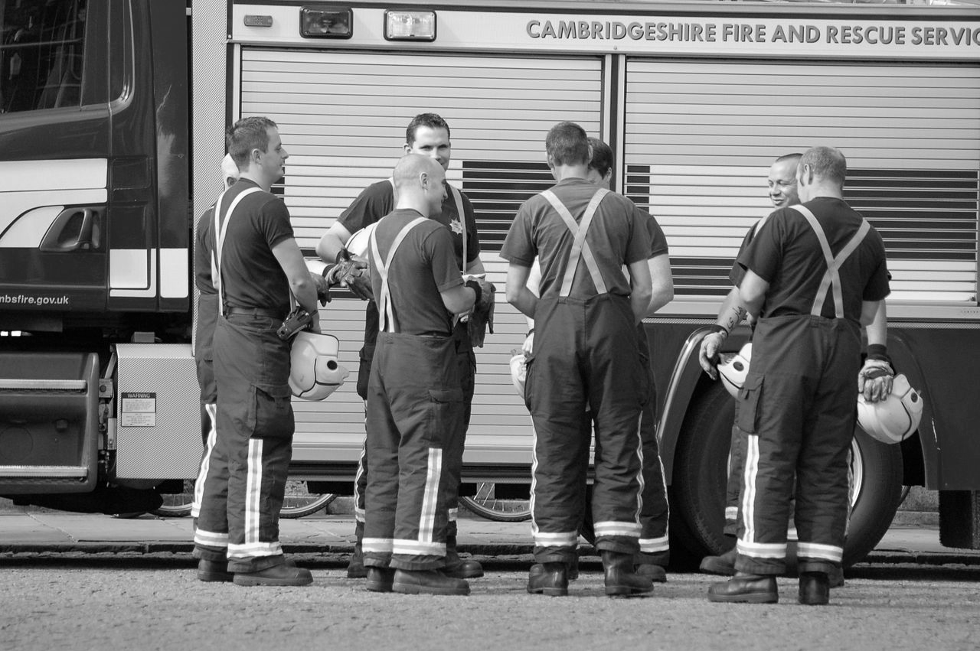
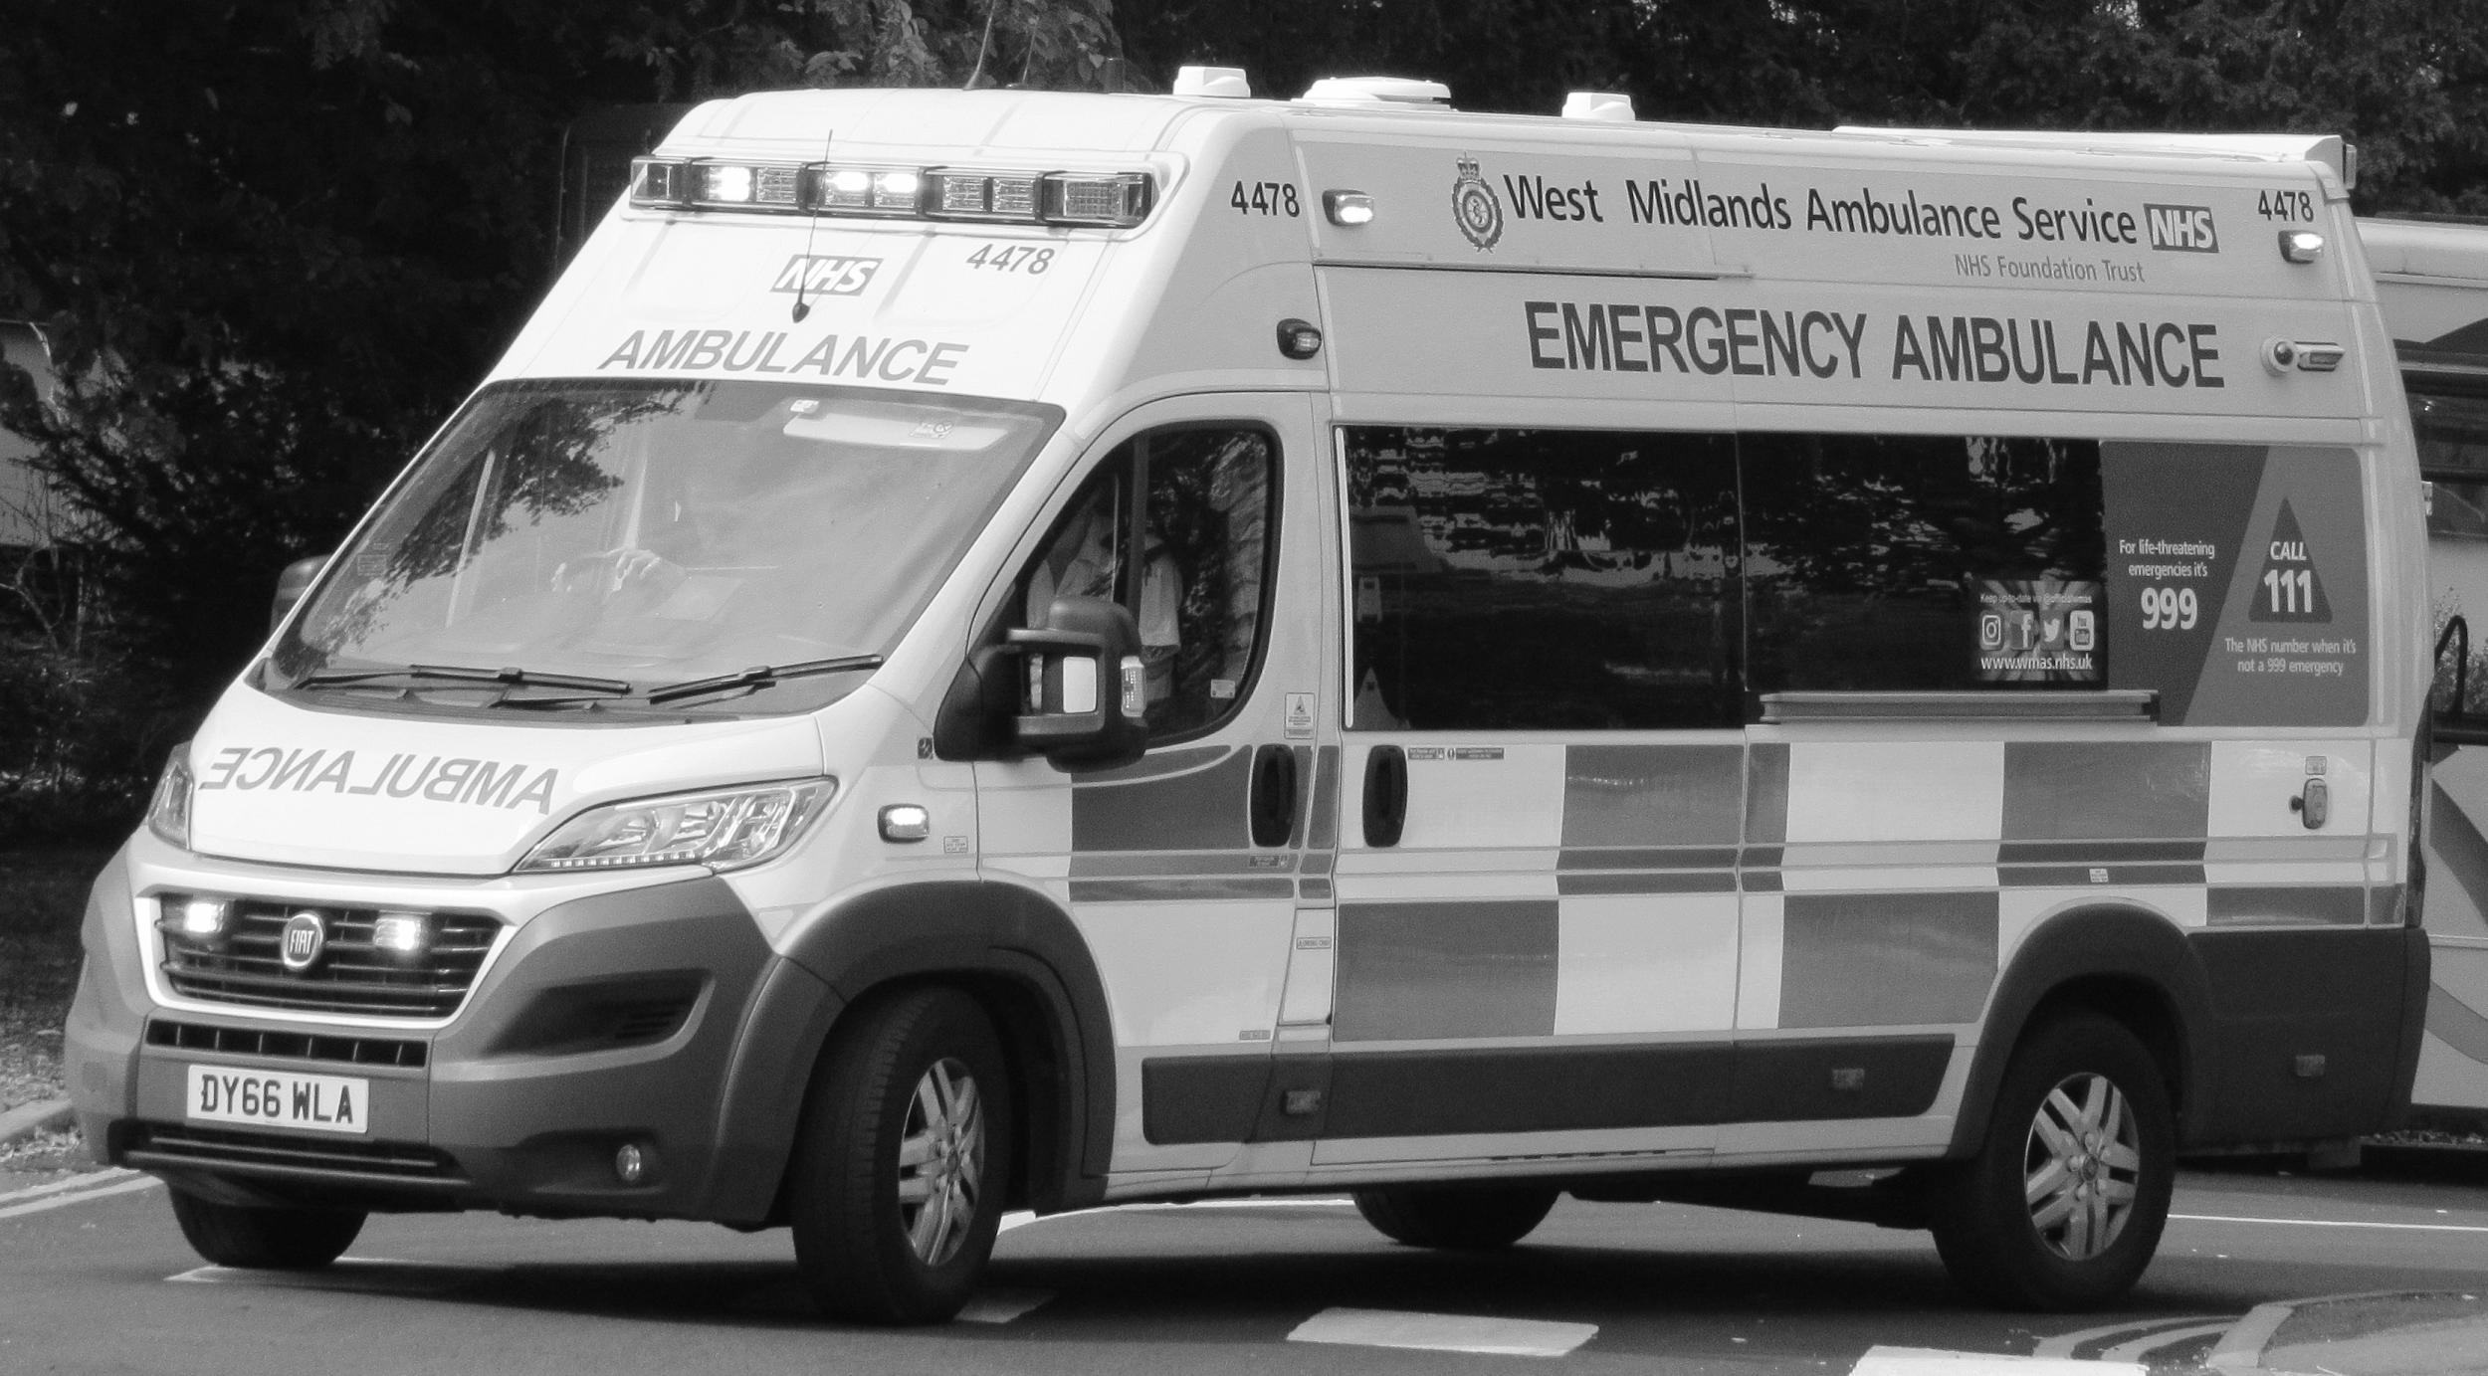
Emergency services
Look at pictures a, b,and c closely. Who are these people that help us?
What do each of them do?
When would we come into contact with these professionals that help us?
Notes:
Discuss;
Look at pictures a, b,and c closely, who are these people that help us?
What do each of them do?
When would we come into contact with these professionals that help us?
*only in an emergency. We would see a paramedic If someone was seriously hurt or ill. We would see a firefighter if there was a fire. We would see a police officer if we saw a crime or were involved in an incident.
If for one of these reasons you needed an emergency service, what number would you dial?

Slide 9
Emergency services - Answers
The Fire Service The Police Service The Ambulance Service
We would see a firefighter if there was a fire.
We would see a police officer if we saw a crime or were involved in an incident.
We would see a paramedic If someone was seriously hurt or ill.

Slide 10
Activity 2
Look closely at the different healthcare professionals who help us on the next slide and match them with their job roles.

Slide 11
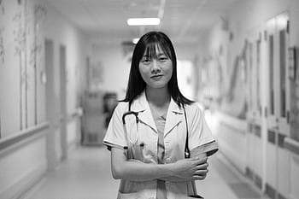
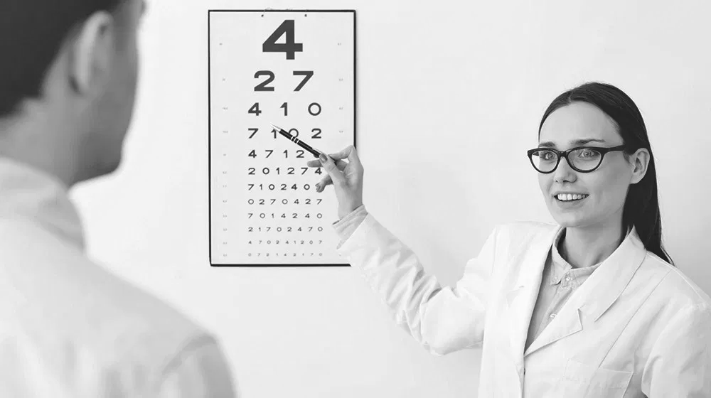
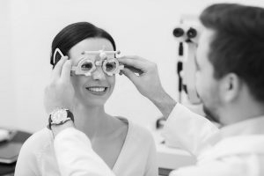
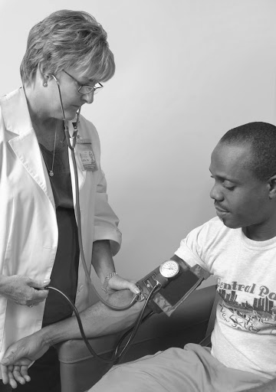
People who help us to stay healthy
Notes:
Discuss;
Look at pictures a, b,and c closely, who are these people that help us?
What do each of them do? Look at pictures 1, 2 and 3 to help you.
When would we come into contact with these professionals that help us?
*We would see a doctor If we were unwell. We would see a dentist if we had a problem with our teeth our gums. We would see an optician if we couldn’t see properly or had a problem with our eyes.
Activity
Using the letters and numbers can you match the healthcare professional with their role?

Slide 12
People that help us to stay healthy - Answers
Notes:
A,2
B,3
C,1

Slide 13
Activity 3
Look closely at the different people in our community who help us on the next slide and match them with their roles.

Slide 14
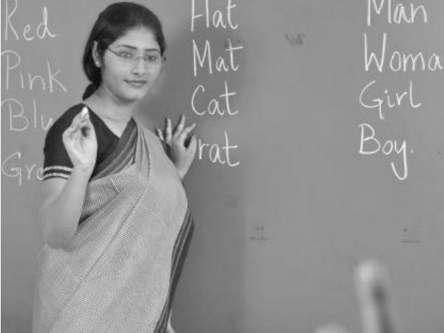
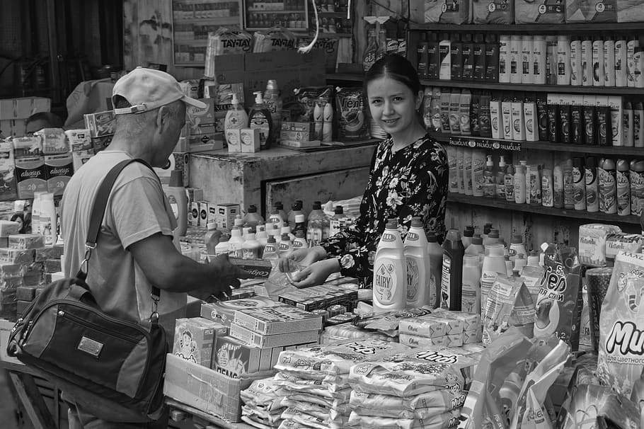
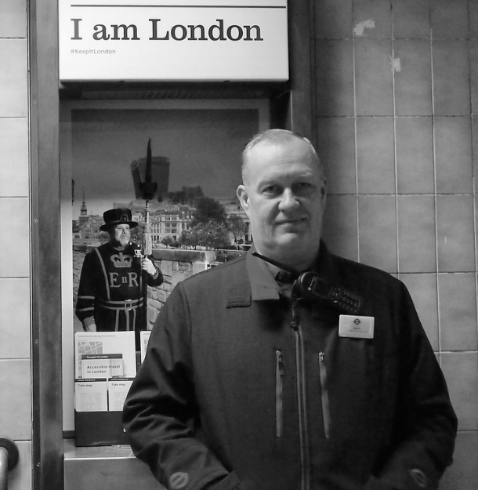
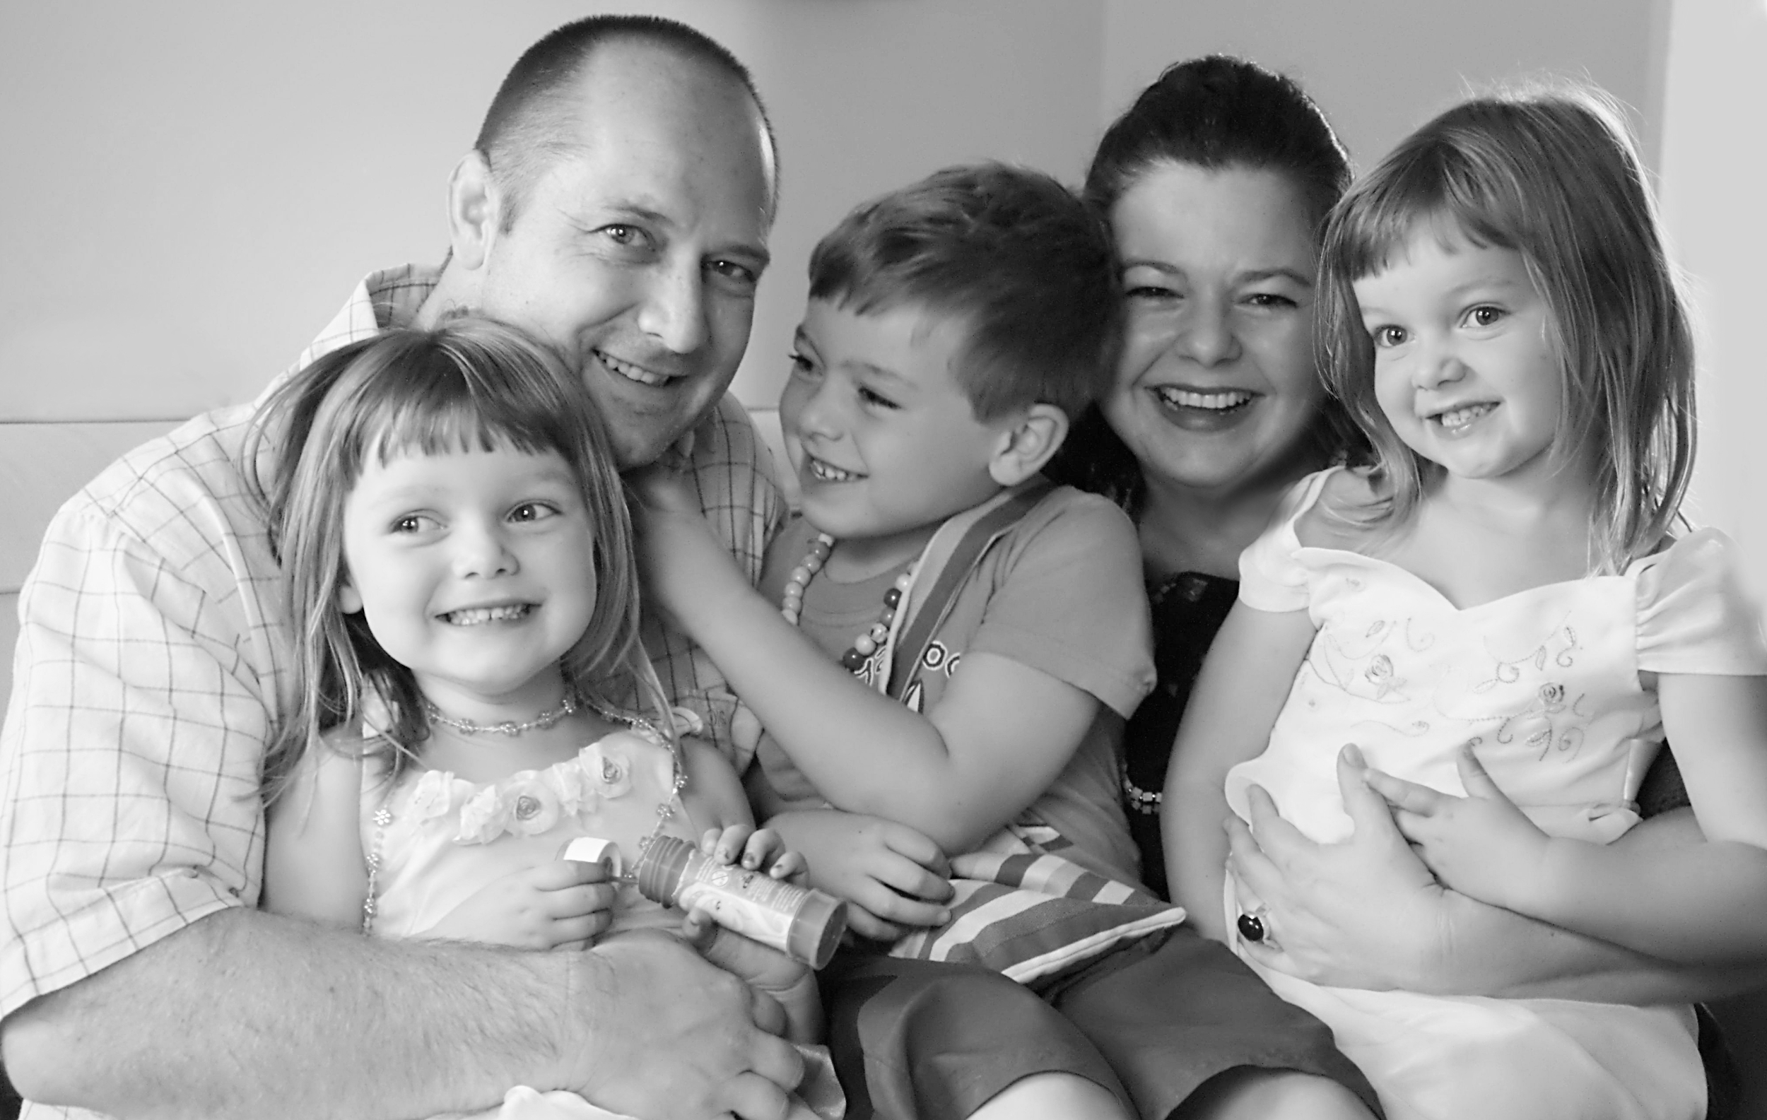
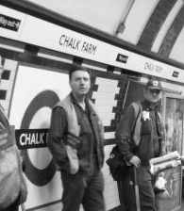
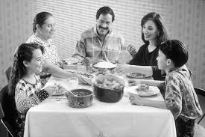
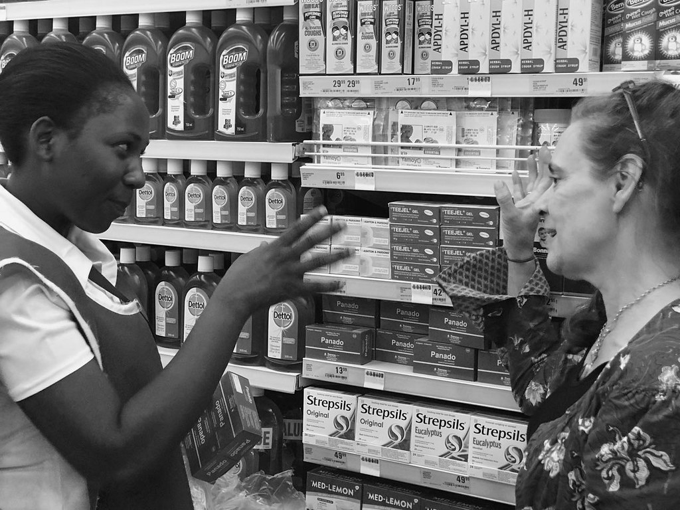
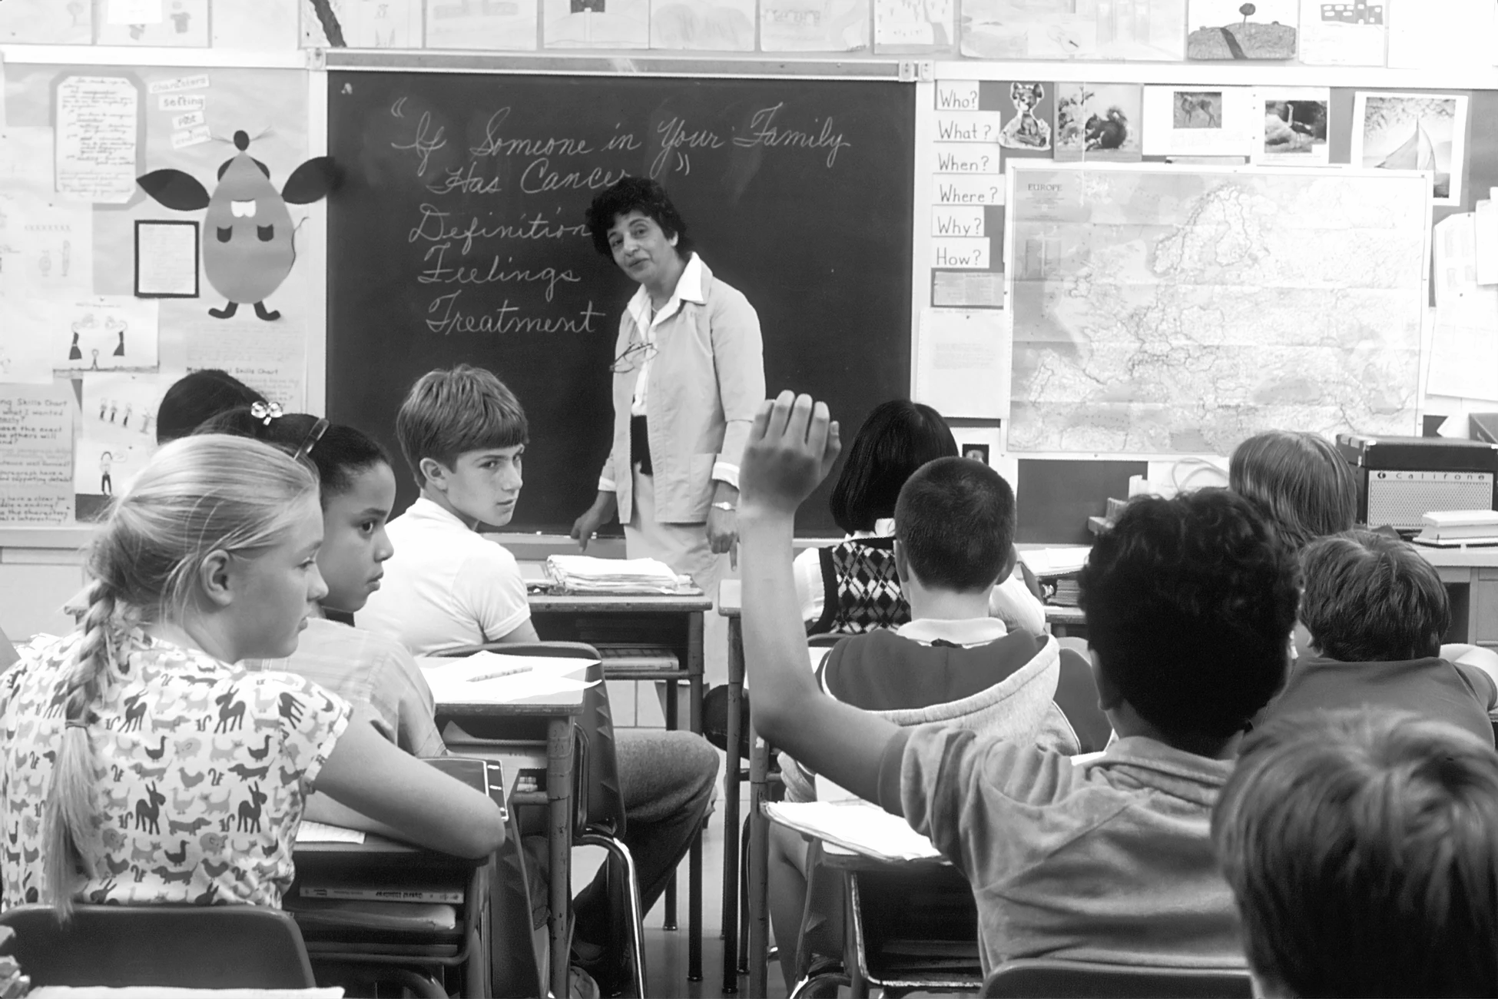
Other people who can help us
Notes:
Look at pictures a, b,and c closely, who are these people that help us?
What do each of them do? Look at pictures 1, 2, 3 and 4 to help you.
When would we come into contact with these professionals that help us?
* We would see a teacher at school or college. We would see a shop assistant in any of the shops that we use. We would see a transport worker at a train station, tube station or driving a bus. We see our family, parents, carers or friends at home.
Activity
Using the letters and numbers can you match the people in our community that help us with their role?

Slide 15
Other people that can help us - Answers
Notes:
A,4
B,3
C,1
D,2

Slide 16
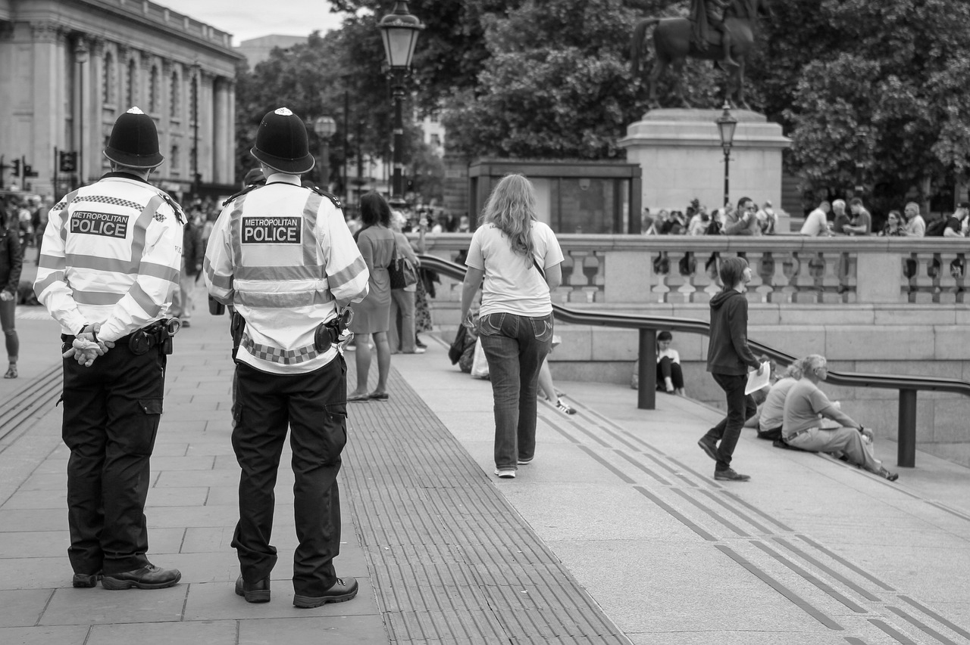
People who help us...
In an emergency:
Police
The Ambulance Service and Paramedics
The Fire Service
Notes:
To finish the lesson, think of some scenarios that you might need help with e.g. you get to the train station and you have forgotten your ticket. Who could you ask for help? You have a toothache, who could you ask for help? You are feeling sad and you don’t know why. Who could you ask for help?
Make a note of the people you know who you can ask for help.

Slide 17
People who help us...
With our health needs:
Doctor Dentist Optician
Notes:
To finish the lesson, think of some scenarios that you might need help with e.g. you get to the train station and you have forgotten your ticket. Who could you ask for help? You have a toothache, who could you ask for help? You are feeling sad and you don’t know why. Who could you ask for help?
Make a note of the people you know who you can ask for help.

Slide 18
People who help us...
If we need help, advice and support:
Teacher Shopkeeper Transport-worker
Family and Friends
Notes:
To finish the lesson, think of some scenarios that you might need help with e.g. you get to the train station and you have forgotten your ticket. Who could you ask for help? You have a toothache, who could you ask for help? You are feeling sad and you don’t know why. Who could you ask for help?
Make a note of the people you know who you can ask for help.

Slide 19
Independent Living
Applying Learning
Community - People who help us
Make it easier
Make it harder
More ideas
Focus on the emergency services and learn about the different jobs they do in the community.
Think about other people that help us in our community and find out what they do to help us (e.g. refuse collectors, bus drivers, train drivers, delivery drivers, postal service workers).
Think about the skills you need to do one of these jobs, or research different roles within one profession (e.g. paramedics, nurses, doctors, care assistants) with a parent/carer.

Slide 20
Signposting
Independent Living:
Building Understanding- Familiar health services (Unit 4)
Applying Learning- Health support in the community (Unit 4)
Notes:
Insert info for subject/lesson name/stage (if appropriate)

Slide 21
References
Slide 8 & 9- Cambridge firefighters,Benjah, bmm27, Wikimedia Commons/Firefighters,pxhere, Creative Commons CC0/A police officer at the Buckingham Palace gate. London, UK, Ввласенко, Wikimedia Commons Attribution-ShareAlike 2.0 Generic (CC BY-SA 2.0) /2016 Fiat Ducato 42 Maxi West Midlands Ambulance Service 3.0,Makizox, Wikimedia Commons
Slide 11 & 12-Anesthesia, doctor, female, stethoscope, hospital, healthcare, vietnam, medical, student, healthcare and medicine,pxfuel/This image depicts a female clinician in the process of conducting a blood pressure examination upon a seated male patient in a clinical set,CDC/ Amanda Mills,Public Domain Files/ Dentist, Piqsels/ Dentist, pxhere, Creative Commons CC0/ Vision Test, Associated Retina Consultants/The Importance Of Getting An Eye Vision Test Frequently,Dr Kondrot, Healing The Eye and Wellness Center.
Slide 14 & 15-Education Crisis In India: Government Schools Short Of 1 Million Teachers,Vidhya Shree, Career India/Children in a classroom, Unsplash/Jane and Shop Assistant in Shoprite Sep-19,Simon Berry, Flickr Attribution-ShareAlike 2.0 Generic (CC BY-SA 2.0) / Tube Workers,flashbender,Flickr Attribution-ShareAlike 2.0 Generic (CC BY-SA 2.0)/I am London, Barry Collins,Flickr Attribution 2.0 Generic (CC BY 2.0)/Market stall, market hall, market, shopping, sale, stands, shop assistant, woman, retail, real people, Pxfuel/Happy family, Catherine Scott, Wikimedia Commons/ Family eating meal, National Cancer Institute, Wikimedia Commons

