Slide 1
Lesson 14 - Review (Part 1)
(Downloadable Student Document)
Science - Biology - Key Stage 3
Cells, Tissues and Organs
Miss Wickham

Slide 2
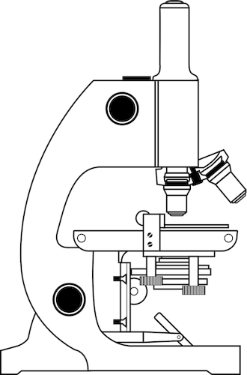
Recap on Part of a Microscopes
Label the parts of the microscope using these keywords: eyepiece lens, mirror, objective lens, coarse focus, stage, fine focus
1
6
2
3
5
4

Slide 3
Match up the part to the description
Part of the microscope
(1) Eyepiece lens
(2) Coarse focus
(3) mirror
(4) stage
(5) Fine focus
(6) Objective lens
Functions of parts
(a) Reflects light onto stage
(b) Moves the stage up and down
(c) Where the specimen is placed to be viewed
(d) Changes the magnification
(e) The viewer looks through to see the specimen
(f) Used to make a clearer image

Slide 4
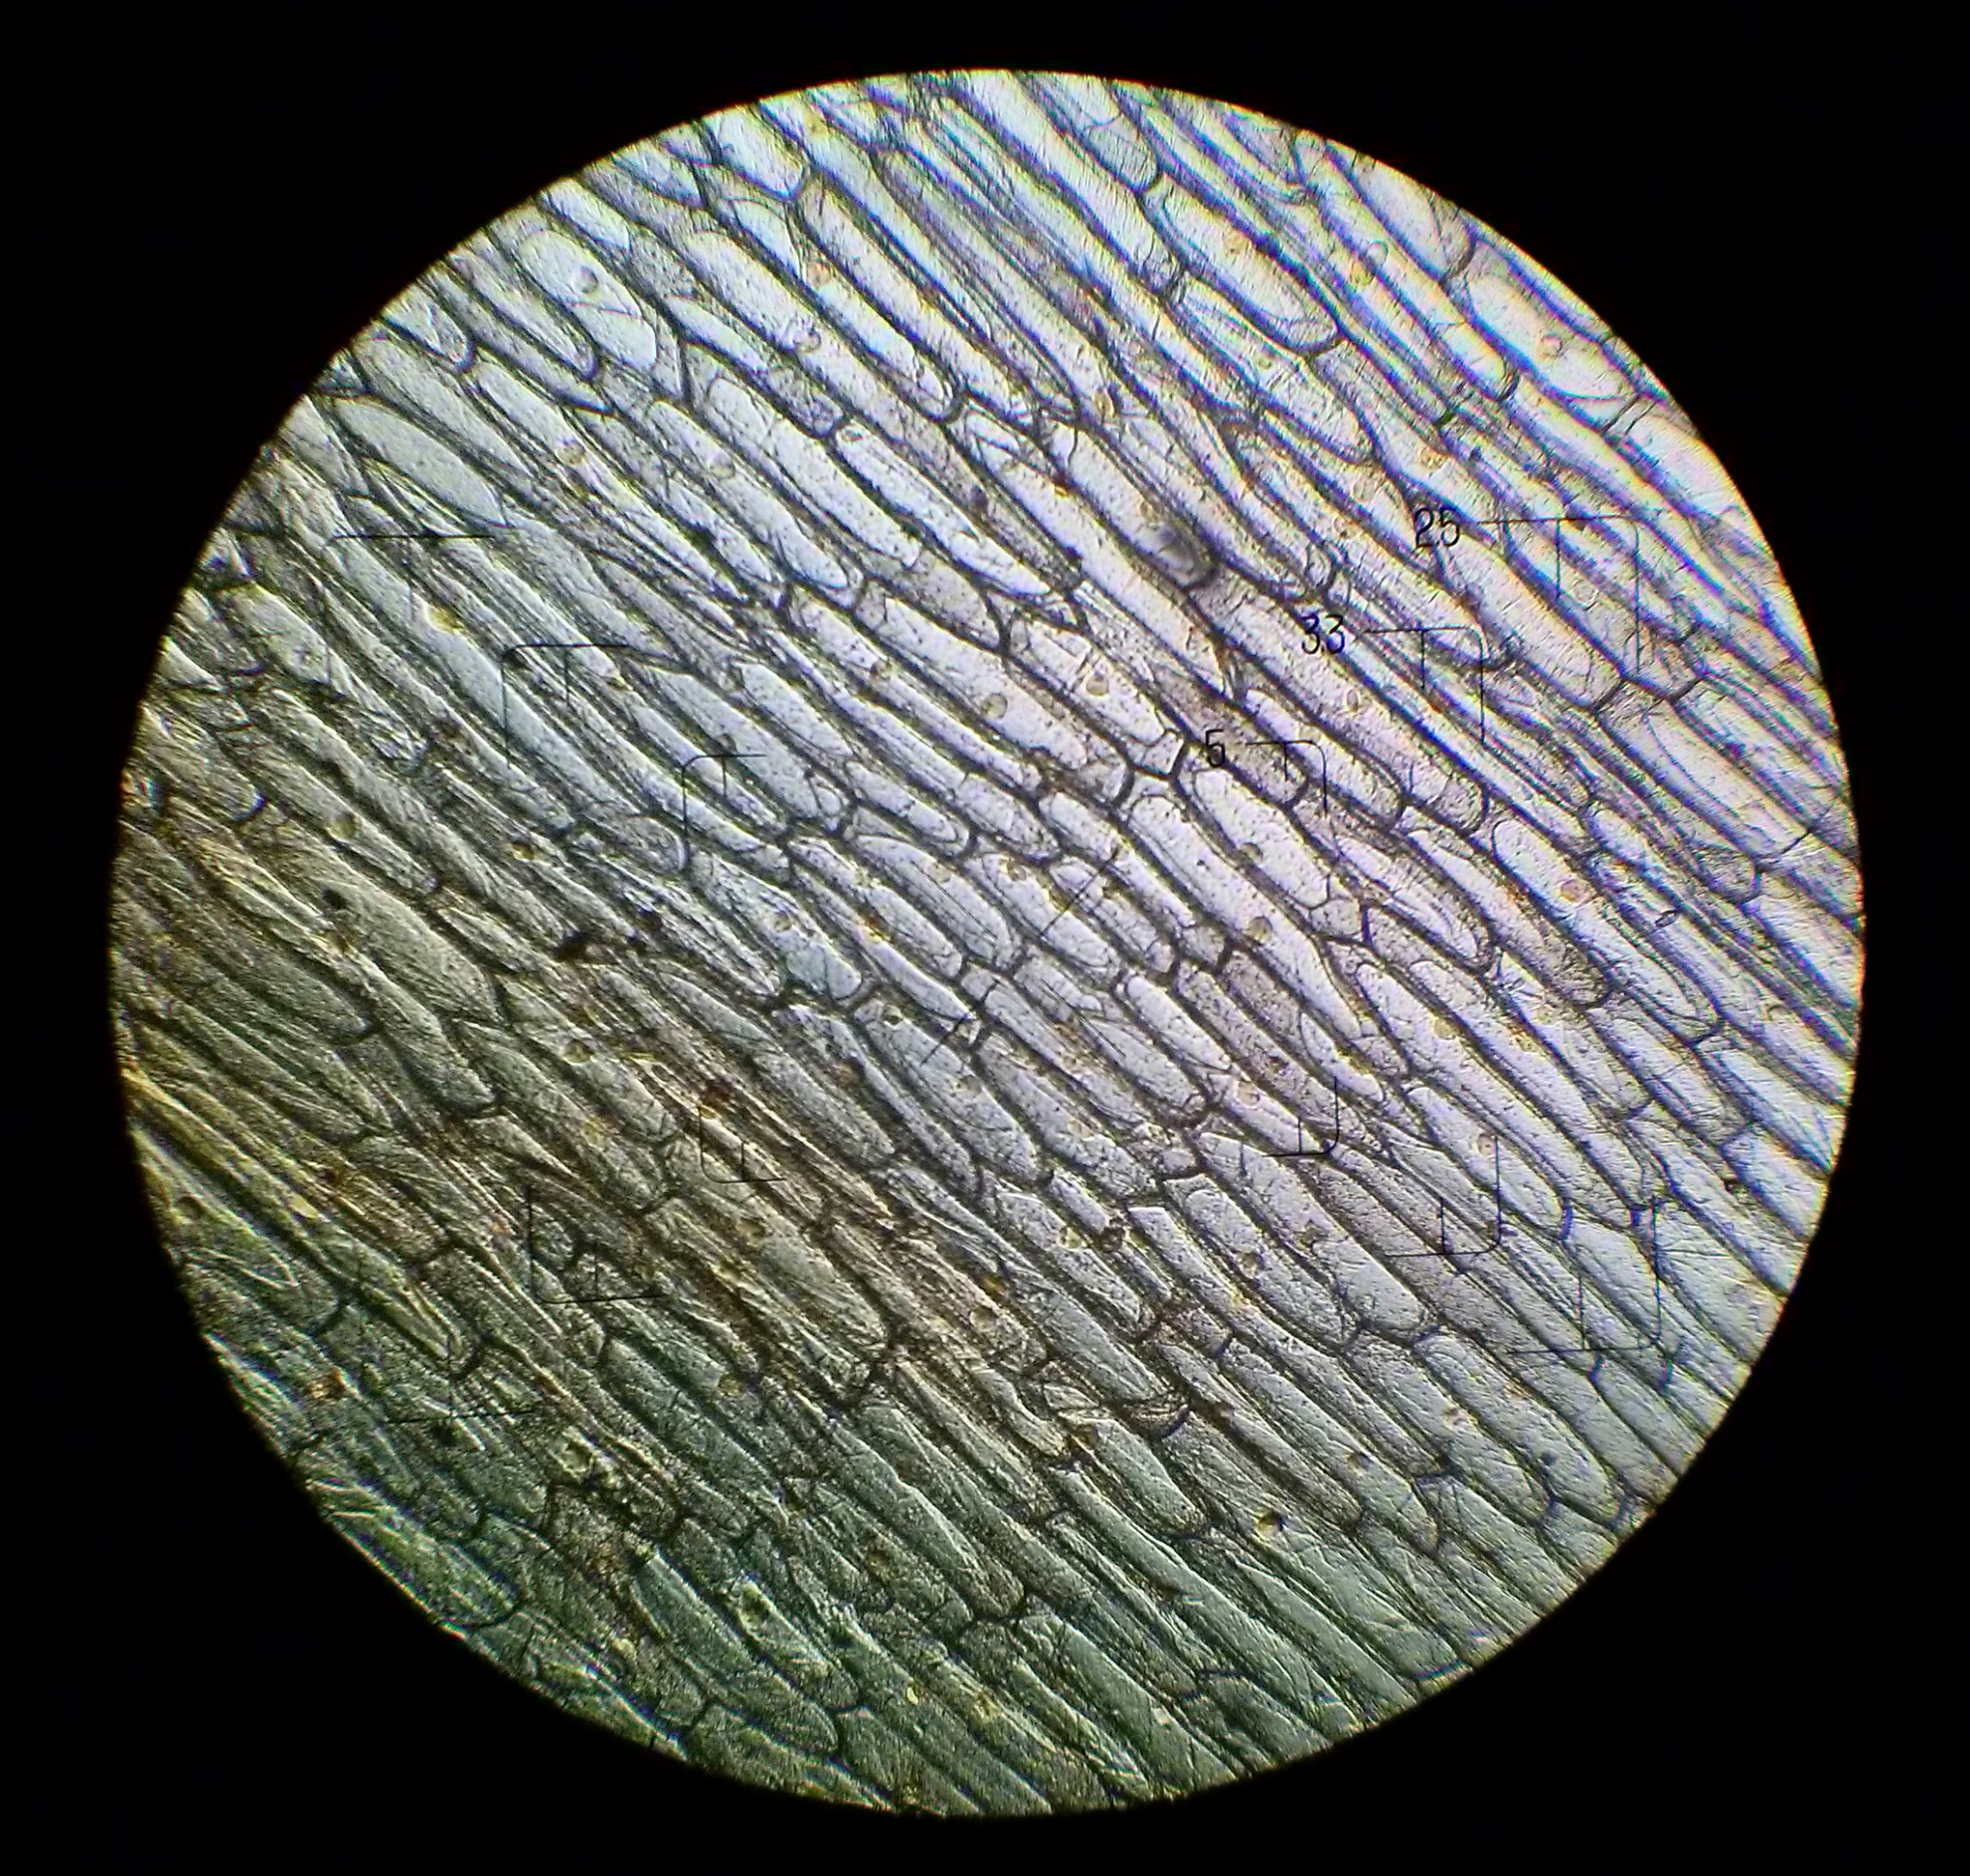
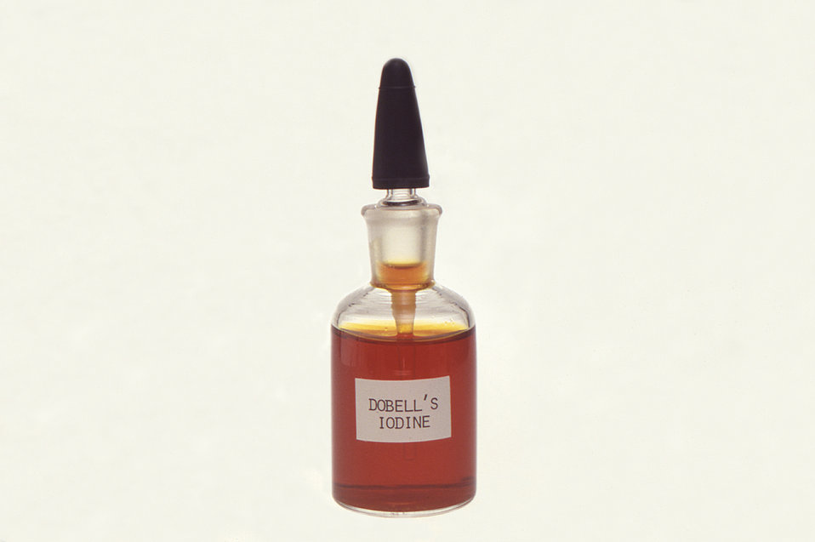
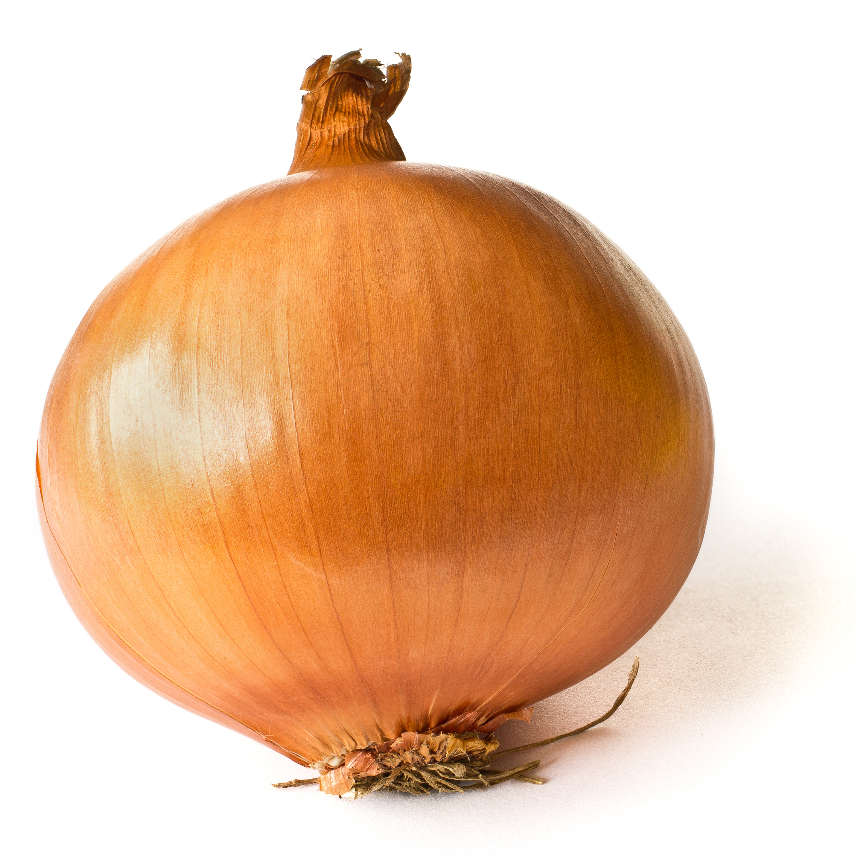
Task - describe how to prepare a slide to view plant cells
Looking at animal and plant cells with a microscope
Use the images to help you.
Include:
5 steps
Objects seen in the images below

Slide 5
Task - spot the mistakes in the description on how to view cheek cells under the microscope
Method of preparing a cheek slide:
Take a dirty cotton wool and gently scrape the inside of your nose.
Smear the cotton wool on the centre of the microscope stage for 2 to 3 seconds.
Add a drop of iodine solution and place a coverslip on top, making sure there is no air bubbles and remove any excess with a bath towel
Place the glass slipper onto the mirror on the microscope

Slide 6
Describe how to view the animal/plant cells under the microscope.
Include:
Numbered steps
Each part of the microscope (eyepiece lens, fine focus, coarse focus, stage, mirror, objective lens)
Prepare the ________ and place on the _______.

Slide 7
Calculating magnification
Magnification = image size ÷ actual size
An animal cell in a photograph measures 23 mm across. If the actual size of the cell is 0.020 mm, what is the magnification in the photograph?
A bacteria cell in a photograph measures 36 mm across. If the actual size of the cell is 0.018 mm, what is the magnification in the photograph?
A euglena is 0.034 mm in length, but under the microscope the image of the euglena appears to be 26mm long. What is the magnification?
Notes:
Go through the first example with them, give pause time to come up with the answer

Slide 8
Magnification
4. The nucleus in a photograph of a cell measures 3 mm across. If the magnification in the photograph is × 500, what is the actual size of the nucleus?
Values
Equation
Substitute
Rearrange
Answer
Unit

Slide 9
Magnification
5. You are looking at onion cells under a microscope and want to know how big the cells really are. You measure the size of the cells as it appears and find out that is measures 20mm with a magnification of x1000. Work out the actual size of the cell.
Values
Equation
Substitute
Rearrange
Answer
Unit

Slide 10
Magnification
6. What is the image size of a virus head, in the actual size is 6.8mm and it has been magnified x2500?
Values
Equation
Substitute
Rearrange
Answer
Unit

Slide 11
Magnification
7. A butterfly wing measured 10cm in length and was magnified x 10. Calculate the image size of the butterfly wing.
Values
Equation
Substitute
Rearrange
Answer
Unit

Slide 12
Magnification
7. A root hair cell measured 102 micrometres in length and was magnified x 20. Calculate the image size of the root hair cell.
Values
Equation
Substitute
Rearrange
Answer
Unit

Slide 13
Extension magnification questions
Calculate the magnification of a euglena cell if the image size is 10 millimeters and actual size is 0.001 centimeters.
Calculate the image size of a red blood cell if actual size is 2.3cm and is magnified x15.
Calculate the actual size of a flea if the image measures 3.43 cm and is magnified x20.
Calculate the magnification of a bee if the image is 6.77 millimeters and actual size is 3.4 micrometers.
Calculate the actual size of a skin cell if the image size is 67.7 micrometers and is magnified x 10.

Slide 14
References
Slide [2, 4] -[Outlined image of microscope] - [public domain] - [publicdomainvectors]
Slide [4] - [Public Health Image Library] - [Dr. Mae Melvin] - [publicdomainlibrary]
Slide [4] - [Microscope glass] - [Szőcs TamásTamasflex] - [Wikimedia Commons]
Slide [4] - [An onion on a white background] - [Colin] - [Wikimedia Commons]
Slide [4] - [Onion cells through the light microscope] - [Kateryna Kot] - [wikimedia commons]

