Slide 1
German
Describing a school day [1 / 3]
Telling the time
Herr Jones

Slide 2
v
vor
Steve Clarke / Rachel Hawkes

Slide 3
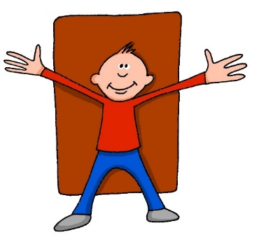
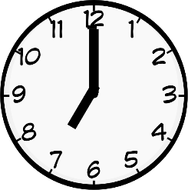
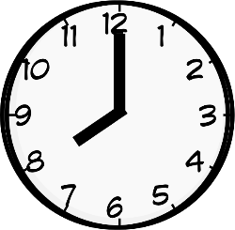
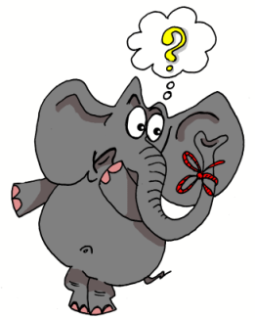
v
positiv
voll
vor
bevor
Vater
vergessen
Rachel Hawkes

Slide 4
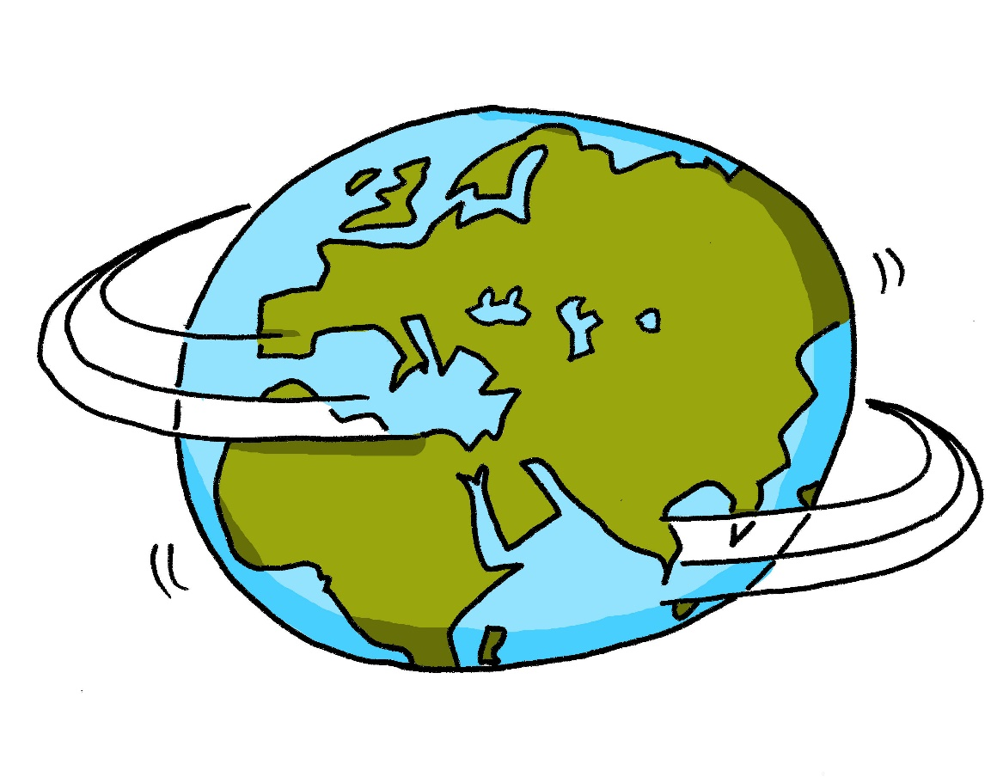
w
Welt
Steve Clarke / Rachel Hawkes

Slide 5
w
Wasser
wahr
Welt
Was?
gewinnen
antworten
Rachel Hawkes

Slide 6
der Stundenplan | timetable
die Stunde | lesson, hour
der Unterricht | lessons, curriculum
das Fach | subject
die Pause | break
die Mittagspause | lunch break

Slide 7
On the hour
To say “at” a certain time, you need to use “um”.
um neun Uhr
at nine o’clock
um fünfzehn Uhr
at three o’clock (in the afternoon)
um Mittag
at midday
Germans use both the 12- and 24-hour clock

Slide 8
“To” and “past”
You could also say um acht Uhr fünfzig.
vor - to (literally “before”)
nach - past (literally “after”)
um zehn vor neun
at 08:50 / at 20:50
um zwanzig nach vier
at 04:20 / at 16:20
You could also say um vier Uhr zwanzig.

Slide 9
“Quarter” and “half”
Viertel - quarter
halb - half
Be careful! Germans say “half way to”.
um Viertel vor neun
at quarter to nine
um Viertel nach vier
at quarter past four
um halb neun
at half past eight / at 08:30
You could also say um acht Uhr dreißig.

Slide 10
Telling the time:
To say “at” a certain time you use ………..
The German word for “quarter” is ……………...
“Half past eight” - …………………………..
The word vor means ………….. and nach means …………..
um
Viertel
halb sieben
to
past

