Slide 1
Reading and writing the time to half past
Mathematics
Mrs Bramble and Miss Sidhu

Slide 2
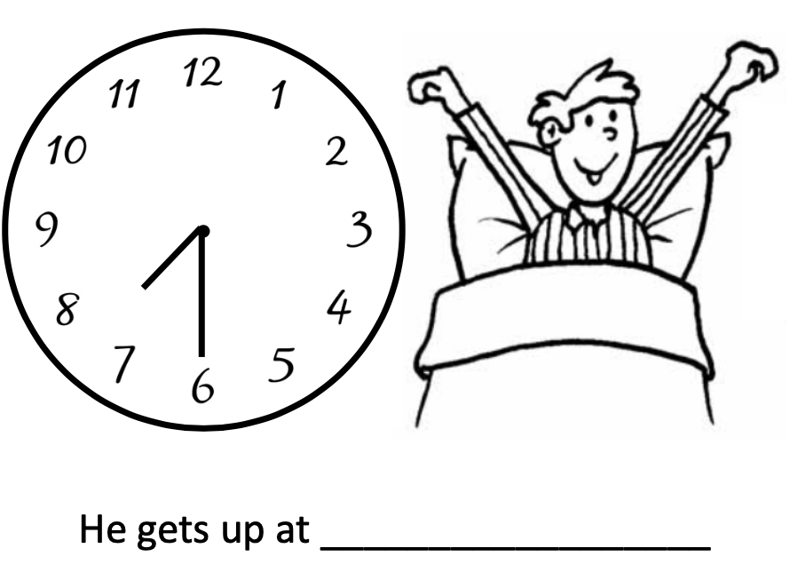
Notes:
For your task, you need to write the time on the line that each clock face is showing. All the times are half past times.

Slide 3
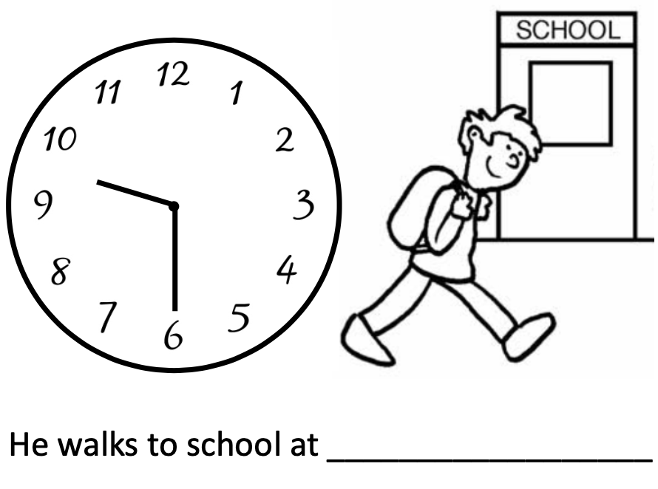
Notes:
For your task, you need to write the time on the line that each clock face is showing. All the times are half past times.

Slide 4
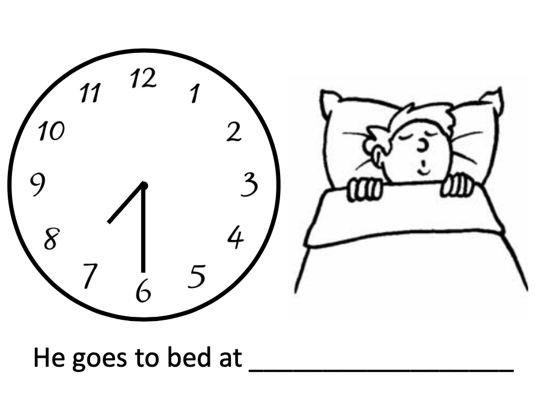
Notes:
For your task, you need to write the time on the line that each clock face is showing. All the times are half past times.

