Slide 1
Who is Louis Pasteur?
Science
Miss Simkin

Slide 2
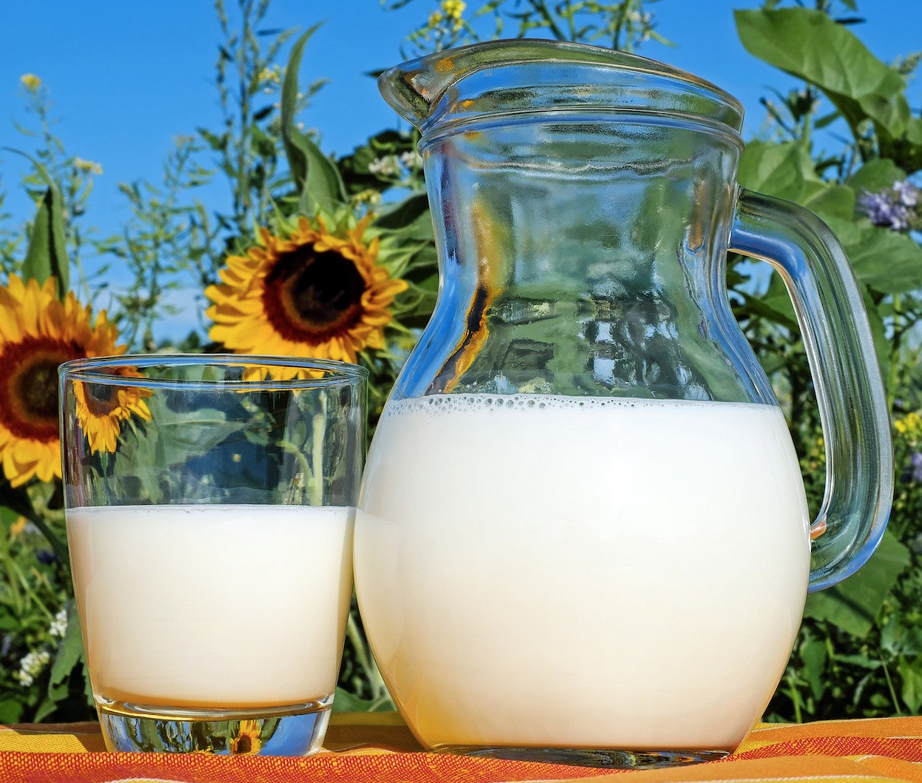
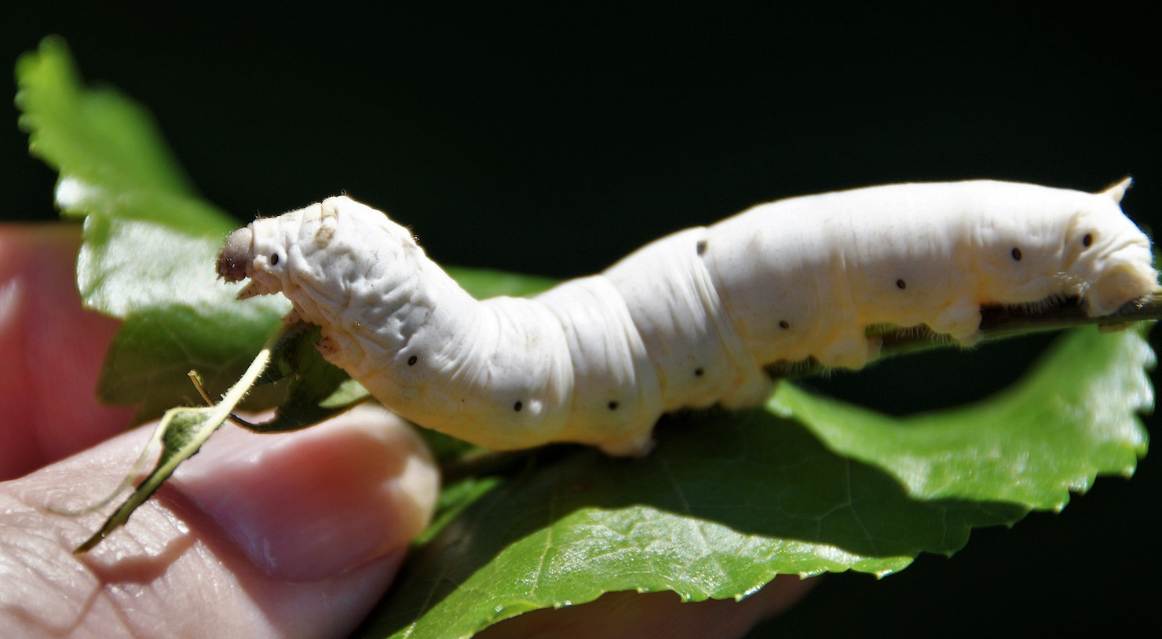
Match the picture to the achievement
1) Created vaccines for 5 diseases.
2) Saved the silk industry!
3) Invented pasteurisation.
💉
Image from Pixabay.
Image from Pixabay.

Slide 3
Write a conclusion and draw a picture of your results:
I found that______________________________________________________.
Dry bread: Damp bread:

