Slide 1
Find missing angles around a point and on a straight line
Maths
Mr Clasper

Slide 2
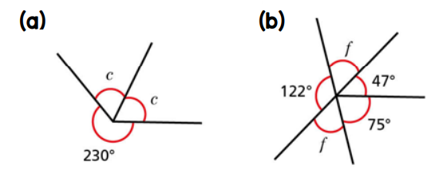
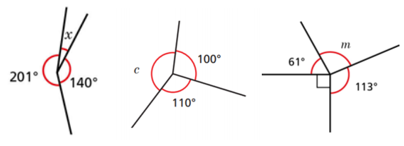
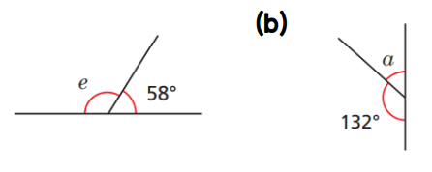
Find missing angles around a point and on a straight line
1. Calculate the missing angles.
2. Calculate the missing angles.
3. Calculate the missing angles.
310°
220°
47°
122°
73°
75°
230°
100°
61°
58°
210°
140°
110°
113°
132°

Slide 3
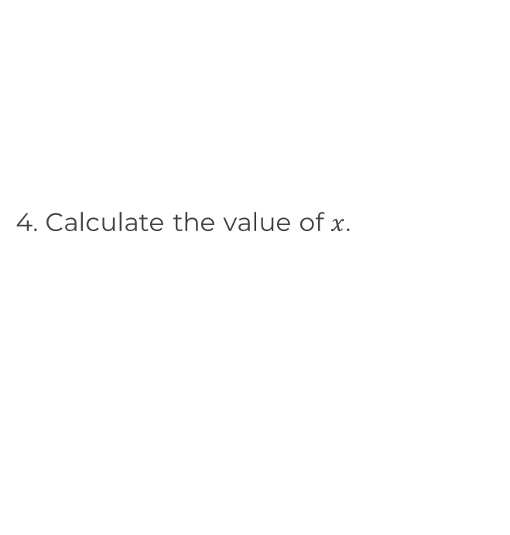
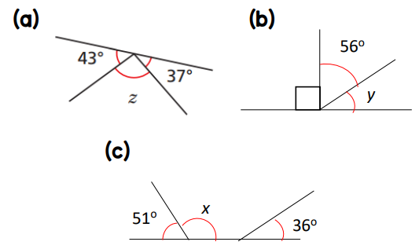
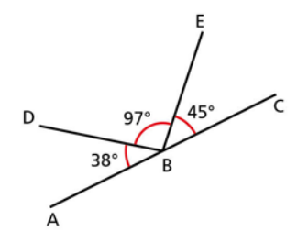
Find missing angles around a point and on a straight line
5. Each diagram contains two straight lines. Calculate the missing angles.
6. Is ABC a straight line? How do you know?
43°
56°
37°
56°
110°
70°
E
51°
36°
45°
C
51°
36°
D
97°
38°
B
A

Slide 4
Answers

Slide 5
Find missing angles around a point and on a straight line
1. Calculate the missing angles.
2. Calculate the missing angles.
3. Calculate the missing angles.
310°
220°
47°
122°
73°
75°
230°
m=96⁰
100°
61°
58°
210°
140°
110°
113°
132°

Slide 6
Find missing angles around a point and on a straight line
5. Each diagram contains two straight lines. Calculate the missing angles.
6. Is ABC a straight line? How do you know?
43°
56°
37°
56°
110°
70°
E
51°
36°
45°
C
51°
36°
D
97°
38°
The angles have a sum of 180° therefore ABC is a straight line
B
A

