Slide 1
Describing a region [2 / 5]
Position and agreement of adjectives
French
Monsieur Lowe

Slide 2
Phonétique

Slide 3
[SFC]
c r f l
Be c a r e f u l with these!

Slide 4
[SFC]
dans
X

Slide 5
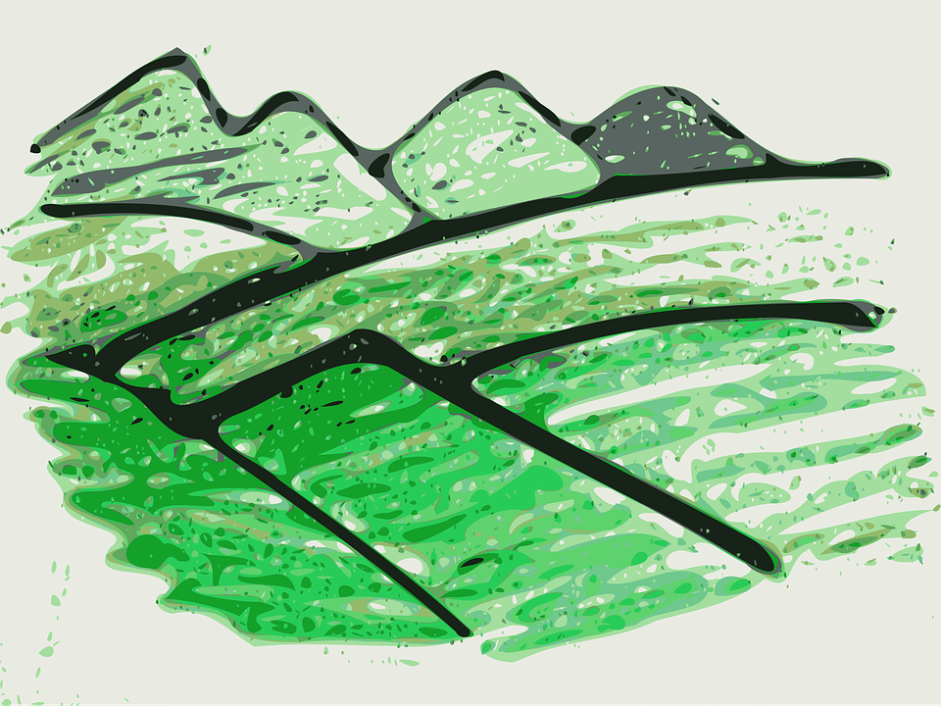
[SFC]
collines
fermes
champs

Slide 6
les collines | hills
les fermes | farms
les champs | fields
la côte | coast
la frontière | border
la vue | view
la rivière | river
la mer | sea
la plage | beach

Slide 7
Grammaire Position and agreement
of adjectives

Slide 8
Adjectives
DESCRIBE nouns
Shopping
Before the noun
After the noun
grand =
big
small
beautiful
old
new
vert =
green
historic
industrial
picturesque
interesting
petit =
historique =
beau =
industriel =
vieux =
pittoresque =
nouveau =
intéressant =
BAGS → Beauty, Age, Goodness, Size

Slide 9
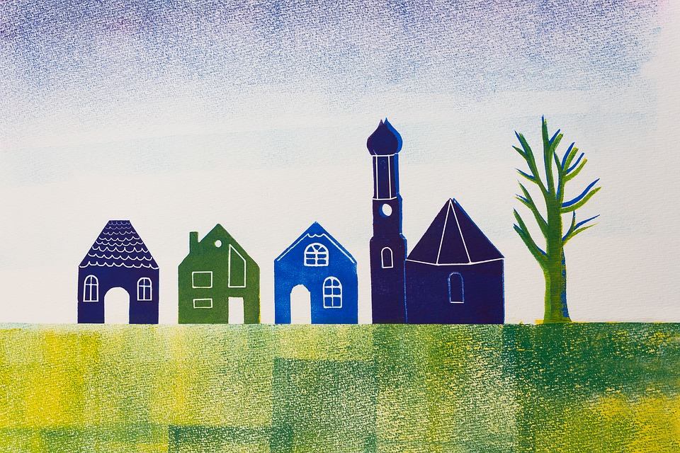
Regular Adjectives
Adjectives agree with the gender of noun they are describing
un petit village
= a little village
une petite ville
= a little town
deux petits villages
= 2 little villages
deux petites villes
= 2 little towns

Slide 10
Regular Adjectives
Adjectives agree with the gender of noun they are describing
un village calme
= a calm village
une ville calme
= a calm town
deux villages calmes
= 2 calm villages
deux villes calmes
= 2 little towns

Slide 11
Regular Adjectives
Adjectives agree with the gender of noun they are describing
Add an ‘e’ to the end of the adjective to describe a feminine noun.
un petit village
= a little village
une petite ville
= a little town
If the adjective already ends in an ‘e’ it stays the same.
Add an ‘s’ to the end of the adjective to describe a plural noun.
deux petits villages
= 2 little villages
deux petites villes
= 2 little towns

Slide 12
Adjectives
DESCRIBE nouns
Masculine Singular
Feminine Singular
Masculine Plural
Feminine Plural
vert
verte
historique
pittoresque
intéressante
industrielle
verts
vertes
historiques
pittoresques
intéressantes
industrielles
historique
historiques
pittoresque
pittoresques
intéressant
intéressants
industriel
industriels
All of these adjectives go after the noun. Dans ma ville, il y a une vue pittoresque

Slide 13
Describing a region
BAGS means
Beau (adj.) comes =
Historique (adj.) comes =
A beautiful village =
Green fields =
Historic hills =
Beauty, Age, Goodness and Size
Before the noun
After the noun
Un beau village
Des champs verts
Des collines historiques

