Slide 1
Numbers Within 10:
Counting Up To Nine Objects Reliably
Mathematics
Lesson 4 of 10
Miss. Molnar

Slide 2
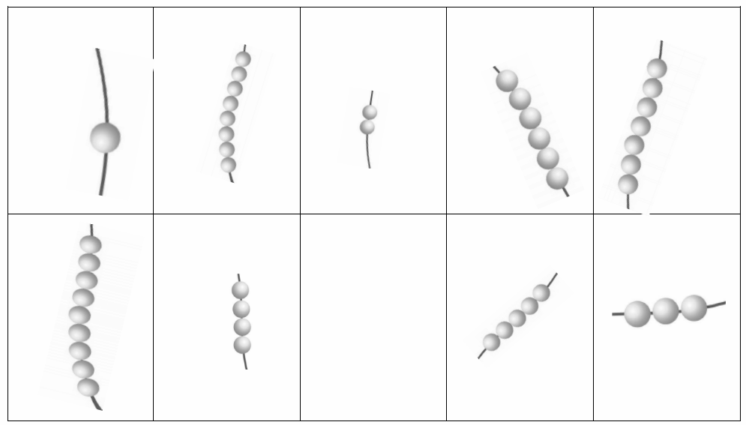
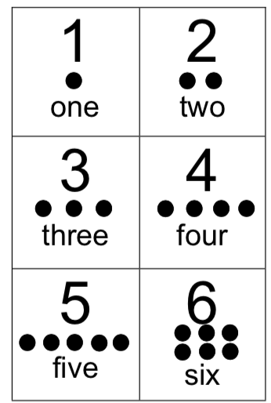
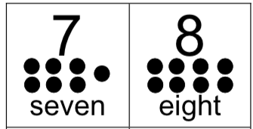
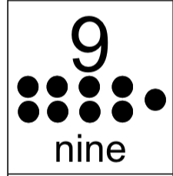
Can you represent the number and match it to the picture?

