Slide 1
Participating in your community [1/1]
Indirect object pronouns
French
Madame Williams
Madame Williams

Slide 2
[ i ]
[ eu ]
midi
deux
lui
leur

Slide 3
écrire à (qqn) | to write to (someone)
parler à (qqn) | to write to (someone)
rendre visite à (qqn) | to visit (someone)
offrir un cadeau à (qqn) | to give a present to (someone)
envoyer ….. à (qqn) | to send …. to (someone)
J’écris à mon ami

Slide 4
écrire à (qqn) | to write to (someone)
parler à (qqn) | to write to (someone)
rendre visite à (qqn) | to visit (someone)
offrir un cadeau à (qqn) | to give a present to (someone)
envoyer ….. à (qqn) | to send …. to (someone)
Je parle à ma mère

Slide 5
écrire à (qqn) | to write to (someone)
parler à (qqn) | to write to (someone)
rendre visite à (qqn) | to visit (someone)
offrir un cadeau à (qqn) | to give a present to (someone)
envoyer ….. à (qqn) | to send …. to (someone)
Je rends visite à mes grands-parents

Slide 6
écrire à (qqn) | to write to (someone)
parler à (qqn) | to write to (someone)
rendre visite à (qqn) | to visit (someone)
offrir un cadeau à (qqn) | to give a present to (someone)
envoyer ….. à (qqn) | to send …. to (someone)
J’offre un cadeau à ma soeur

Slide 7
écrire à (qqn) | to write to (someone)
parler à (qqn) | to write to (someone)
rendre visite à (qqn) | to visit (someone)
offrir un cadeau à (qqn) | to give a present to (someone)
envoyer ….. à (qqn) | to send …. to (someone)
5
4
3
2
1
J'envoie un message à mon mari

Slide 8
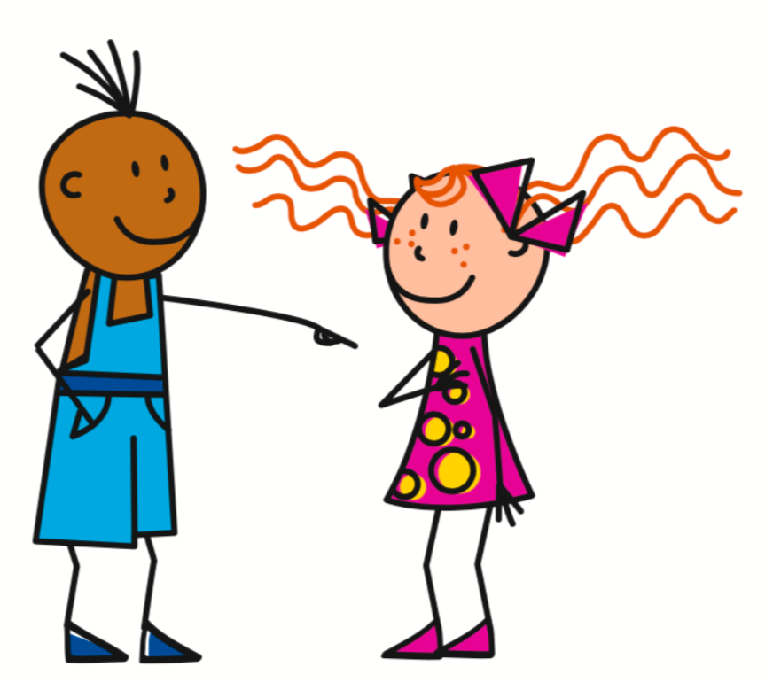
Indirect object pronouns
We use indirect object pronouns with verbs which are followed by the preposition à
Indirect object pronouns replace the preposition and the noun in a sentence.
Je lui écris = I write to him / her
me or m’ = (to) me
te or t’ = (to) you
lui = (to) him or her
nous = (to) us
vous = (to) you (plural)
leur = (to) them

Slide 9
Participating in the community
Which preposition comes after the verbs écrire, parler and rendre visite?
2. What does this preposition mean?
3. Which IOP* replaces ‘to him / to her’?
4. Which IOP* replaces ‘to them’?
5. Where are IOPs* placed in a sentence?
à
to
lui
leur
Between the subject and the conjugated verb
*IOP = Indirect object pronoun

