Slide 1
A night out with friends [1 / 3]
Using the perfect tense with on
French
Monsieur Lowe

Slide 2
Phonétique

Slide 3
[ on ]
non

Slide 4
[ on ]
onze
au fond
[at the back]
monde

Slide 5
on a regardé | we watched, have watched
on a pris | we took, have taken
on a vu | we saw, have seen
on a mangé | we ate, have eaten
on a bu | we drank, have drunk
hier | yesterday
la semaine | week
le mois | month
dernier | last

Slide 6
Grammaire Using on in the perfect tense

Slide 7
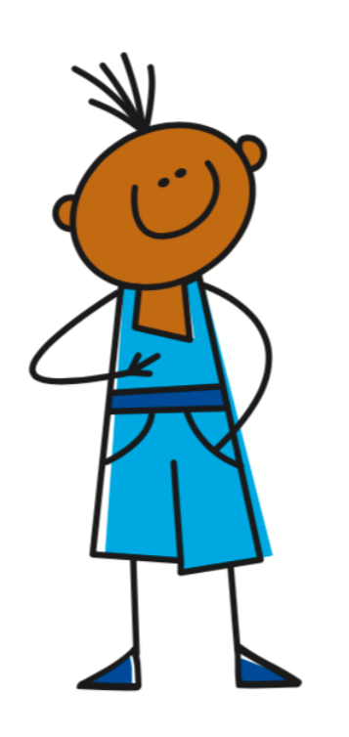
The perfect tense - a completed action in the past
I watched / I have watched
We watched / we have watched
J’
ai
regardé
On
a
regardé
I ate / I have eaten
We ate / we have eaten
J’
ai
mangé
On
a
mangé

Slide 8
The Perfect Tense - The Auxiliary
1. | I drank = | J’___ bu
2. | We ate = | On ___ mangé
3. | I saw = | J’___ vu
4. | We took = | On ___ pris
5. | I watched = | J’___ regardé
ai
a
ai
a
ai

Slide 9
The perfect tense
1. The Subject Pronoun
2. The Auxiliary Verb
(Avoir - Present Tense)
3. Past Participle
Je/J’ | ai | mangER - mangé
 |  | FinIR - fini
 |  | vendRE - vendu
On | a | Irregular Past Participles, e.g. vu - saw, pris - taken, bu - drank
= I
= We

Slide 10
Negatives in the perfect tense
A positive sentence
A negative sentence
On a pris le bus = We took the bus
On n’a pas pris le bus = We did not take the bus
Note - ne changes to n’ when used before a vowel.
E.g. On n’aime pas

Slide 11
A night out with friends
The perfect tense refers to a completed action in the...
2. To form it we need a pronoun, the auxiliary verb and a...
3. On means ...
4. Negatives go around the … verb
5. Avoir is an .... verb
6. We took =
past
past participle
you, we
auxiliary
auxiliary
on a pris

