Slide 1
The four colour map theorem A long-standing mathematical problem
Downloadable resource
Mathematics
Miss Kidd-Rossiter

Slide 2
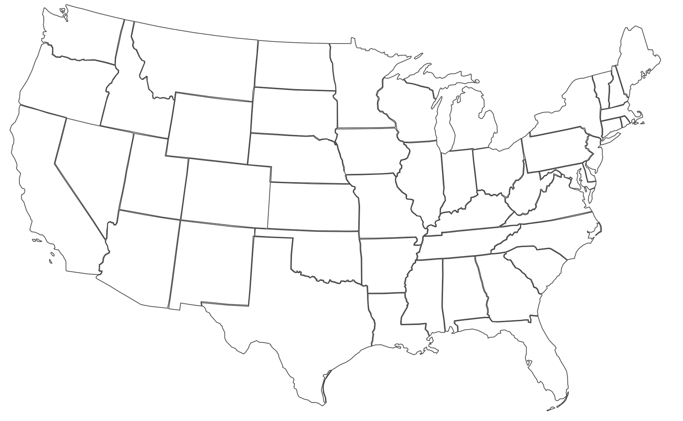
Binh is colouring this map of the United States. She applies the below condition.
No bordering states can have the same colour.
Binh
What is the minimum amount of colours Binh needs to use?
Can you find another map?
How many colours are needed to colour countries/states, etc. here?
Credit: wikimedia commons

Slide 3
To prove this, you need to :
show that all maps in existence only need four or less colours, or;
find one map that needs five or more colours.

Slide 5
Draw a network to show Country A bordering:
No other countries;
Two other countries;
Three other countries;
Four other countries;
Five other countries.
Draw a network to represent a map of Great Britain and Northern Ireland.
What is the most complex (possible) network that you can come up that could represent a map?

Slide 6
Antoni is thinking about the four colour map theorem.
All maps can make a network. Therefore, all networks could make a map.
Antoni
Do you agree with Antoni?
Can you find some examples that either show or don’t show this to be true?

