Slide 1
Calculating duration of time in hours and minutes
Mathematics
Miss Sabzvari

Slide 2
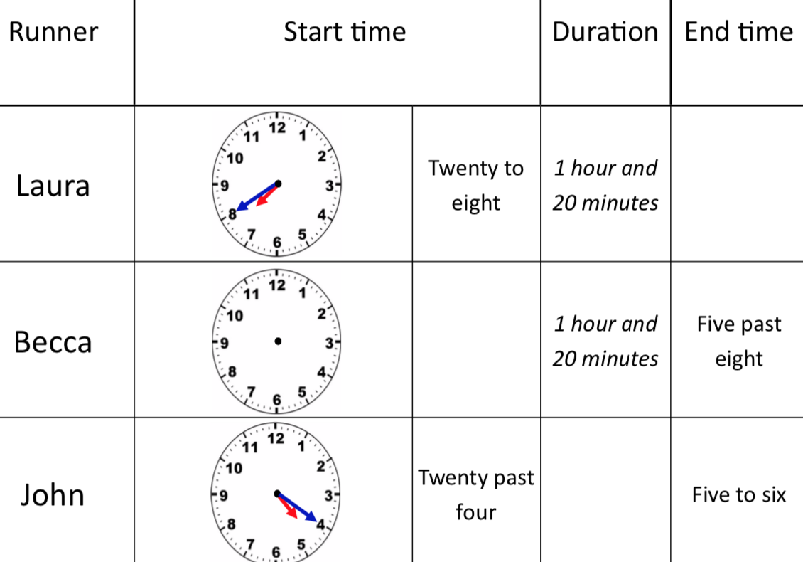
Independent Task
-Fill in the missing values on the race table.
-Use your clocks to calculate the answers.
-Draw the minute and hour hands on the clocks.

