Slide 1
Comparing sets using ‘more’ or ‘fewer’
Mathematics
Mrs Bramble and Miss Sidhu

Slide 2
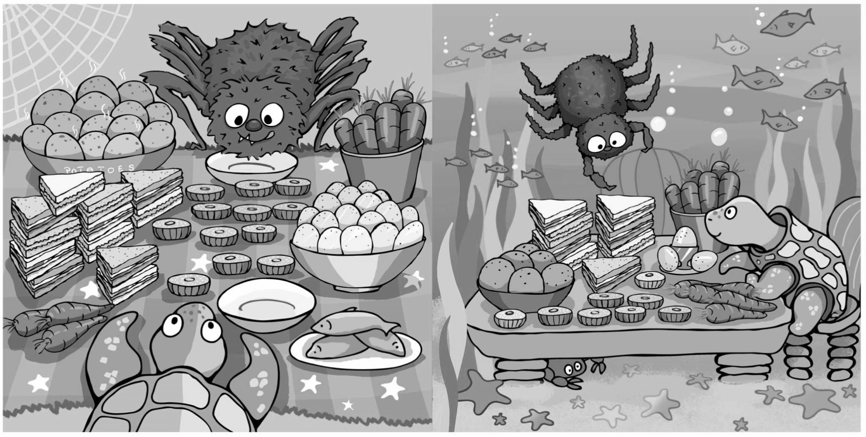
Independent Task
Find out how many carrots and sandwiches Spidey and Turtle have?

Slide 3
Independent Task
Who has more sandwiches?
Who has fewer carrots?

Slide 4
Answers
Spidey has 12 sandwiches and Turtle has 8 sandwiches.

Slide 5
Answers
Turtle has fewer sandwiches than Spidey. Spidey has more sandwiches than Turtle.
Spidey has 4 more sandwiches than Turtle.
Turtle has 4 fewer sandwiches than Spidey.

Slide 6
Answers
Spidey has 9 carrots and Turtle has 11 carrots.

Slide 7
Answers
Turtle has more carrots than Spidey.
Spidey has fewer carrots than Turtle.
Turtle has 3 more carrots than Spidey.
Spidey has 3 fewer carrots than Turtle.

