Slide 1
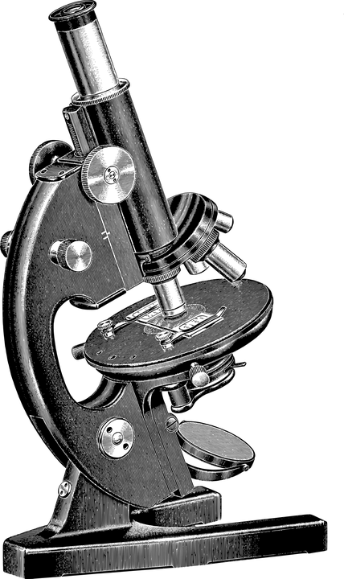
Microscopes
Task 1: Labelling the parts of a microscope
Label the photograph of a microscope using the key terms below.
coarse lens
light source
fine focus
stage clips
stage
arm
eyepiece lens
objective lenses
Task 2: Describing how to use a microscope
a) The method for using a microscope has been mixed up. Number the steps to put the method into the correct order. One and two have been done for you.
1 | Place the slide on the stage.
2 | Adjust the light source if necessary.
 | Move the stage clips down to hold the slide in place.
 | Turn the focus wheels to make the image clear.
 | Look down the eyepiece.
 | Rotate the objective lenses to select the one with the lowest magnification.
b) Name the type of image produced when using a microscope.
Science Microscopes

Slide 2
Task 3: Calculating magnification
a) Which two values are multiplied together to calculate the total magnification of a microscope?
b) Describe where the magnification values can be found on the microscope.
c) Calculate the total magnification power of a microscope with an eyepiece magnification of x10 and an objective lens magnification of x20.
Science Microscopes

Slide 3
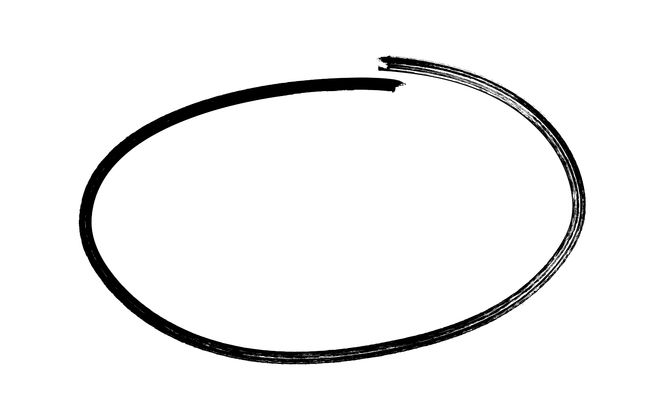
Microscopes
Answers
Task 1: Labelling the parts of a microscope
Label the photograph of a microscope using the key terms below.
coarse focus
eyepiece lens
fine focus
objective lenses
arm
stage
stage clips
light source
coarse lens
light source
fine focus
stage clips
stage
arm
eyepiece lens
objective lenses
Task 2: Describing how to use a microscope
a) The method for using a microscope has been mixed up. Number the steps to put the method into the correct order. One and two have been done for you.
1 | Place the slide on the stage.
2 | Adjust the light source if necessary.
 | Move the stage clips down to hold the slide in place.
 | Turn the focus wheels to make the image clear.
 | Look down the eyepiece.
 | Rotate the objective lenses to select the one with the lowest magnification.
3
6
5
4
b) Name the type of image produced when using a microscope.
a micrograph
Science Microscopes

Slide 4
Answers
Task 3: Calculating magnification
a) Which two values are multiplied together to calculate the total magnification of a microscope?
eyepiece lens magnification and objective lens magnification
b) Describe where the magnification values can be found on the microscope.
The values are written on the eyepiece and the objective lenses.
c) Calculate the total magnification power of a microscope with an eyepiece magnification of x10 and an objective lens magnification of x20.
X 200
Science Microscopes

