Slide 1
Subtracting 3-digit numbers (regrouping in multiple columns)
Independent Task
Mathematics
Miss Brinkworth

Slide 2
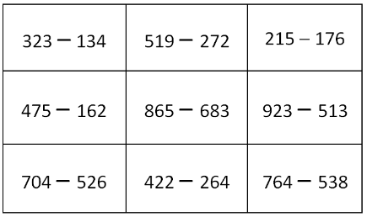
Part A (Not all need column subtraction so look carefully)
Notes:
6 or bigger

Slide 3
Part B -
What do you think might be the best way to answer this calculation?
Can you spot the mistake here?
 |  | 2 | 1 | 5
 | - | 1 | 2 | 6
 |  | 1 | 8 | 9
Notes:
Bigger than 6 (ist box q1)

