Slide 1
What is a population pyramid?
Geography
Population
Mr Hutchinson

Slide 2
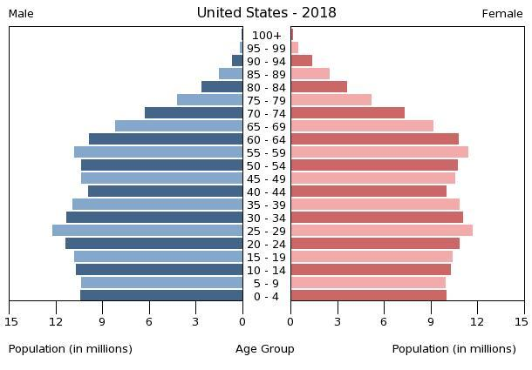
Age | Number of females
100+ | 0.1m
95-99 | 0.5m
90-94 | 1.5m
85-89 | 2
80-84 | 4m
75-79 | 5m
Complete the population pyramid using the data from the table.
CIA Factbook / Public domain

