Slide 1
Constructing a Line Graph
Worksheet
Mr Ward

Slide 2
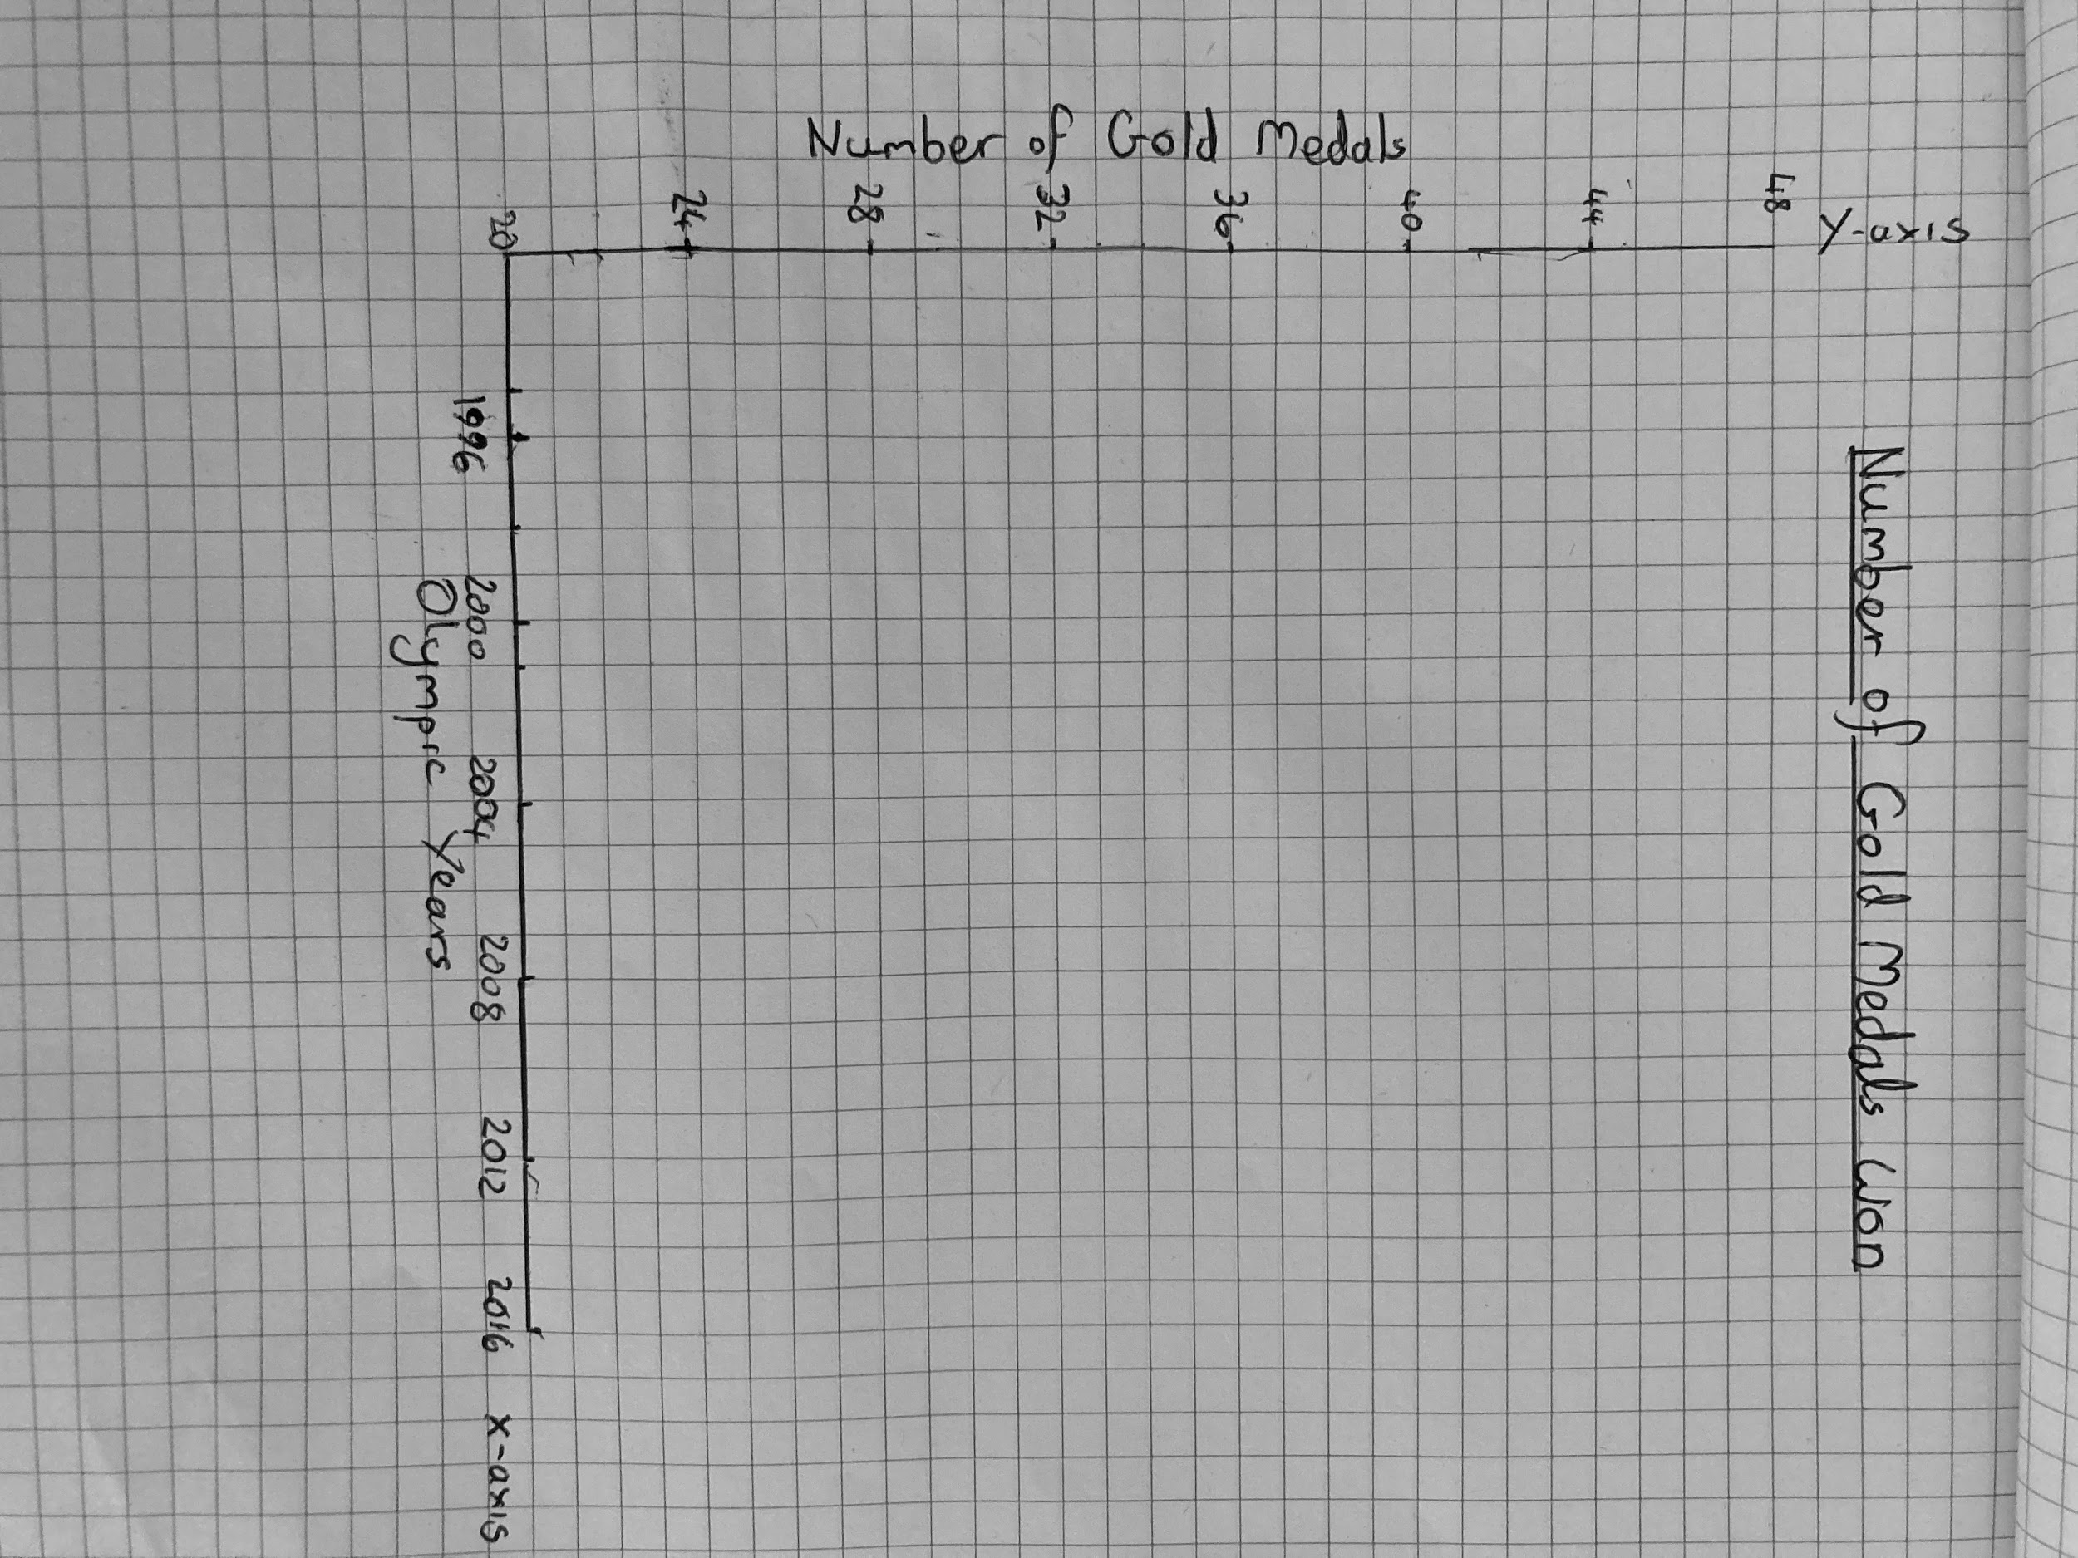
Step 1
Constructing a line graph

Slide 3
Step 2
Plot the points!

Slide 4
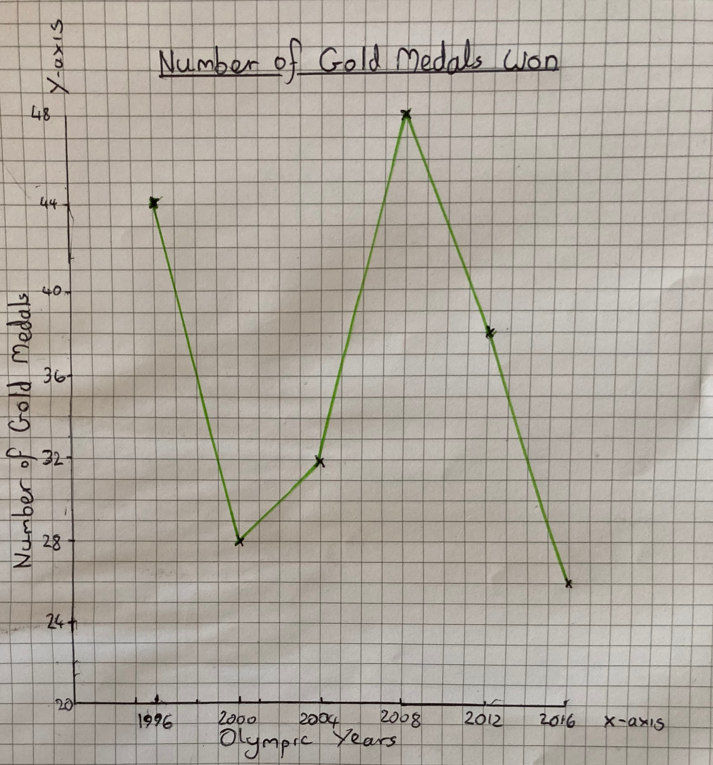
Step 3
What questions can we ask?
What statements can we make?

Slide 5
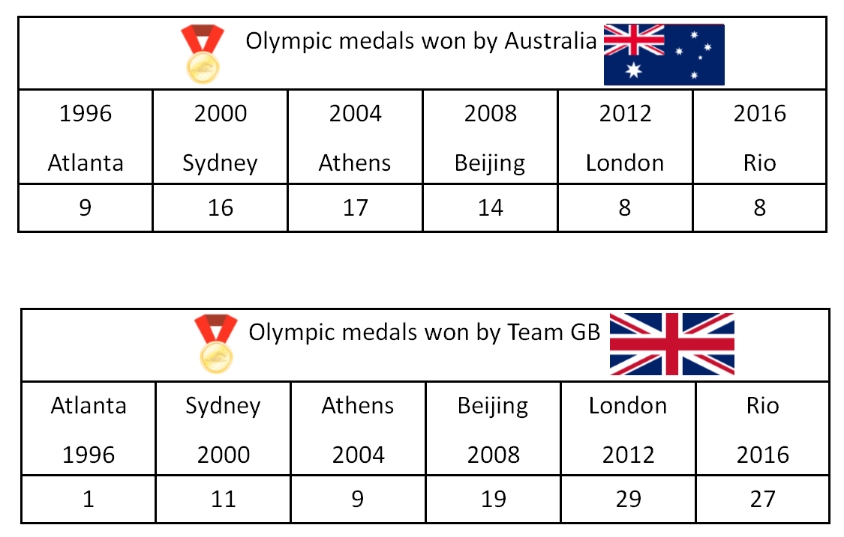
Construct a line graph with all required features.
Present the data on your line graph from both tables below
Create four factual sentences which compare both sets of data

Slide 7
Challenge Slide
Don’t forget to pause the video if you want to have a go!
How many Gold Medals did both countries win altogether?
What was the range of gold medals for both countries?
Which year was the most successful and least successful for both countries combined?

