Slide 1
Describe what people have [2 / 2]
Definite articles
Subject pronoun ‘it’
French
Madame Sooden
Notes:
Take the title for the lesson from the context column of the SOL. Take the grammar focus from the grammar column. Show full green screen to start with and then bring in your face in the top right hand corner.
E.g. Hola. Soy [Doctora Hawkes] ¿Cómo estás? In this lesson we [practise the present tense with some regular verbs so we can talk about what people do]. I hope you are in a quiet space without distractions, and have a pen and paper to hand.

Slide 2
[ ç / c ]
français
garçon
cinéma

Slide 3
[ i ]
ici
qui ?
il

Slide 4
[ eu ]
un peu
jeu
[a little]
lieux
[place]

Slide 5
Vocabulary list for this lesson:
la fille | girl
le garçon | boy
la femme | woman
l’homme | man
l’ami | friend
le médecin | doctor
le professeur | teacher
intéressant | interesting
drôle | funny
sympa | nice
5
4
3
2
1

Slide 6
Definite articles
 | Masculine | Feminine
Definite the | le | la
Indefinite a | un | une

Slide 7
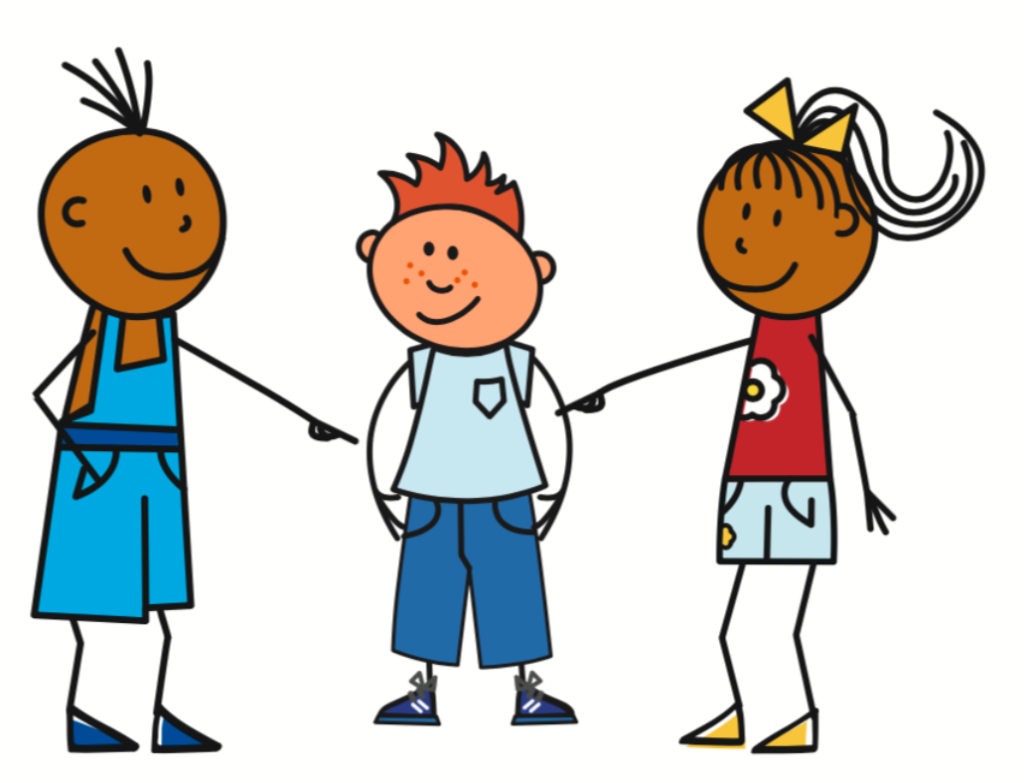
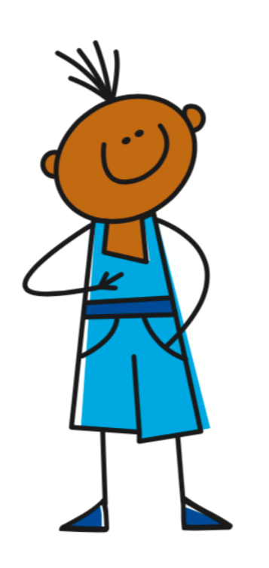
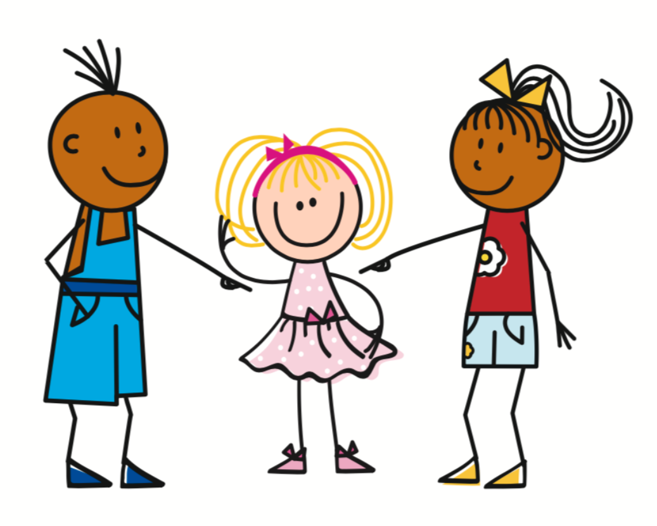
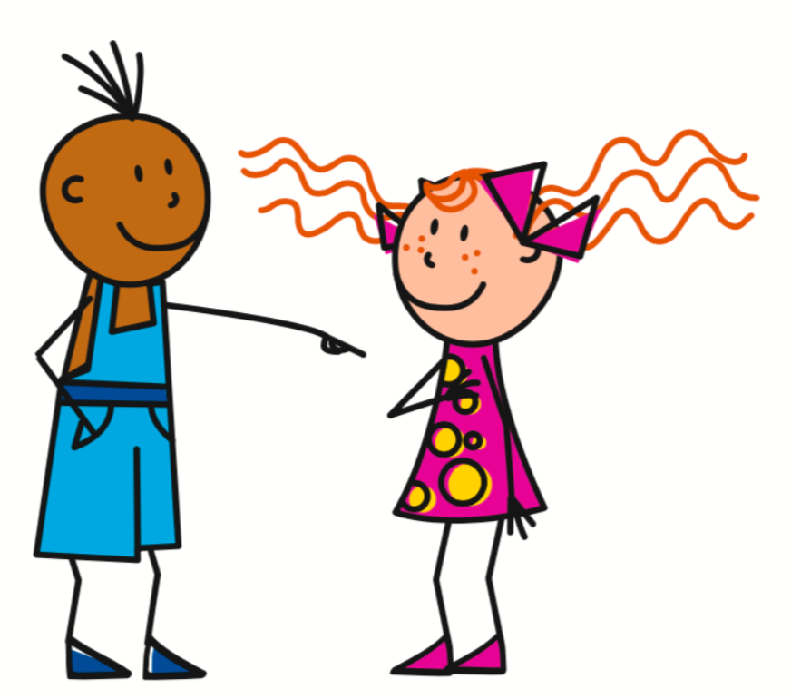
Present Tense - Irregular verbs
To conjugate être into the present tense, you must memorise the irregular pattern.
Être - To be
Il est - He is
Elle est - She is
Je suis - I am
Tu es - You are
On est - You are

Slide 8
It is (masculine), it is (feminine)
Être - To be
Il est
= It is
Elle est
= It is
3rd person singular (pronoun + irregular verb)
3rd person singular (pronoun + irregular verb)

Slide 9
Describe what people have
1 | Name a masculine definite article
2 | Which definite article goes before a vowel?
3 | Name two ways of saying ‘it’ in French.
4 | Which of these ways is feminine?
5 | Translate ‘it is nice’ (m) into French.
6 | Translate ‘it is funny’ (f) into French.
le
l’
il / elle
elle
il est sympa
elle est drôle

