Slide 1
To add a 1-digit number to a teens number using a known fact
Mathematics
Miss Charlton

Slide 2
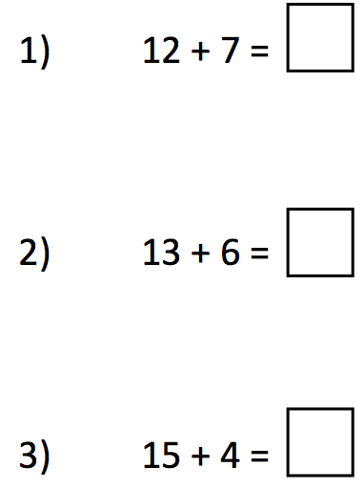
Independent task
Which number bond would help you solve each equation?
6 + 3
5 + 4
7 + 2
‹#›

Slide 3
Answers
Which number bond would help you solve each equation?
6 + 3
5 + 4
7 + 2
19
19
19
‹#›

