Slide 1
What are everyday materials made from?
Worksheet
Science
Miss Couves

Slide 2
Match the words to their definitions
Transparent Opaque Brittle Malleable High Melting point Poor conductor |  | A material that you cannot see through A substance that needs a lot of energy to melt A material that does not let heat pass through easily A material that can be bent into shape A material that you can see through A material that breaks easily

Slide 3
Properties of glass, ceramics and plastics
Draw this table into your notes.
Material | Glass | Ceramics | Plastic
Description
Properties
Uses

Slide 4
Properties of materials
Glass
Large structure made from silicon and oxygen particles
Properties:
Transparent
Brittle
High melting point
Poor conductor
Uses:
Windows
Bottles
Jars

Slide 5
Properties of materials
Ceramics
Large structure made from metal oxide particles
Properties:
Opaque
Brittle
High melting point
Poor conductor
Uses:
Building materials
Pots

Slide 6
Properties of materials
Plastic
Large structure made up of repeating units
Properties:
Malleable
Low melting point
Poor conductors
Uses:
Clothes
Plastic bags

Slide 7
Properties of materials
Give one property of glass.
Why do you think the properties of glass make it good for making windows?
Give one property of ceramics
Why do you think the properties of ceramics make it good for making oven dishes?
Give one property of plastics.
Why do you think the properties of plastics make it good for making plastic bottles?

Slide 8
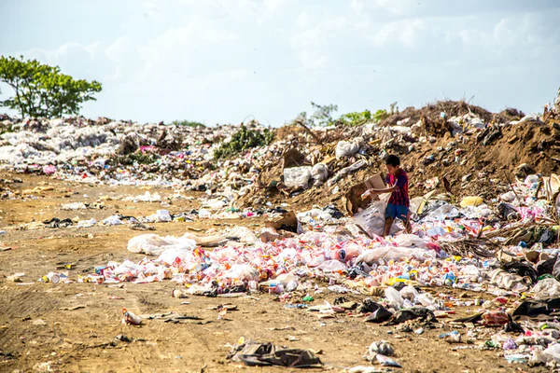
The problem with synthetic materials
Landfill sites
When materials are thrown away they end up in landfill sites.
Synthetic materials take a long time to break down
Plastic bag: 10-20 years
Plastic bottle: 450 years!
Problems with landfill:
Don’t look very nice
Produce harmful toxins
Produce harmful pollutants
Credit: Image from unsplash

Slide 9
The problem with synthetic materials
Landfill sites
What happens to materials when they are thrown away?
What are the problems associated with landfill sites?
What could we do with these materials instead?
Credit: Image from unsplash

