Slide 1
Using arrays to represent the 3 and 4 times table
Mathematics
Miss Brinkworth

Slide 2
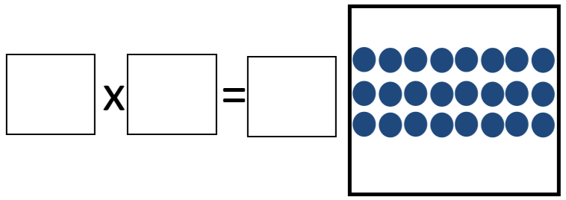
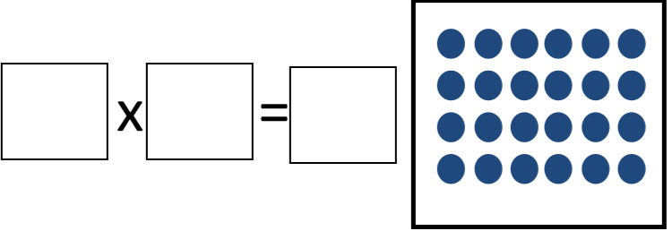
Part A
1.
2.
3.

Slide 3
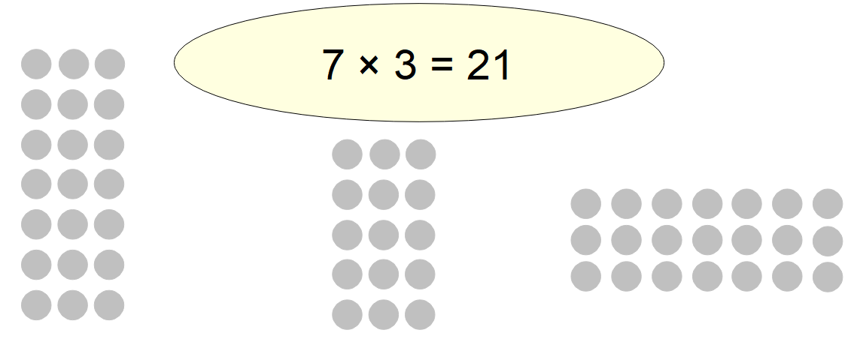
Part B
1.
2. Which array does not show this calculation?

