Slide 1
Occupational Therapy
Visual Perception:
Form Constancy
Aniesa Blore

Slide 2
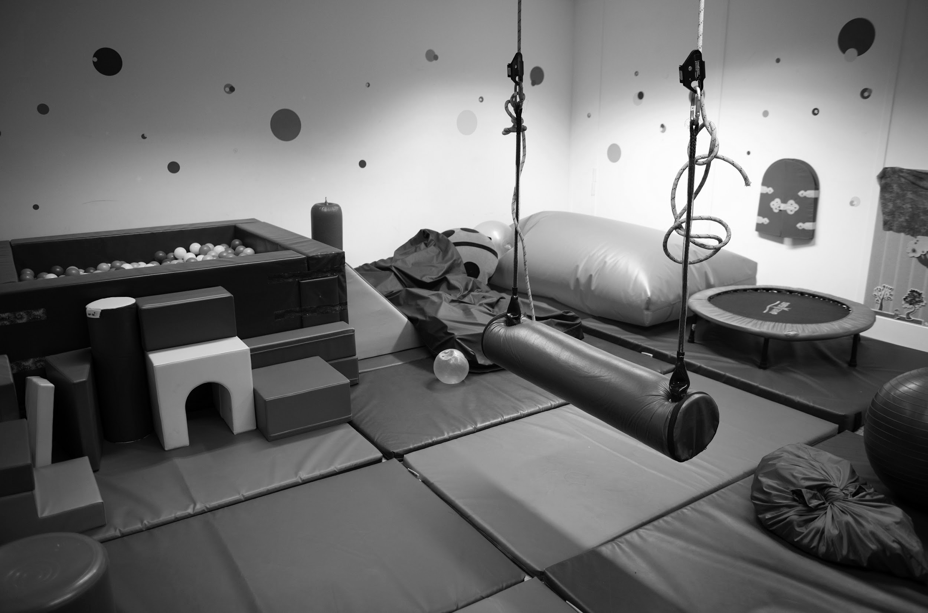
Find circles and rectangles

Slide 3
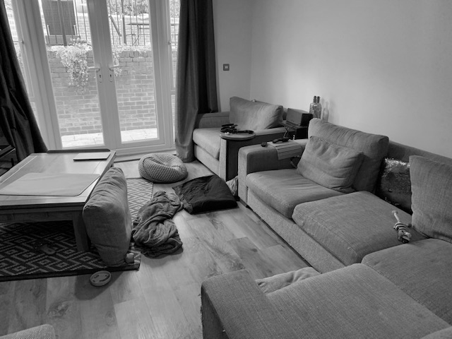
Find circles, squares and rectangles

Slide 4
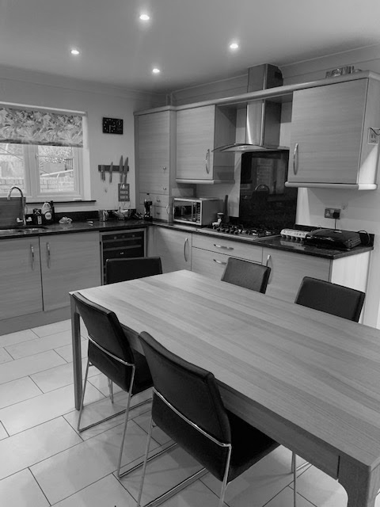
Find circles and rectangles
When the picture is not so busy it is easier to find things.

Slide 5
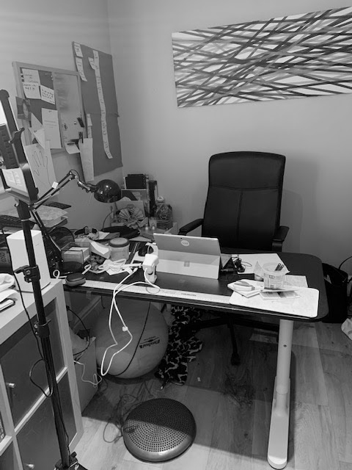
Find circles and rectangles
When the picture is not so busy it is easier.
Look how messy my desk is!

