Slide 1
Specific heat capacity - required practical - worksheet
Combined science - Physics - Key stage 4 - Energy
Dr Fishwick

Slide 2
In lesson questions

Slide 3
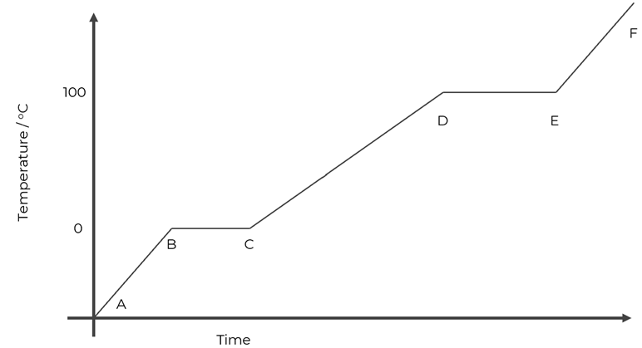
Pause the video to complete your task
Sketch this graph and identify which sections are related to the heat capacity of the material.
Explain why it is not possible to identify directly the specific heat capacity from this graph.
(hint - think about which quantity is missing)
Temperature / ºC
Energy transferred / J
Resume once you’re finished

Slide 4
Step | Reason
Measure and record the mass of the block in kg. | To be used to calculate specific heat capacity
Place the heater in the larger hole in the block. Use the pipette to put a small amount of water in the other hole. Put the thermometer in this hole. | To allow for temperature to be measured
Connect the ammeter, power pack and heater in series. Connect the voltmeter across the heater in parallel
Set the power pack to 12 V. Switch on the power pack to turn on the heater. Record the ammeter and voltmeter readings.
Record temperature on the thermometer and start the stopwatch
Record temperature every 60 s for 10 minutes

Slide 5
Design a method
Write a method to investigate the specific heat capacity of water.
Pour ………. Of water into a …………………………
Record the …………………..
Place a thermometer and heater ……..
Record ……..
Turn on heater and ………
……
……
…..
…..
Independent variable
Dependent variable
Reducing uncertainty - which is the biggest losses
What will go on the graph?
How do you need to use the graph?

Slide 6
Data analysis
Material | Energy transferred in Joules | Mass of block in kg | Temperature change in ºC | Specific heat capacity in J/kg ºC
Copper | 3 400 | 1.10 | 8
Aluminium | 14 490 | 1.05 | 15
Iron | 4 218 | 0.95 | 10
Energy change = mass ⨉ specific heat capacity ⨉ change in temperature
Notes:
Live model for copper,
From a very similar experiment to that you’ve seen in this lesson the following sets of data were found from their graphs.
Calculate the specific heat capacity for each of the three materials. If you’re confident, pause and go ahead, if not I’ll show you how to do the first one.
students to calculate for Aluminium.

Slide 7
Conclusions
Type of metal block | Density in g/cm³
Copper | 8.96
Aluminium | 2.70
Iron | 7.87
Material | Specific heat capacity in J/kg ºC
Copper | 390
Aluminium | 920
Iron | 444
Hypothesis: Denser materials have a higher specific heat capacity.
Use the data to say whether this is true.
The data shows that…….
Explain your reasoning.
The specific heat capacity for aluminium is…. And the density is…. This compares to …….
Notes:
Here are the results from our experiment, and the densities of the metals. It is suggested that there is a link between density and specific heat capacity. The questions below will allow you to draw a conclusion about the data.

Slide 8
Answers

Slide 9
Review
Sections A-B, C-D and E-F are related to heat capacity.
This graph will only identify the heat capacity of the material, because it does not indicate the mass. The total energy transferred will depend upon the mass.
Temperature / ºC
Energy transferred / J

Slide 10
Step | Reason
Measure and record the mass of the block in kg. | To be used to calculate specific heat capacity
Place the heater in the larger hole in the block. Use the pipette to put a small amount of water in the other hole. Put the thermometer in this hole. | To allow for temperature to be measured
Connect the ammeter, power pack and heater in series. Connect the voltmeter across the heater in parallel
Set the power pack to 12 V. Switch on the power pack to turn on the heater. Record the ammeter and voltmeter readings.
Record temperature on the thermometer and start the stopwatch
Record temperature every 60 s for 10 minutes
To allow for power to be measured
To transfer energy to the block
Measure temperature and allow for energy transferred to be calculated
Notes:
Let’s look through each of these answers

Slide 11
Design a method
Write a method to investigate the specific heat capacity of water.
Pour 250 cm³ Of water into a beaker and wrap it in insulation
Record the mass of the water
Place a thermometer and heater into the beaker
Record temperature of the water using the thermometer
Turn on heater and record the power of the heater using P = I V.
Record the temperature every 60 s for 10 minutes.
Plot a graph of energy transferred against temperature
Use the straight line section to find the gradient.
Specific heat capacity = 1/(gradient x mass). Use this to calculate specific heat capacity

Slide 12
Data analysis
Material | Energy transferred in Joules | Mass of block in kg | Temperature change in ºC | Specific heat capacity in J/kg ºC
Copper | 3 400 | 1.10 | 8 | 390
Aluminium | 14 490 | 1.05 | 15 | 920
Iron | 4 218 | 0.95 | 10 | 444
Energy change = mass ⨉ specific heat capacity ⨉ change in temperature
Notes:
Live model for copper,
From a very similar experiment to that you’ve seen in this lesson the following sets of data were found from their graphs.
Calculate the specific heat capacity for each of the three materials. If you’re confident, pause and go ahead, if not I’ll show you how to do the first one.
students to calculate for Aluminium.

Slide 13
Review
Hypothesis: Denser materials have a higher specific heat capacity.
Use the data to say whether this is true.
The data shows that the more dense materials do not always have a higher specific heat capacity
Explain your reasoning.
The specific heat capacity for aluminium is 920 J/kg ºC And the density is 2.70 g/cm³ . This compares to Copper (or Iron) which has 390 J/kg ºC (444 J/kg ºC) and density of 8.96 g/cm³ (7.87 g/cm³).
Notes:
Here are the results from our experiment, and the densities of the metals. It is suggested that there is a link between density and specific heat capacity. The questions below will allow you to draw a conclusion about the data.

