Slide 1
Independent Living Unit 5 - World of Work
Oak Specialist
Applying Learning

Slide 2
Unit 5- World of Work
Lesson 1 - The benefits of work
Lesson 2 - Different types of work
Why do we work? This lesson explores what’s good about getting a job.
Not all jobs are the same. This lesson looks at understanding what a job family is and the different types of tasks that can be done.
Option 3
Lesson 4 - Routes into employment
Lesson 3 - Vocational profiling
Option 4
What is a vocational profile and how can it help you?
What are the different ways to get a job. Which route is right for you?
Lesson 5 - Getting a job
Lesson 6 - Workplace behaviour
Option 3
Option 4
Where should you look for jobs? Understanding Interviews and reasonable adjustments
How is work different to school or college? What rules are the same and what ones are different?
Notes:
Depending on how many lessons for each unit, there could be a 2nd page for lesson 5…etc

Slide 3
Lesson 5 - Getting a job

Slide 4
Teacher notes- Lesson 5
-Learning intention:
To know and understand where to find employment and the process involved
To understand that we all require support at certain times and to know who how and where to ask for help
Where to find jobs
Sharing your needs and reasonable adjustments
Interview help
Resources needed:
Pen, Paper, old magazines, scissors or computer/printer

Slide 5
Lesson Activity Stages
This lesson will be taught in 3 parts:
Where to find jobs
Sharing your needs and getting support
Help with interviews
Notes:
Share with the student the purpose of the lesson and the things you will be doing together

Slide 6
Part 1: Where to find jobs
There are many different ways businesses let people know of jobs that are available and lots of ways we can find jobs.
With your teaching partner see how many different ways to find a job you can think of and write these down.
Can you think of at least three ways of finding a job?
On the next slide there is a list of possible ways we can find jobs. How many did you get? Did you come up with any not on the list?
Notes:
Teaching point: Encourage student to think of different ways they can find jobs. Share with them how you or someone they know got a job. Give them an example such as the local newspaper to get them started.

Slide 7
Where to find jobs
How many did you get? Did you come up with any not on the list?
Newspaper - Job section
Social media - sponsored post or informal request
Jobcentre
Recruitment agency
Follow on employment opportunity after a work placement, supported internship or apprenticeship
Ask - approaching a business directly
Asked - a business approaches you
Family friend
Start your own job - self employment
Notes:
Teaching point: There will be some things in this list that they might not know about. Take time to explain what a ‘recruitment agency’ is and what some of the benefits and disadvantages of each method are. E.g. Will do the research for you, but you have to pay for the service.

Slide 8
Part 2: Sharing your needs and finding support
Everyone needs help at sometime. Getting a job and keeping a job can be hard work so it’s important to plan for what help we think we might need and where we can find support.
Look back at the work you did in lesson 3 - vocational profiling
You have already started thinking about what things you may need help with.
For example:
“I get nervous when talking to new people”
“I need instructions broken down for me”
“I use pictures to help understand a task”
Notes:
Teaching point: The student might be nervous about sharing their disability or learning difficulty for fear of it negatively impacting on their chances of getting a job. Explain to them that employers MUST NOT disadvantage someone because of their disability. Through discussion explain that an employer won’t know what is wrong or how to help if they don't understand the problem.

Slide 9
Sharing your needs and finding support
Write down the three most important things you might need help with when thinking about getting a job and keeping a job.
1.
2.
3.
Notes:
Use the examples on the previous slide and any responses they gave in their vocational profile to support them in giving their answers.

Slide 10
Sharing your needs and finding support
Look back at the three things that you thought you might need help with. Now write down next to each one where you think you might be able to find support.
Is there a supported employment service in your area?
Is there someone at school, college or a family member that can help?
Do you have access to some technology or visual aid that can help?
Would the employer consider an alternative to an interview as part of their ‘reasonable adjustments’?
Remember to let the employer know your needs!
Notes:
Teaching point: the student may require you to give them examples of how a Job Coach may be able to support them in the workplace. If you are unsure what a Job Coach does, look this up together.

Slide 11
Part 3: Help with interviews
As seen in lesson 4, ‘routes into employment’, there are multiple ways of entering the world of work, however at some point someone will probably ask you to share a bit about yourself, your interests, past experiences and your skills.
These conversations are called an interview. This can be formal, dressing smart and sitting down and talking, or informal, as part of a work trial process.
Notes:
Teaching point: Ask the student how they feel about doing an interview. Have they done one before? How did it go?

Slide 12
During an interview you might be asked...
What do you like to do in your freetime?
Is this your first interview?
Are you nervous?
What type of role are you looking for?
What experience do you have?
Have you done anything like this before?
What is your best quality?
This can be quite overwhelming and when we feel worried we can forget the answers to simple questions such as ‘where did you do work experience?’ or find it hard to say positive things about ourselves like what we are good at doing. So we need help.
Notes:
Teaching point: Ask the student how they feel about doing an interview. Have they done one before? How did it go?

Slide 13
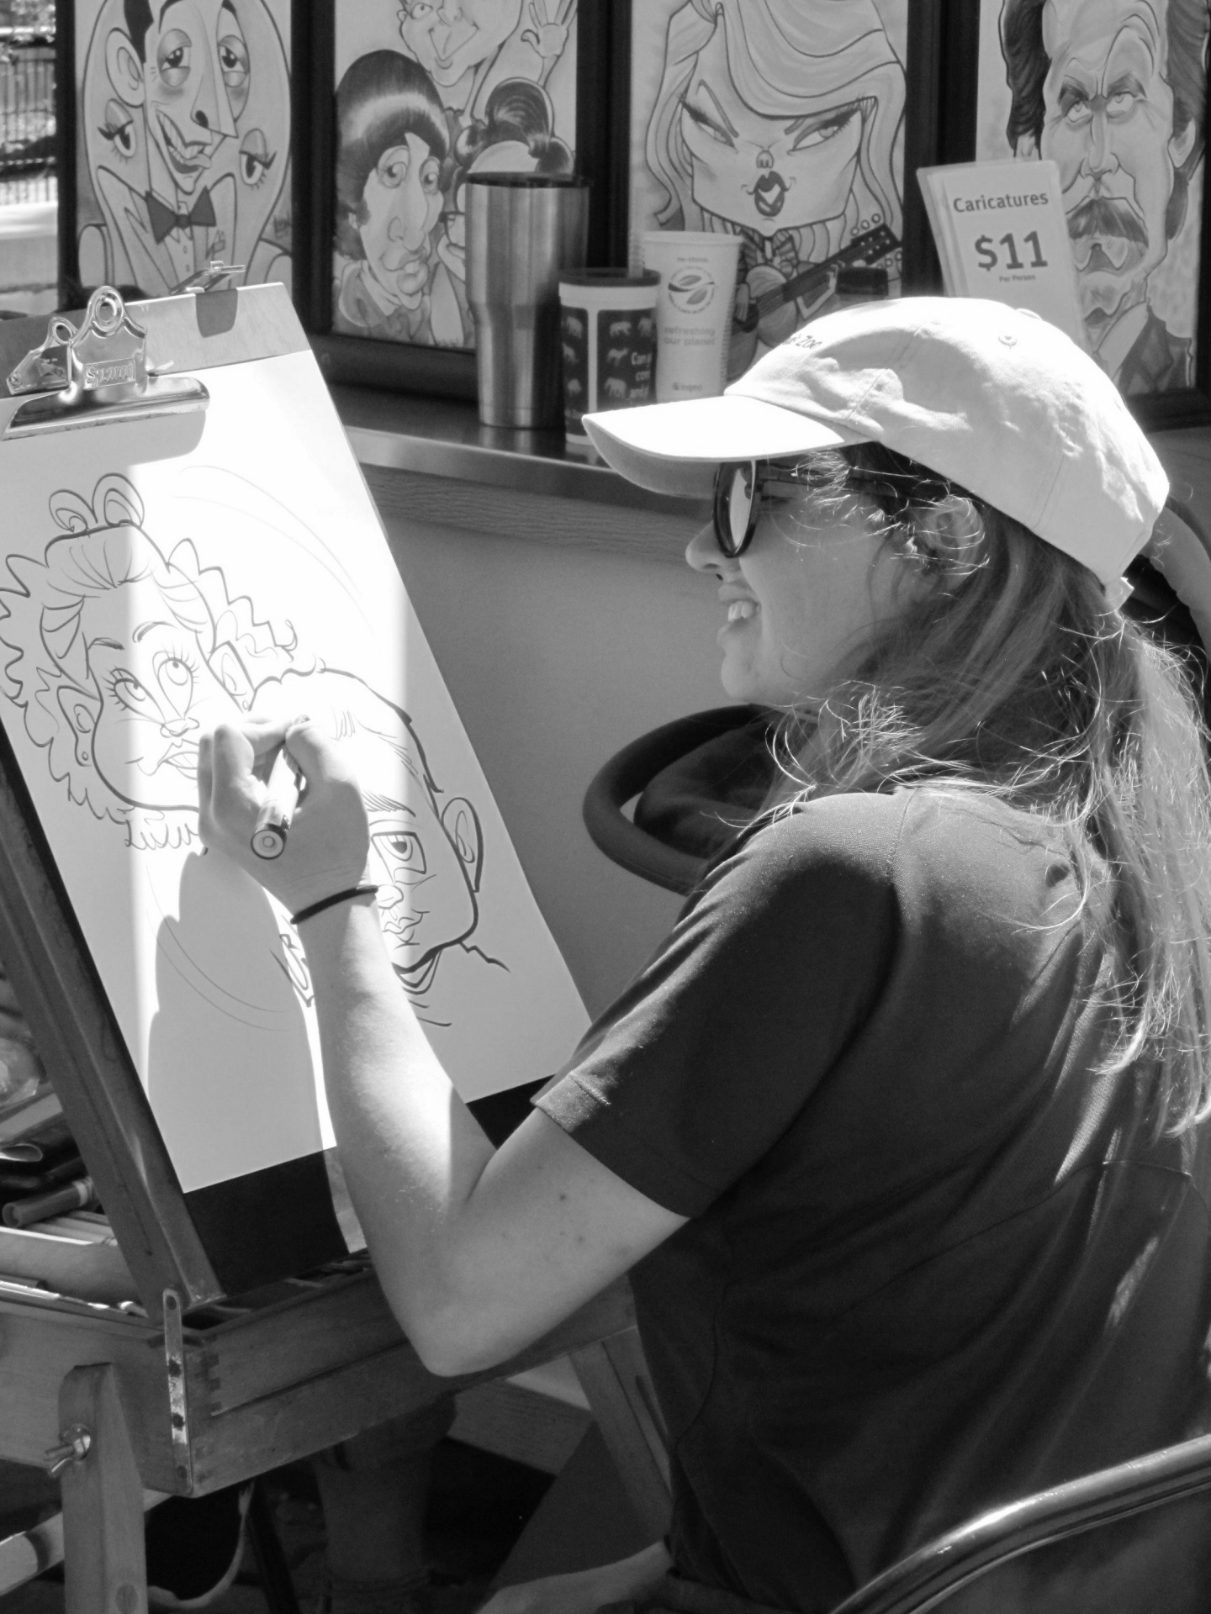
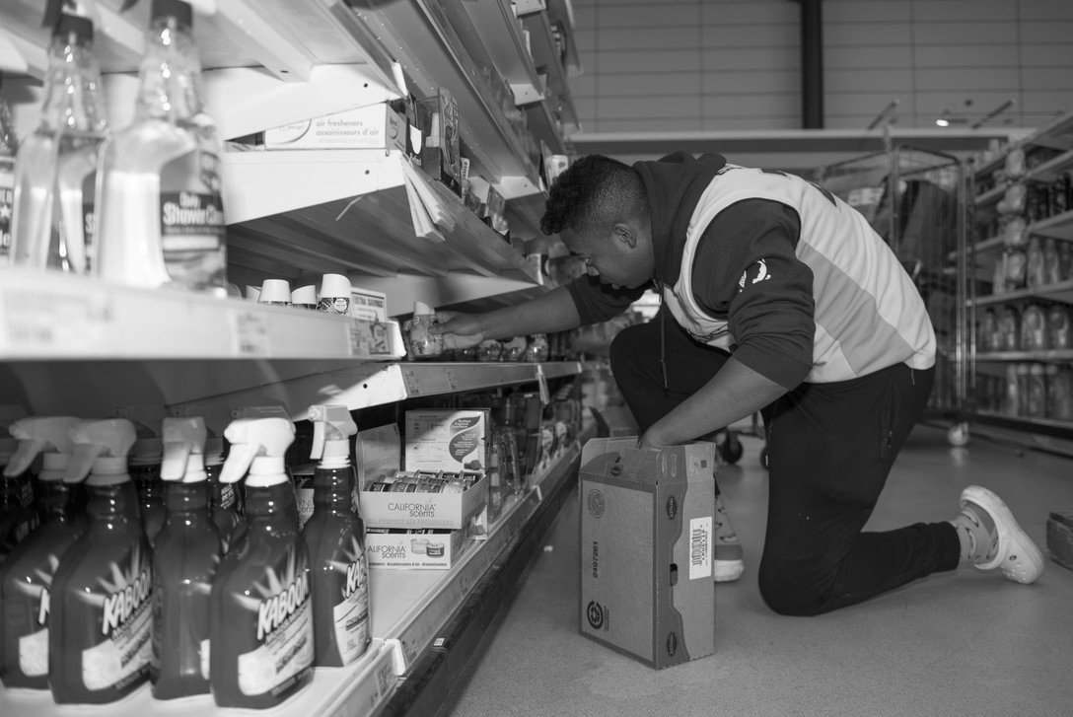
Help with interviews
Creating a talking picture sheet

Slide 14
Help with interviews
Creating a talking picture sheet
Using pictures, symbols or drawings is a simple way to remind us what it is we want to say. The pictures are grouped under three headings:
About me - personal interest
I’m good at - skills and qualities
My experience - things you have done in the past that will help you do the job you are applying for
Notes:
This can be quite overwhelming and when we feel worried sometimes we forget the answers to simple questions such as ‘where did you do work experience?’ or find it hard to say positive things about ourselves like what we are good at doing. The picture sheet is designed to support you when you have these conversations.

Slide 15
Talking about myself - Example 1
Notes:
Teaching point:Look at this example and the hand drawn one on the following slide. Discuss why the person being interviewed has selected the images they have. What do you think they are trying to say or remember?

Slide 16
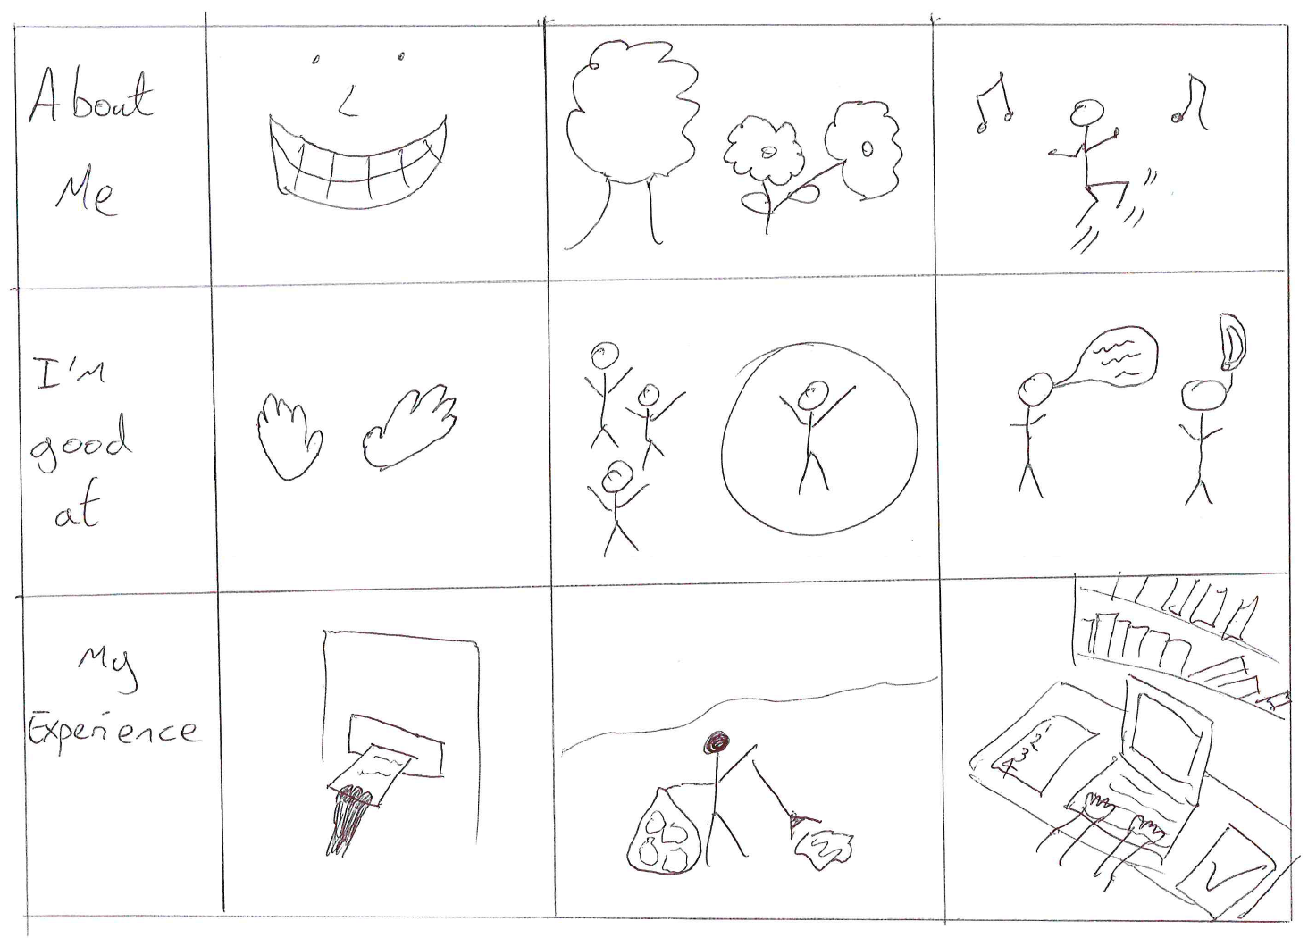
Talking about myself - Example 2
Image teachers own
Notes:
Teaching point: Look at this example and the photo example on the previous slide. Discuss why the person being interviewed has selected the images they have. What do you think they are trying to say or remember?

Slide 17
Talking about myself - have a go at making one for yourself
About me
I’m good at
My experience
Notes:
Either by downloading and directly filling out the table or by drawing or cutting out photos from magazines have a go at completing a talking picture grid with the student.
Teaching point: for each picture they select get them to practise the sentence or conversation that they will have around the image. The picture is designed as a prompt and the information they recall will need to be practiced. Refer back to the example slides for ideas.

Slide 18
Help with interviews
People often use different words to ask the same things.
Over the next three slides you will see some examples of this.
Have a go at answering these questions with your teaching partner.
Remember to use your talking picture sheet to support your answers.

Slide 19
Same question different words
Tell us a bit about yourself
What do you like doing in your own time?
Do you have any hobbies or interests?
Notes:
Teaching point: the way people talk in interviews can be confusing. For example tell us about yourself is an instruction but really it is a question. What does the person asking the question want to know?

Slide 20
Same question different words
Why do you believe you would be the right person for this job?
What are your strengths?
Please tell us some of your skills.
Notes:
Teaching Point: What does the person asking the question want to know. What is relevant and what is simply a personal interest.

Slide 21
Same question different words
What experience do you have?
Have you done any work experience?
What did you do on your work experience?
What did you learn when you did your work experience?
Notes:
What does the person asking the question want to know. What is relevant and what is simply a personal interest.

Slide 22
Independent Living
World of Work
Getting a job
Make it easier
Make it harder
More ideas
Do part 3 of the lesson: act out an interview question and answer using the talking picture grid for support.
Set up a mock interview with a member of your household.
Get them to ask questions as if you were interviewing for your dream job.
Research supported employment services in the area and make an appointment to meet with them.

Slide 23
Signposting
Independent Living:
World of Work: Vocational Profiling
External Websites:
Local Authority 16-25 years old offer (put into a search engine the name of your council and ‘local offer’ ‘16-25’)
Supported Employment - Look at the British Association for Supported Employment (BASE) for member organisations operating in your area
Notes:
The services, and employment options will be different depending on where you live. Take the time to research what is available in your local area.

Slide 24
References
Slide 11- Interview, Waseem Farooq, Pxhere / Group Job Interview, Wallpaper Flare
Slide 13- Beach, Pixels, Pixabay / Paddleboard, Pixabay / Green park, Pixabay / Artist, Public Domain Pictures / Clock, Pixabay / Accounting report, Pixabay / Volunteering, Pixabay / Construction, Pixabay / 200320-F-IM475-1445, Airman 1st Class Jennifer Zima, U.S. AIR FORCES IN EUROPE & AIR FORCES AFRICA
Slide 19- Women running, Pixabay / Chess game, Pixabay

