Slide 1
Compare past experiences [1/2]
Perfect tense regular -ER verbs (‘tu’ form)
Questions with intonation and qu’est-ce que
French
Madame Johnson

Slide 2
[ ai ]
vrai

Slide 3
[ ai ]
maison
mauvais
[bad]
faire
[to do]

Slide 4
l’été | summer
le printemps | spring
l’automne | autumn
l’hiver | winter
la saison | season
le musée | museum
belge | Belgian
Belgique | Belgium
Bruxelles | Brussels

Slide 5
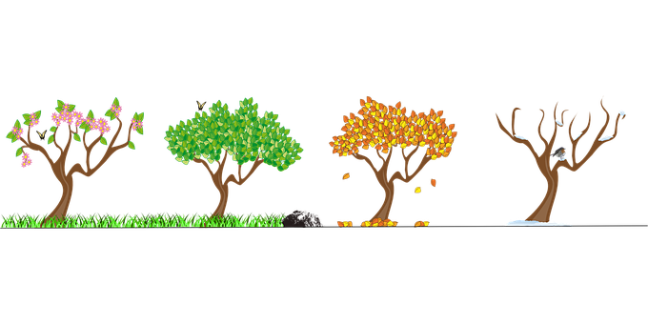
Les saisons
En été
En hiver
En automne
Au printemps
In summer
In winter
In autumn
In spring

Slide 6
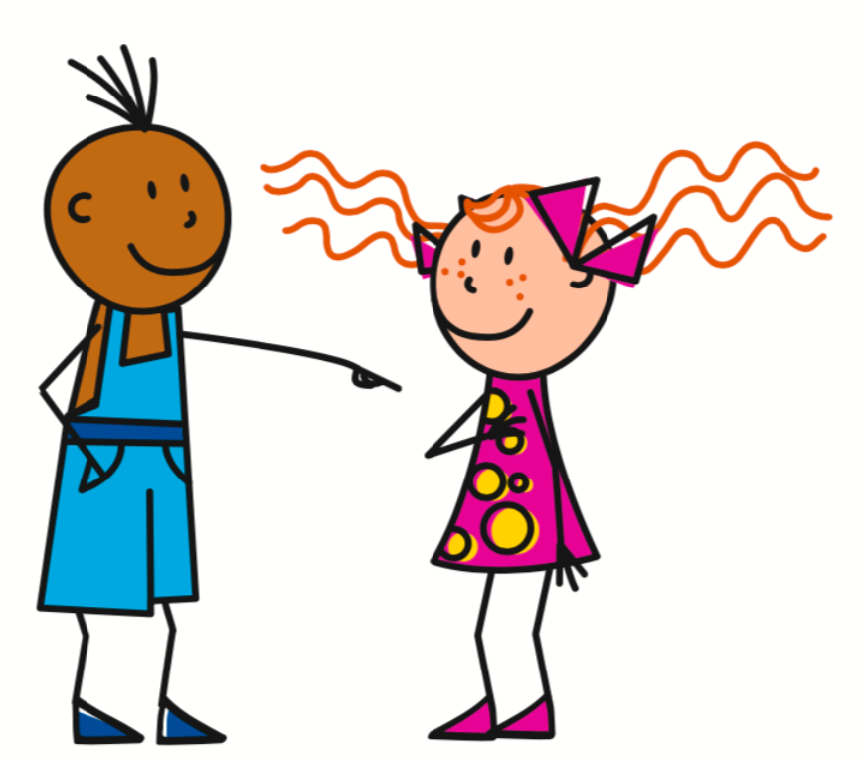
The perfect tense - a completed action in the past
I visited / I have visited
You visited / you have visited
J’
ai
visité
Tu
as
visité
I bought / I have bought
You bought / you have bought
J’
ai
acheté
Tu
as
acheté

Slide 7
The Perfect Tense - The Auxiliary
1. | I visited = | J’___ visité
2. | You ate = | Tu ___ mangé
3. | I bought = | J’___ acheté
4. | You played = | Tu ___ joué
5. | I watched = | J’___ regardé
ai
as
ai
as
ai

Slide 8
The perfect tense - je and tu forms
1. The Subject Pronoun
2. The Auxiliary Verb
(Avoir - Present Tense)
3. Past Participle
Je | ai | e.g.
 |  | regardER - regardÉ
 |  | payER - payÉ
Tu | as
= I
= you

Slide 9
The perfect tense - Irregular verb ‘faire’
I did / I made
You did / you made
J’
ai
fait
Tu
as
fait

Slide 10
Changing your intonation to ask questions
Statement
Tu as payé.
You paid.
Question (intonation)
Tu as payé?
You paid?

Slide 11
For more on present tense questions with qu’est-ce que, please see lesson ‘Say what people do in general’
Asking Questions
(Qu’est-ce que)
Qu’est-ce que tu regardes?
What are you watching?
Que
est-ce que
pronoun
verb
= qu’est-ce que

Slide 12
Asking Questions in the past (perfect) tense
(Qu’est-ce que)
Qu’est-ce que tu as regardé?
What did you watch?
Que
est-ce que
pronoun
auxiliary
Past participle
= qu’est-ce que

Slide 13
Que
est-ce que
pronoun
auxiliary
past participle
Qu’
est-ce que
tu
as
fait?
What did you do?
Qu’
est-ce qu’
tu
as
mangé?
What did you eat?

Slide 14
Compare past experiences [1/2]
I visited =
You visited =
What did you visit? =
What did you do? =
In summer I played tennis =
What did you do in winter? =
J’ai visité
Tu as visité
Qu’est-ce que tu as visité?
Qu’est-ce que tu as fait?
En été j’ai joué au tennis.
Qu’est-ce que tu as fait en hiver?

