Slide 1
Lesson 1 : Invasion Games
Basketball
Physical Development - Building Understanding
Alistair

Slide 2
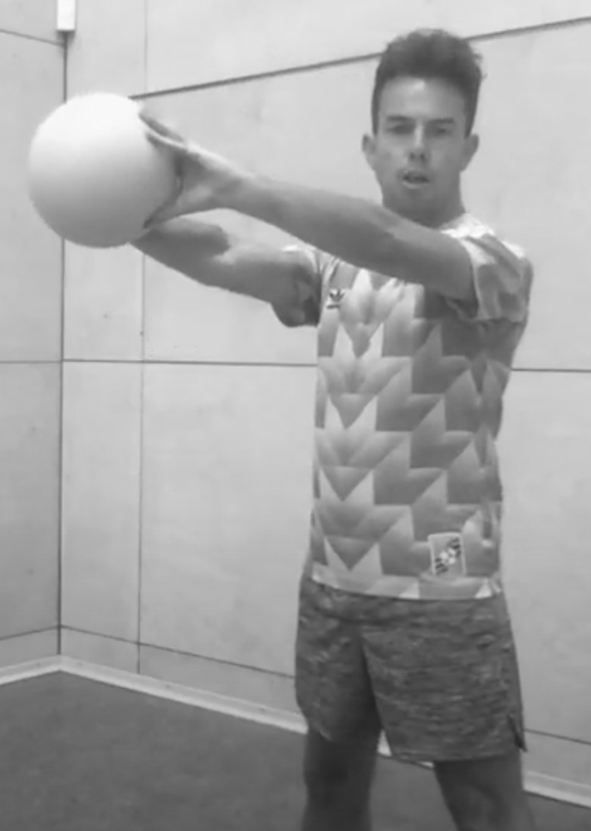
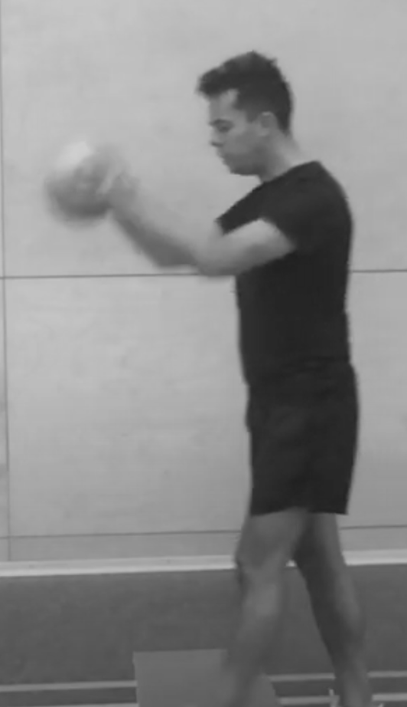
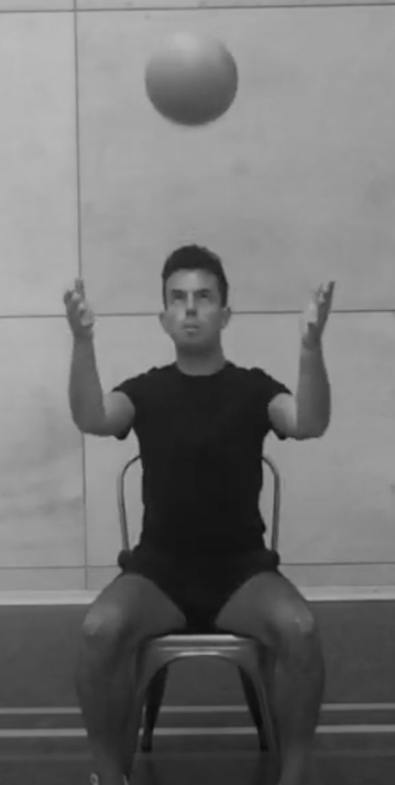
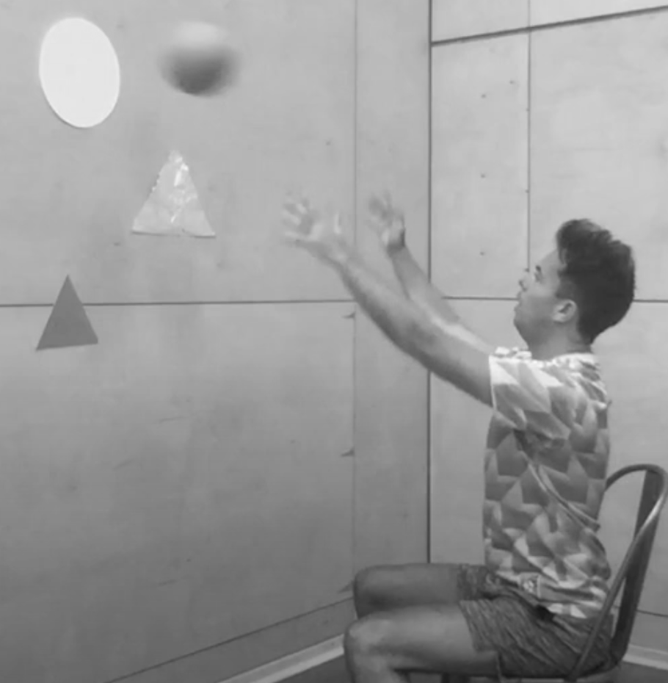
Activity Card
Invasion Games: Basketball
Explore different ways to pass a basketball to your teammate.
Try to pass the ball in different ways e.g. a chest pass.
Practise your basketball dribbling skills, bouncing the ball as you move.
Refine your skills, thinking about the direction and power of your passes.
Begin to move confidently in different directions.
Aim for a target (the basket) with increasing accuracy.
Aim for a range of targets and try to score a basket.
Practise your catching skills, keeping your hands up and your eyes on the ball.

