Slide 1
Counting in twos, fives and tens
Mathematics
Mrs Bramble and Miss Sidhu

Slide 2
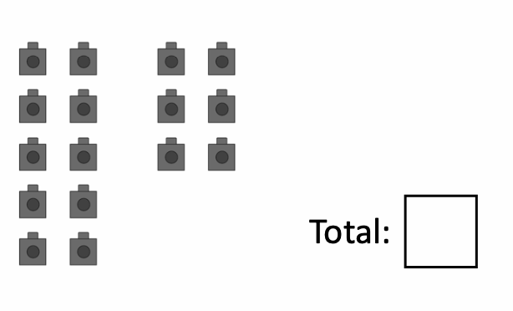
Independent Task
Count the cubes in either twos, fives and tens, then write the total in the box.

Slide 3
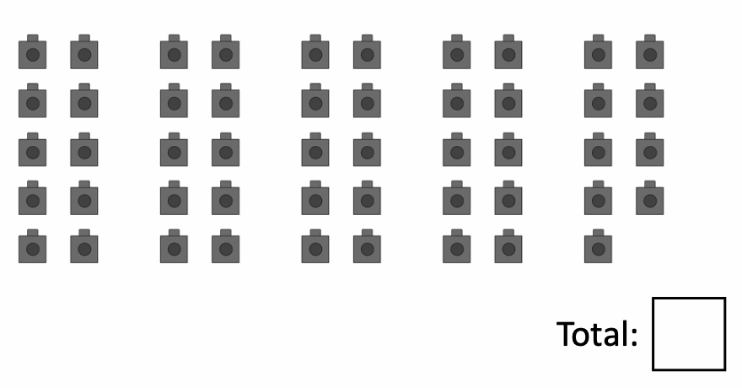
Independent Task
Count the cubes in either twos, fives and tens, then write the total in the box.

Slide 4
Support

Slide 5
Answers
16

Slide 6
Answers
49

