Slide 1
Identify rational and irrational numbers
Maths
Miss Parnham

Slide 2
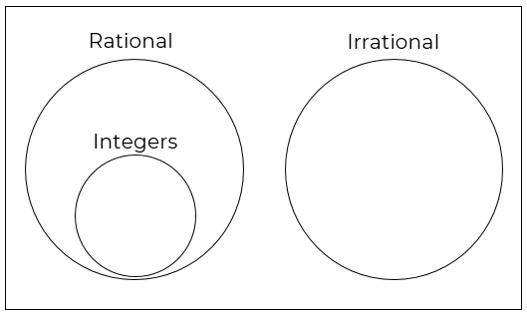
Identify rational and irrational numbers
Integers | Non-integers

Slide 3
Identify rational and irrational numbers

Slide 4
Answers
Answers

Slide 5
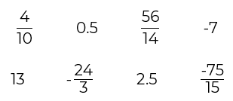
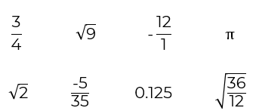
Identify rational and irrational numbers
1. Sort the values into integers and non-integers.
.
2. Sort the numbers into the Venn diagram.
Integers | Non-integers

Slide 6
Identify rational and irrational numbers
4. Give an example of a number between 5 and 6 which is
Rational
Irrational
Show working to justify your answers.
5. Which equation has a rational solution?
.

