Slide 1
Grouping and sharing
Practising counting in equal groups and adding them together
Mathematics Independent Task
Mrs Khaira

Slide 2
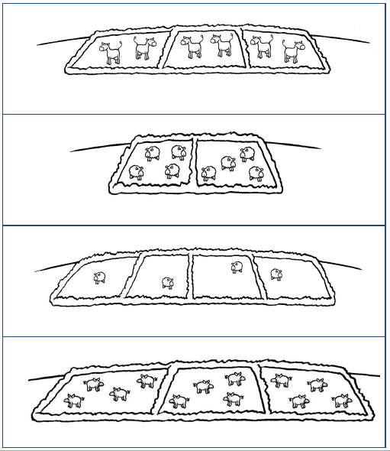
Activity 1

Slide 3
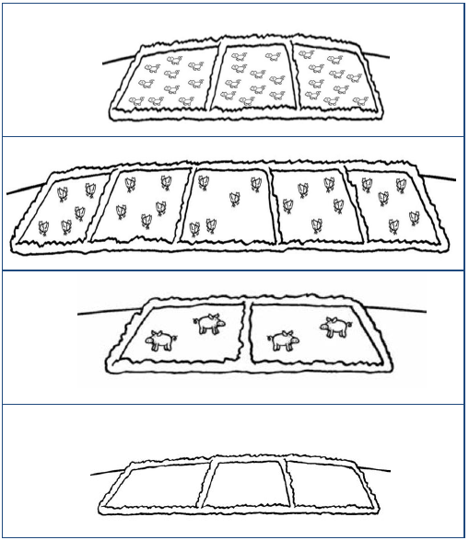
Activity 2

