Slide 1
Lesson 2 : Movement and Balance
Physical Development - Building Understanding
Stevie
Resources provided by St Martins School Derby (CC BY-NC-SA).

Slide 2
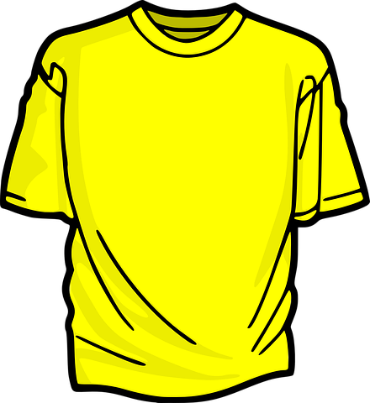
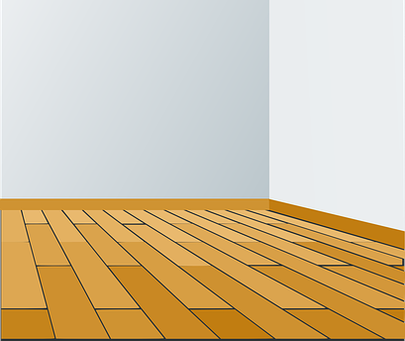
For this lesson you will need
Comfortable clothes
A clear floor space

Slide 3
Let’s get ready
Find a quiet, clear space to work away from distractions.
Ensure the area is safe and that your child is feeling fit and well to take part in the lesson.
Check you are wearing the right clothes for sport & physical activity.
Use a familiar reference to prepare the learner that the activity is going to start. This could be a symbol, sound or song.

Slide 4
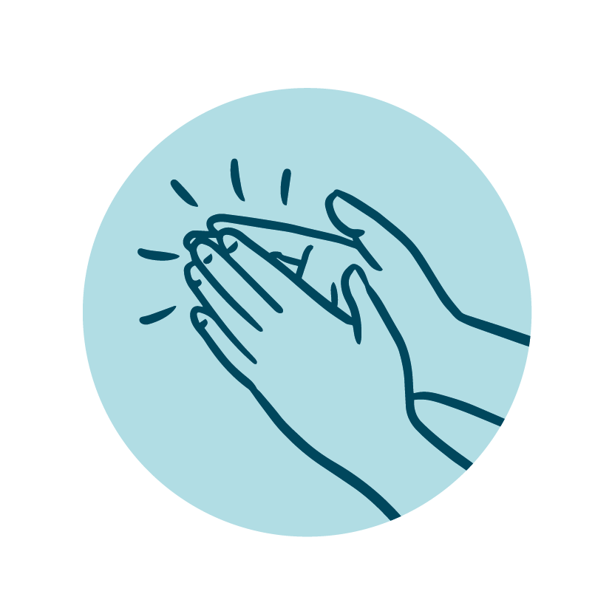
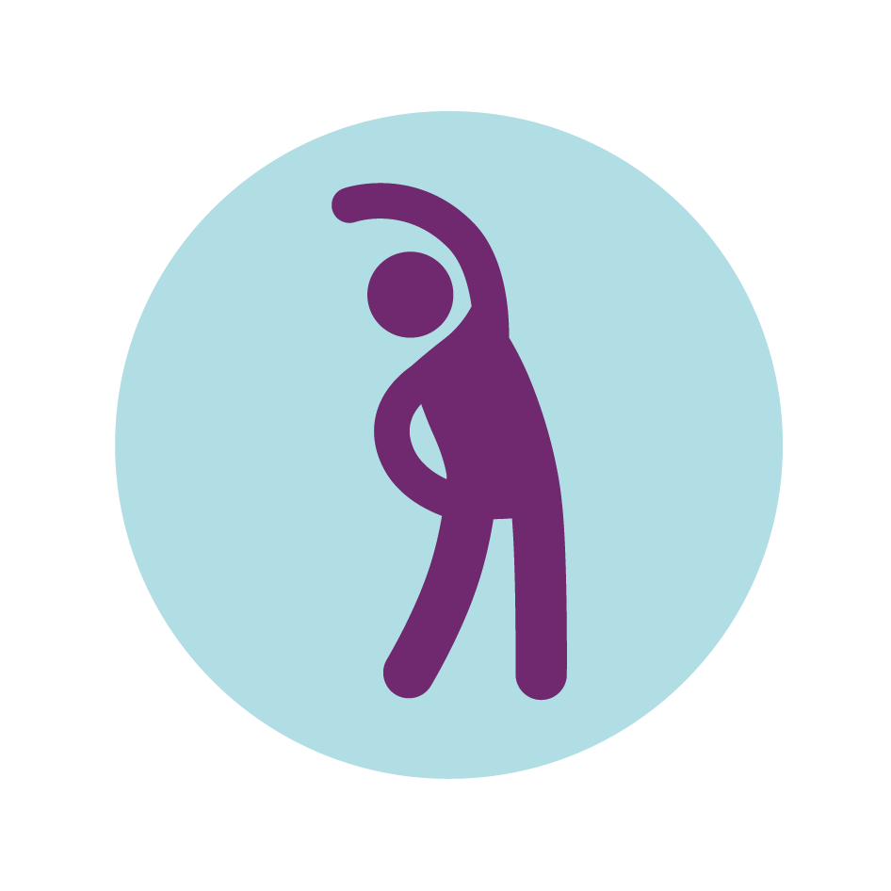
Warm up...
Shake
Clap
Stretch
Clap your hands, stretch your arms up and shake all over to get your muscles ready (warm up can last between 2 & 5 minutes).

Slide 5
Balances...
Stand still
Lift one leg
Rotate your foot
Stand still, look straight ahead. Lift one leg and try not to wobble. Carefully rotate your foot. Bring your foot down and stand still. Repeat on the other side.

Slide 6
Sequence of movements...
Stand still
Rock side-to-side
Life one leg
Hop
Practise balancing on two legs by rocking from side to side. Then balance on one leg and see if you can add a hop.

Slide 7
Make it easier
Make it harder
More ideas
*Take breaks to shake the arms and legs before moving on.
*Personalise the warm up / movements to best meet the needs of your child (fewer exercises / shorter duration).
*Look at our masterclass and explore ‘top tips’ from elite athletes.
*Encourage slowing down and speeding up the movements.
*Ask your parent or carer to help you search for and watch a range of fitness classes - which one do you like best?
*Look for opportunities to stretch and move the body in fun and different ways.

Slide 8
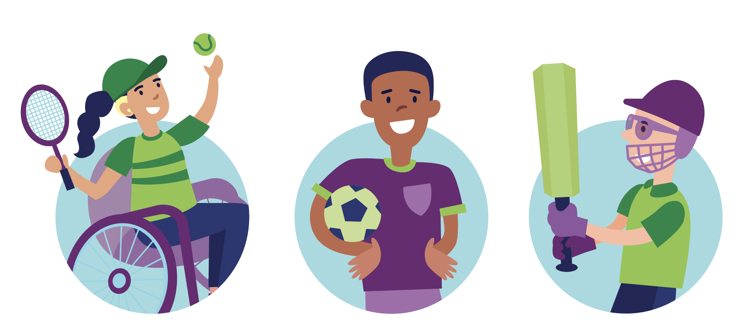
*STEP Principle*
All of our activities can be adapted using the step principle
(Space, Task, Equipment, People)
e.g. Balloon with beads in to support visually impaired learners / Bigger, brighter resources / Adapt space & activities to suit wheelchair users e.g. support learners to sit up as straight as possible and rock from one buttock to the other whilst staying upright, lift one foot at time from the footplate and balance.
Illustrations by Oak National Academy

Slide 9
Share your work with Oak National
If you'd like to, please ask your parent or carer to share your work on Instagram, Facebook or Twitter tagging @OakNational and #LearnwithOak

