Slide 1
Networking hardware Lesson 2 of 6
Computing
Allen Heard

Slide 2
Task 1 part 1: Build a network - scenario 1
Connect each computer to each other computer using lines for cables.
Credit: Free stock photos

Slide 3
Task 1 part 2: Build a network - scenario 1
Connect each computer to each other computer using lines for cables.
How many cables do you need for this configuration?
Credit: Free stock photos

Slide 4
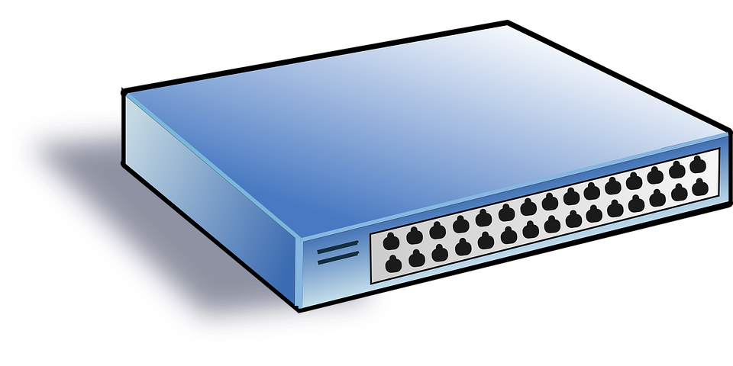
Task 2: Build a network - scenario 2
As before, connect the computers together, but this time with the addition of a hub.
?
Credit: Computer: Free stock photos
Hub: Pixabay

Slide 5
Task 3: Build a network - scenario 3
Add a file server to your network diagram.
A
?
C
B
Hub
D
Credit: Computer: Free stock photos
Hub: Pixabay
Server: Needpix

Slide 6
Task 4: Creating a network - fill in the blanks
(each word is only used once)
To connect together different devices, you need cables. The cables carry the messages sent between machines communicating with one another. The most common type are called ‘Ethernet cables’. The cable is made up of a number of copper wires and has the ability to send data in ____ directions.
cables
server
files
video
hub
both

Slide 7
Task 4: Creating a network - fill in the blanks
(each word is only used once)
A ____ connects a number of computers together within the same room or building. This means that each computer does not need to have its own dedicated connection to every other computer in a network, which reduces the number of ____ needed.
cables
server
files
video
hub
both

Slide 8
Task 4: Creating a network - fill in the blanks
(each word is only used once)
A ____ is often described as a powerful computer that provides services. One example of a service that it can provide is shared access to ____ such as text, images, sound, or ____.
cables
server
files
video
hub
both

Slide 9
Task 5: Build a network - scenario 4
Add a router and an Internet Service Provider
(an ISP is normally represented by a cloud)
ISP connection to the internet
Hub
?
?
Credit: Computer: Free stock photos
Hub: Pixabay
Server and router: Needpix

