Slide 1
Tessellating quadrilaterals
Independent Task
Mathematics
Miss Oreyomi
Miss Oreyomi

Slide 2
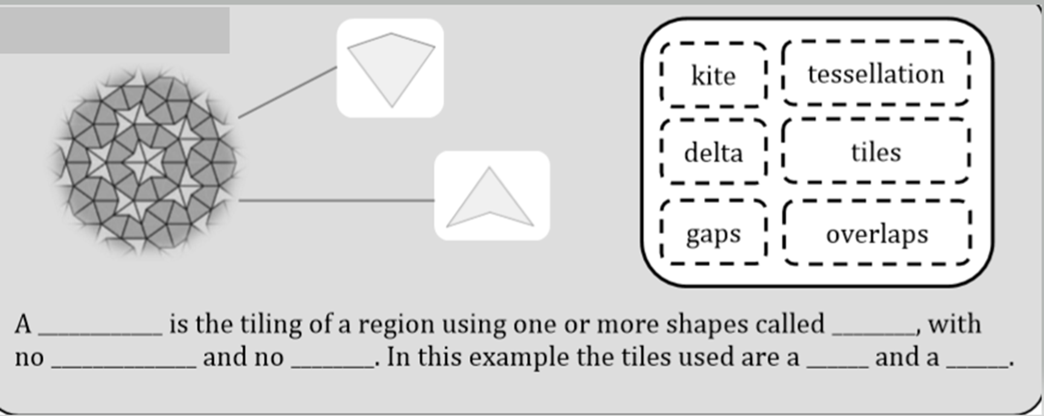
Questions

Slide 3
Questions

Slide 4
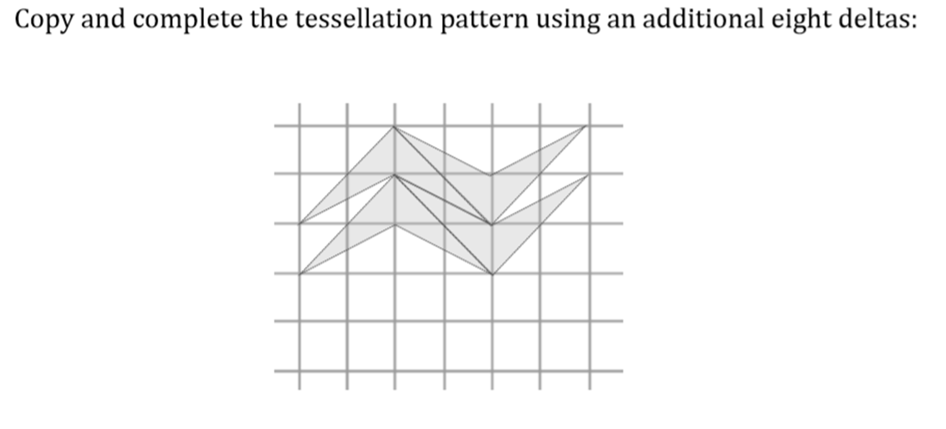
Questions

Slide 5
Questions

