Slide 1
Jesus’ Life
Lesson 4 of 14
Religious Education
Miss Kendrick

Slide 2
Task:
Look at the table which starts on slide 4. There is a different teaching on each slide.
Using the example in slide 3 to help you, read each Bible verse and answer each question to explain what it means. There are some hints to help you.
You could draw the table in your book or on a piece of paper, or you could lay it out like the example on the next slide.

Slide 3
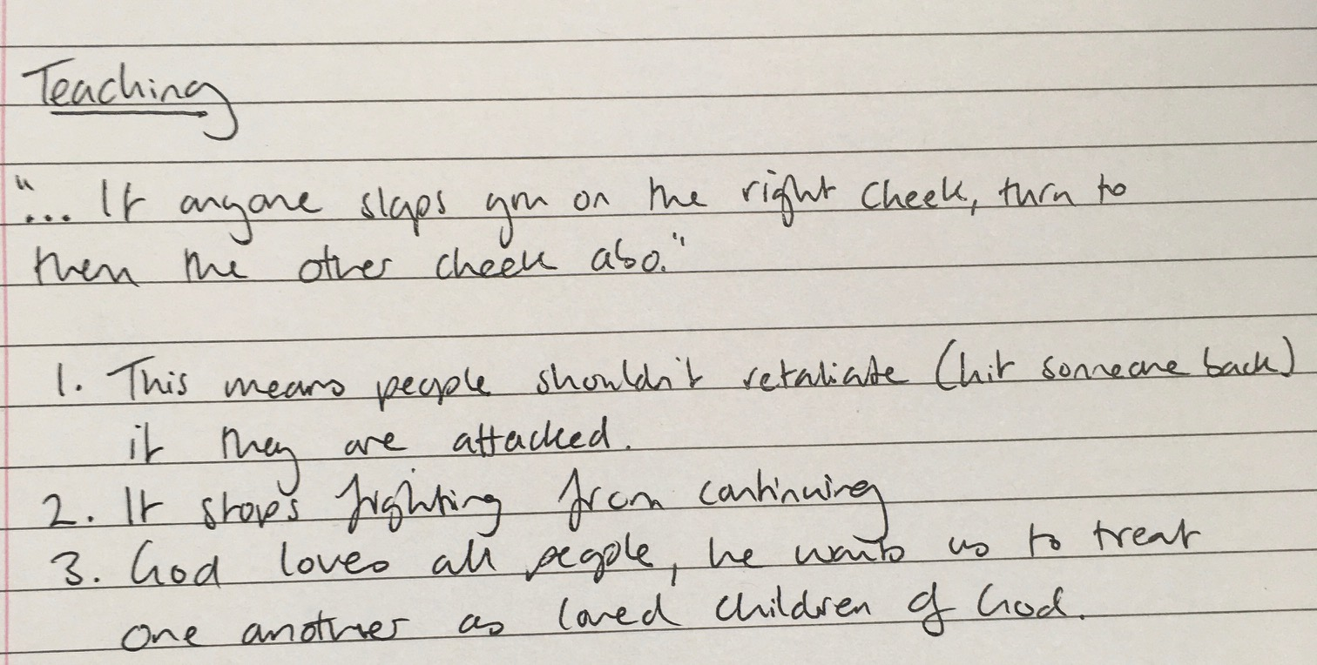
Example layout:

Slide 4
Jesus’ teachings
Teaching | 1) What this means | 2) How does it help people get on with each other? | 3) Why would this please God? | 4) Is this easy to follow?
E.g But now I tell you: do not take revenge on someone who wrongs you. If anyone slaps you on the right cheek, let him slap your left cheek too. Matt 5:39 GNB | E.g This means people shouldn’t retaliate (hit someone back) if they are attacked. | E.g It stops fights from continuing. | E.g God loves all people, he wants us to treat one another as loved children of God. | E.g This can be difficult as we might feel justified in hitting someone back or feel very angry.

Slide 5
Teaching | 1) What this means | 2) How does it help people get on with each other? | 3) Why would this please God? | 4) Is this easy to follow?
‘You have heard that it was said, ‘Love your friends, hate your enemies.’ But now I tell you: love your enemies and pray for those who persecute you’ Matt 5:43-44 GNB |  | Think about how this might stop people from being enemies.

Slide 6
Teaching | 1) What this means | 2) How does it help people get on with each other? | 3) Why would this please God? | 4) Is this easy to follow?
‘…when you help a needy person, do it in such a way that even your closest friend will not know about it… And your Father, who sees what you do in private, will reward you.’ Matt 6:3-4 GNB |  | Why might it be better to give to charity privately?

Slide 7
Teaching | 1) What this means | 2) How does it help people get on with each other? | 3) Why would this please God? | 4) Is this easy to follow?
‘If you forgive others the wrongs they have done to you, your Father in heaven will also forgive you.’ Matt 6:14 GNB |  |  | Why might God be happy if we forgive others like he forgives us?

Slide 8
Teaching | 1) What this means | 2) How does it help people get on with each other? | 3) Why would this please God? | 4) Is this easy to follow?
‘…do not start worrying: ‘Where will my food come from? or my drink? or my clothes?’ Your Father in heaven knows that you need all these things.’ Matt 6:31-32 GNB |  | What sort of things might people do which affects others if they’re worried about getting what they need?

Slide 9
References
‘Scriptures and additional materials quoted are from the Good News Bible © 1994 published by the Bible Societies/HarperCollins Publishers Ltd UK, Good News Bible© American Bible Society 1966, 1971, 1976, 1992. Used with permission.’

