Slide 1
To recognise and create repeating patterns
Mathematics
Miss Charlton

Slide 2
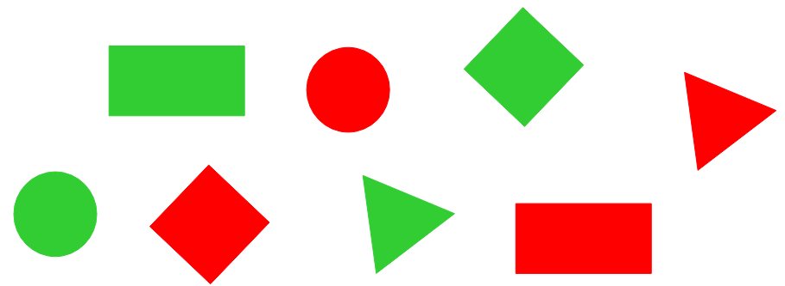
Independent task
‹#›

