Slide 1
Internal angles in a quadrilateral
Independent Task
Mathematics
Miss Oreyomi
Miss Oreyomi

Slide 2
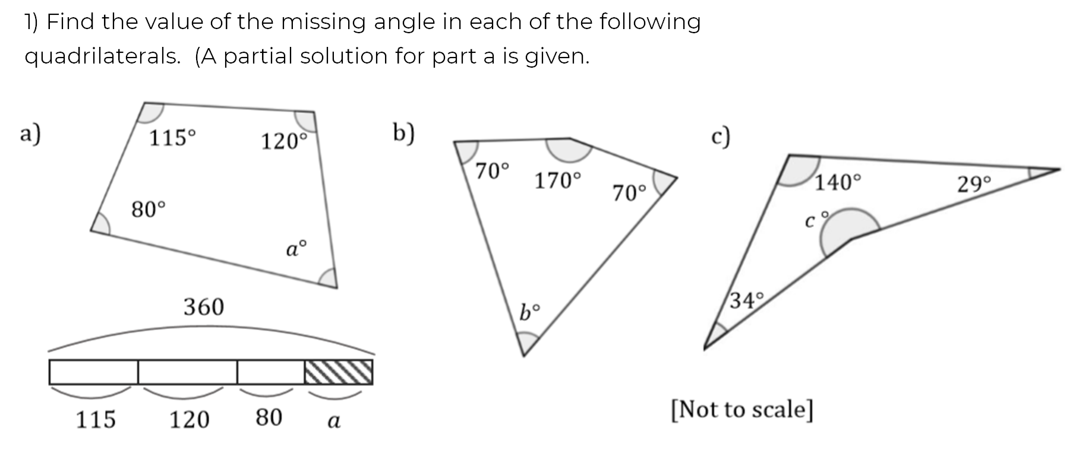
Questions

Slide 3
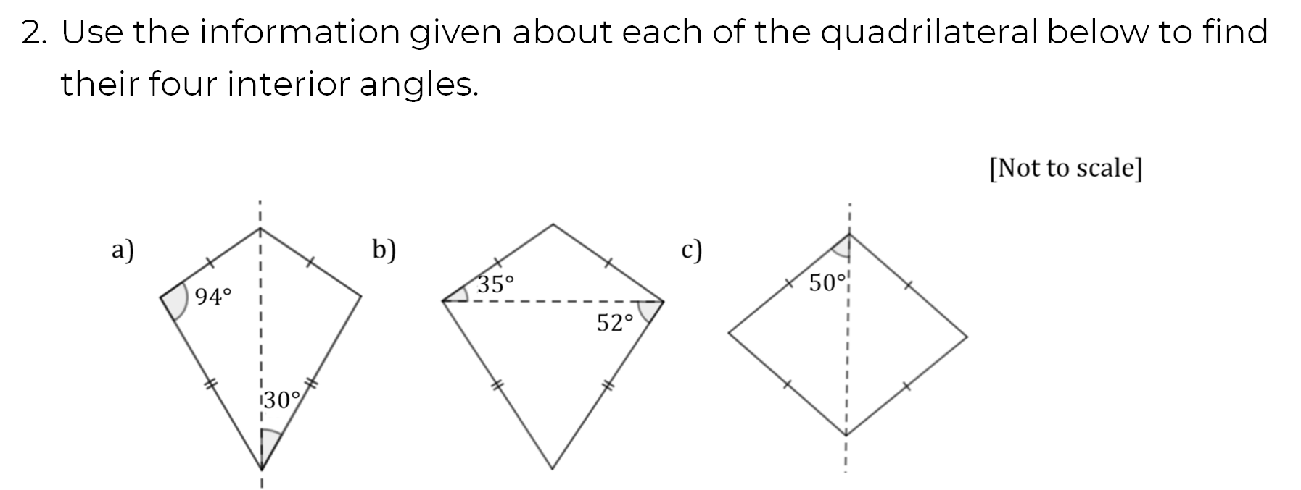
Questions

Slide 4
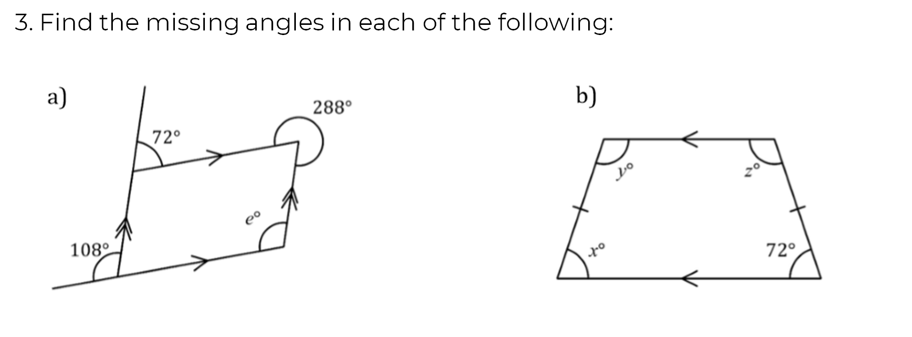
Questions

