Slide 1
How can young people be involved in local decision making?
Lesson 6 of 6
Downloadable Resource
Citizenship
Mr Miskell

Slide 2
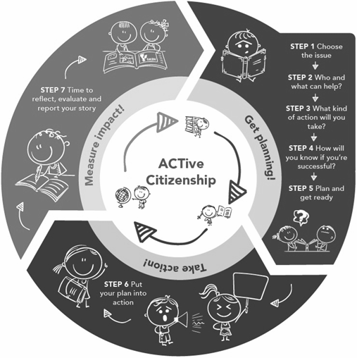
ACTive Citizenship
Learning Cycle
A cycle of 7 steps to plan, do and reflect on citizenship action
•Get planning!
•Take action!
•Measure impact!

Slide 3
Task 2: Prioritising issues/problems in Zac’s neighbourhood
- Most important
1
2
3
A diamond nine can be a very useful tool to help prioritise issues and make decisions.
Help Zac decide which are the most important issues in his neighbourhood to focus on, by creating your own diamond 9.
You should:
1. Use the issues you identified in Task 1.
2. Draw a diamond 9 and place the most important issues at the top and the least important at the bottom.
4
5
6
7
8
9
Least important -
Notes:
TOO MESSY! Look at Daryl’s diamond 9 or split over 2 slides.

Slide 4
Task 3: petition the pros and cons
Write down one pro (positive) about Zac using petitions to help to create change and one con (negative). You may wish to consider:
1. How effective petitions may be in persuading decision makers.
2. Whether it will potentially encourage others to support Zac.
Pro | Con
Notes:
Find Bryden or Kirsty’s take away task

Slide 5
Task 5: Self-assessment feedback
Does your petition include...
A catchy headline?
Text that explains the issue and says why it should be changed?
A call to action, including the phrase ‘we the undersigned’?
A space for people to sign and show their support?
petition by Fission Strategy, US from the Noun Project tick by mikicon from the Noun aProject
Cross by Asmuh from the Noun Project

