Slide 1
Ordering three or more fractions
Maths
Mr Chan

Slide 2
Ordering three or more fractions
Here are some statements.
a) Which statement is incorrect?
b) What correction should be made?

Slide 3
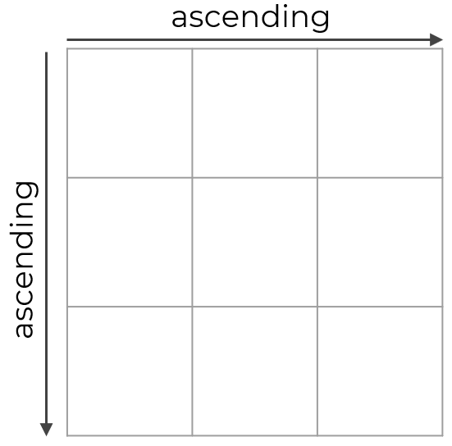
Ordering three or more fractions
4. Put all the fraction cards into the grid so that every row and column are in ascending order.

Slide 4
Answers

Slide 5
Ordering three or more fractions
Here are some statements.
a) Which statement is incorrect?
b) What correction should be made?
a) b)

Slide 6
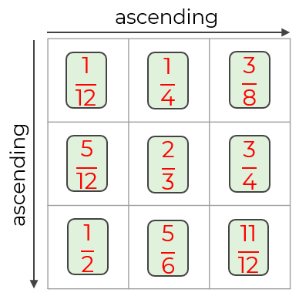
Ordering three or more fractions
4. Put all the fraction cards into the grid so that every row and column are in ascending order.

