Slide 1
Measures:
Comparing the volume of liquid in different containers
Mathematics Lesson 2 of 10
Miss. Molnar

Slide 2
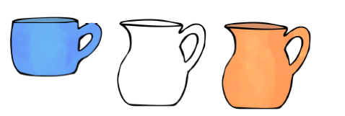
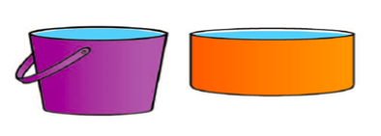
Explore pouring the same amount of water in different containers. Explore pouring different amounts of water in similar containers. What do you notice?

