Slide 1
Measuring the speed of waves in solids
Worksheet
Combined Science - Physics - Key Stage 4 - Waves
Miss Walrond

Slide 2
Q1.
Describe an experiment that could be performed to measure the speed of a wave on a string using a vibration generator.
You should include:
The variables you will measure
How you will measure these variables
How you will improve accuracy
How you will improve reliability
An equation [5]

Slide 3
Answers

Slide 4
Q1.
Check your answers for the following points:
Change the frequency and record the frequency from the vibration generator.
Measure the length of 3 or more waves using a ruler to increase accuracy.
Divide the length of the waves, by the number of waves to obtain the average wavelength.
Repeat the length measurement to improve reliability.
Calculate the wavelength using wave speed = frequency × wavelength.

Slide 5
In lesson questions

Slide 6
Independent Task: Measuring the speed of waves on a string.
Write down the purpose of the vibration generator.
Copy and complete the table below
Method | Reason
Measure the length of multiple waves using a ruler.
Divide the length by the number of waves.

Slide 7
Independent Task - Copy and complete the table of data
Frequency ( Hz) | Length of 3 waves (cm) |  |  |  | Wavelength (cm) | Wave speed (cm/s)
 | 1 | 2 | 3 | average
1.50 | 7.5 | 7.4 | 7.5 | 7.5 | 2.5 | 3.8
1.80 | 6.2 | 6.2 | 6.3
2.10 | 5.4 | 5.5 | 5.3
2.40 | 4.6 | 5.6 | 4.6
2.70 | 4.2 | 4.1 | 4.1
Notes:
Pause the video and take a look through the table of data.
What is the purpose of the repeated readings for the length of 3 waves?
That’s right it is to improve reliability.
Can you see any anomalies?
Let’s take a look at how we would calculate the wave speed for this data.
Live model the first row.

Slide 8
The speed of waves on a string
Complete the sentences:
As the frequency increases the wavelength …..
This is because the wave speed is ....

Slide 9
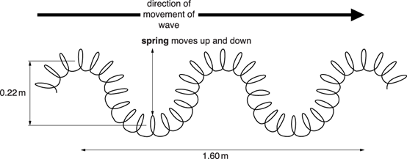
Worked Example - Examination question
P waves and S waves are different.
P waves are longitudinal and S waves are transverse. Look at the diagram of a model of a wave made with a slinky spring.
The wave is made by moving the spring up and down with a frequency of 1.2 Hz.
Look at the diagram.
i. Calculate the speed of the wave.
Answer ……………………………………….. m/s [2]
Answers as discussed in the next slide have not been seen or verified by OCR.
OCR, Gateway Physics A, Paper B751/02, June 2015
Notes:
0.96 m/s
0.80 * 1.2

Slide 10
Worked Example - Examination question
P waves and S waves are different.
P waves are longitudinal and S waves are transverse. Look at the diagram of a model of a wave made with a slinky spring.
The wave is made by moving the spring up and down with a frequency of 1.2 Hz.
ii. What is the amplitude of the wave?
Choose from
0.11 m 0.22 m 0.80 m 1.60 m 1.82 m [1]
Answers as discussed in the next slide have not been seen or verified by OCR.
OCR, Gateway Physics A, Paper B751/02, June 2015
Notes:
0.11 m

Slide 11
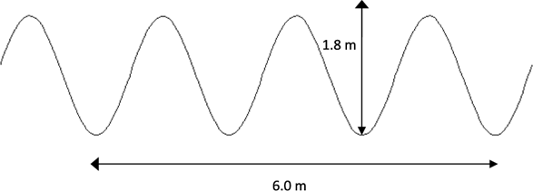
Independent Task - Examination question
In the classroom a teacher demonstrates waves using a rope.
Look at the diagram of the wave. i. The frequency of the wave is 2 Hz.
What does this statement mean? [2]
ii. How many seconds will it take this wave to travel 12 m?
Show your working. [3]
Answers as discussed in the next slide have not been seen or verified by OCR.
OCR, Gateway Physics A, Paper J249/04, Specimen

Slide 12
Answers

Slide 13
Independent Task: Measuring the speed of waves on a string.
Write down the purpose of the vibration generator. The vibration generator produces the transverse waves on the string.
Copy and complete the table below
Method | Reason
Measure the length of multiple waves using a ruler. | This improves the accuracy our length measurement
Divide the length by the number of waves. | This allows us to calculate the mean wavelength.

Slide 14
Review - Independent Task - Copy and complete the table of data
Frequency ( Hz) | Length of 3 waves (cm) |  |  |  | Wavelength (cm) | Wave speed (cm/s)
 | 1 | 2 | 3 | average
1.50 | 7.5 | 7.4 | 7.5 | 7.5 | 2.5 | 3.8
1.80 | 6.2 | 6.2 | 6.3 | 6.2 | 2.1 | 3.8
2.10 | 5.4 | 5.5 | 5.3 | 5.5 | 1.8 | 3.8
2.40 | 4.6 | 5.6 | 4.6 | 4.6 | 1.5 | 3.6
2.70 | 4.2 | 4.1 | 4.1 | 4.1 | 1.4 | 3.8
Notes:
What do we notice about the wave speed. Generally the same value. We have 1 anomalous result frequency of 2.4 Hz.
Look at the relationship between frequency and wavelength. As the frequency increases the wavelength decreases.

Slide 15
Review - The speed of waves on a string
As the frequency increases the wavelength decreases.
This is because the wave speed is constant.

Slide 16
Review: Independent Task - Examination question
In the classroom a teacher demonstrates waves using a rope.
Look at the diagram of the wave. i. The frequency of the wave is 2 Hz.
What does this statement mean? [2] Two waves pass the same point [1] each second [1]
ii. How many seconds will it take this wave to travel 12 m?
Show your working. [3]
Use of velocity = frequency × wavelength V = 2 × 2 = 4 m/s Then, 12 / 4 = 3 seconds
Answers as discussed in the next slide have not been seen or verified by OCR.
OCR, Gateway Physics A, Paper J249/04, Specimen
Notes:
Talk students through the second question.

